Slide 1
University of Salahaddin – Hawler
College of Engineering
Civil Engineering Department
HYDRAULIC STRUCTURES
Lecturer: Othman K. Mohammed

Slide 2
Set by: Othman K. Mohammed
CHAPTER ONE
CANAL DESIGN AND LINING
Introduction
A hydraulic structure is a structure submerged or partially submerged in any body of water, which disrupts the natural flow of water.
Types of Hydraulic Structures
According to the purpose of its function
Storage Structures: to store water such as Dams & Tanks.
Conveyance Structures: to convey water from place to another such as pipelines, Siphons, Culverts, Tunnels, aqueducts and open channels.

Slide 3
Flow Diversion Structures: to regulate and divert the quantities of flow to another structures or canals such as barrages and regulators.
Flow measurement structures: to measure the flow passing through it such as Weirs, Orifices, nozzles, Venturi and Parshall flume.
Energy dissipation structures: to protect the floor of hydraulic structure from erosion and damage due to severe waves which impact with the body of structure such as Stilling basins, Surge tanks, Check dams and vertical drop.
Sediment and Chemical Control Structures: to control or remove sediments and other pollutants such as Sedimentation tanks, Screens, Traps, Filters & mixing basins.
2

Slide 4
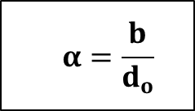
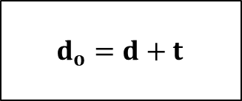
3. Khosla’s theory of seepage flow
In this method. a composite weir or barrage section is split up into a number of simple standard forms where analytical solutions are known
Exit gradient (GE)
Gradient at the exit end is called exit gradient (GE) which is determined from the equation below:
$$G_{E}=\frac{ΔH}{d_{o}}×\frac{1}{π\sqrt{λ}}$$
$$λ=\frac{1+\sqrt{1+α^{2}}}{2}$$
ΔH
$$α=\frac{b}{d_{o}}$$
$$d_{o}=d+t$$
$$d_{o}$$
b
10

Slide 5
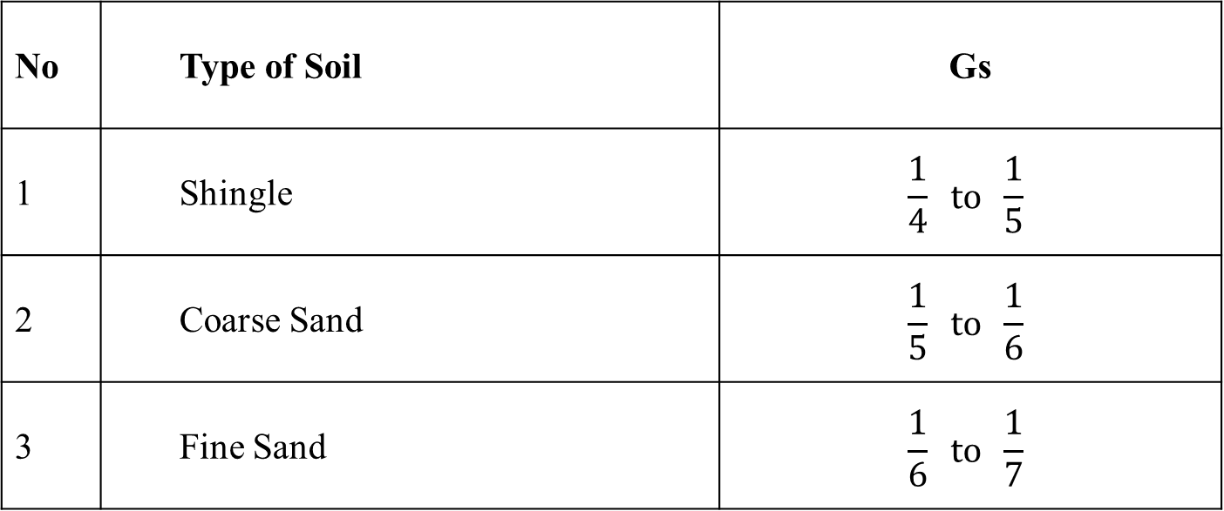
Set by: Othman K. Mohammed
In order to keep the structure safe against piping.
$$\text{Exit} \text{gradient} { (G}_{E})<\text{Safe} \text{Exit} \text{Gradient}\text{ (}\text{Gs}\text{)}$$
Values of Khosla’s Safe Exit Gradient for different types of Soils
No | Type of Soil | Gs
1 | Shingle | $$\frac{1}{4} to \frac{1}{5}$$
2 | Coarse Sand | $$\frac{1}{5} to \frac{1}{6}$$
3 | Fine Sand | $$\frac{1}{6} to \frac{1}{7}$$

Slide 6
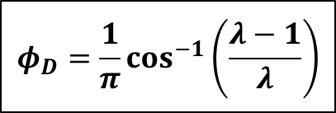
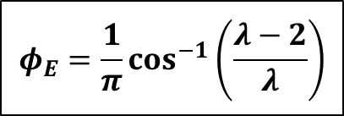
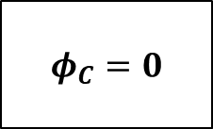
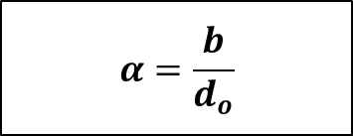
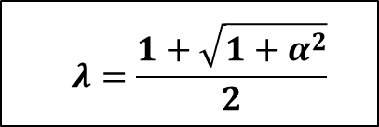
Uplift Coefficients at Key Points in Standard forms
Straight horizontal floor of negligible thickness with Pile at downstream end.
ΔH
$$φ_{E}$$
$$φ_{C}$$
$$d_{o}$$
b
$$φ_{D}$$
$$φ_{E}=\frac{1}{π}\cos^{−1}\left(\frac{λ−2}{λ}\right)$$
$$φ_{D}=\frac{1}{π}\cos^{−1}\left(\frac{λ−1}{λ}\right)$$
$$φ_{C}=0$$
$$λ=\frac{1+\sqrt{1+α^{2}}}{2}$$
$$α=\frac{b}{d_{o}}$$
11

Slide 7
Set by: Othman K. Mohammed
Straight horizontal floor of negligible thickness with Pile at upstream end.
ΔH
$$φ_{E1}$$
$$φ_{C1}$$
$$φ_{E}$$
$$φ_{C}$$
$$d_{o}$$
b
$$φ_{D1}$$
$$φ_{D}$$
$$φ_{C1}=1−φ_{E}$$
$$φ_{E}=\frac{1}{π}\cos^{−1}\left(\frac{λ−2}{λ}\right)$$
$$φ_{D1}=1−φ_{D}$$
$$φ_{D}=\frac{1}{π}\cos^{−1}\left(\frac{λ−1}{λ}\right)$$
$$φ_{E1}=1$$
$$φ_{C}=0$$
$$α=\frac{b}{d_{o}}$$
$$λ=\frac{1+\sqrt{1+α^{2}}}{2}$$

Slide 8
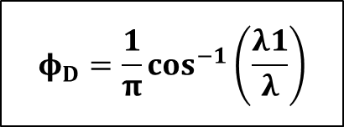
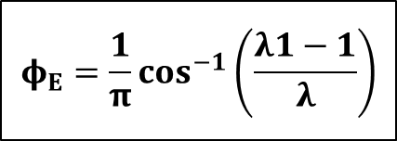
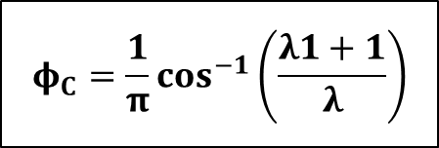
Straight horizontal floor of negligible thickness with Pile at intermediate points.
ΔH
$$φ_{E}$$
$$φ_{C}$$
b1
b2
$$d_{o}$$
$$φ_{D}$$
$$φ_{E}=\frac{1}{π}\cos^{−1}\left(\frac{λ1−1}{λ}\right)$$
$$φ_{D}=\frac{1}{π}\cos^{−1}\left(\frac{λ1}{λ}\right)$$
$$φ_{C}=\frac{1}{π}\cos^{−1}\left(\frac{λ1+1}{λ}\right)$$
$$λ=\frac{\sqrt{1+α_{1}^{2}}+\sqrt{1+α_{2}^{2}}}{2}$$
$$λ1=\frac{\sqrt{1+α_{1}^{2}}−\sqrt{1+α_{2}^{2}}}{2}$$
$$α_{1}=\frac{b_{1}}{d_{o}} α_{2}=\frac{b_{2}}{d_{o}}$$
12

Slide 9
Set by: Othman K. Mohammed
Straight horizontal floor of Depressed thickness below the bed (with no cutoff)
$$φ_{E′}=1$$
$$φ_{C′}=0$$
do
$$φ_{D_{1}^{′}}$$
b
$$φ_{D′}$$
$$φ_{D_{1}^{′}}={1−φ}_{D′}$$
$$φ_{D′}=φ_{D}−\frac{2}{3}\left(φ_{E}−φ_{D}\right)+\frac{3}{α^{2}}$$
$$φ_{D}=\frac{1}{π}\cos^{−1}\left(\frac{λ−1}{λ}\right)$$
$$φ_{E}=\frac{1}{π}\cos^{−1}\left(\frac{λ−2}{λ}\right)$$
$$α=\frac{b}{d_{o}}$$
$$λ=\frac{1+\sqrt{1+α^{2}}}{2}$$
$$G_{E}=0.84 \frac{ΔH}{d_{o}}φ_{D′}$$

Slide 10
Uplift Pressure Coefficients at Key Points
$$φ_{E1}$$
$$φ_{C1}$$
$$φ_{E2}$$
$$φ_{E3}$$
$$φ_{C3}$$
$$φ_{C2}$$
$$φ_{D1}$$
US
sheet pile
$$φ_{D3}$$
$$φ_{D2}$$
DS
sheet pile
Intermediate
sheet pile
13

Slide 11
Set by: Othman K. Mohammed
Corrections in Khosla’s theory
The pressures obtained at the key points by considering simple profile are then corrected for the following:
Correction for floor thickness
The correction to the evaluated values at key points E and C that is applied considering a floor thickness t
t
$$φ_{E}$$
$$φ_{C}$$
$$d_{o}$$
$$Corr. for φ_{E}=\frac{φ_{D}−φ_{E}}{d_{o}}\left(t\right)$$
$$Corr. for φ_{C}=\frac{φ_{D}−φ_{C}}{d_{o}}\left(t\right)$$
$$φ_{D}$$

Slide 12
Correction for mutual interference of sheet piles
The correction C for interference of one sheet pile on the other.
$$C=± 0.19\sqrt{ \frac{D}{b^{′}} } \left(\frac{d+D}{b}\right)$$
Where,
D = vertical distance measured from the key point to the bottom of the interfering sheet pile.
b′ = The horizontal distance between two pile lines
d = The depth of the pile on which the effect is considered
b = Total floor length
Note: Mutual Interference corrections are:
(+) for points (C)
($−$) for points (E)
14

Slide 13
Set by: Othman K. Mohammed
$$φ_{E1}$$
$$φ_{C1}$$
$$D$$
$$φ_{E3}$$
$$φ_{C3}$$
$$φ_{E2}$$
$$φ_{C2}$$
$$b^{′}$$
b

Slide 14
$$φ_{E1}$$
$$φ_{C1}$$
$$φ_{E3}$$
$$φ_{C3}$$
$$D$$
$$φ_{E2}$$
$$φ_{C2}$$
$$b^{′}$$
b
15

Slide 15
Set by: Othman K. Mohammed
$$φ_{E1}$$
$$φ_{C1}$$
$$φ_{E3}$$
$$φ_{C3}$$
$$φ_{E2}$$
$$φ_{C2}$$
$$D$$
$$b^{′}$$
b

Slide 16
$$φ_{E1}$$
$$φ_{C1}$$
$$φ_{E3}$$
$$φ_{C3}$$
$$φ_{E2}$$
$$φ_{C2}$$
$$D$$
$$b^{′}$$
b
16

Slide 17
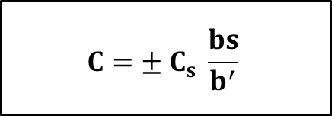
Set by: Othman K. Mohammed
Correction for slope of the floor
This correction is applicable only to the key points of the pile line fixed at the Start or the End of the slope.
$$C=± C_{s} \frac{bs}{b^{′}}$$
bs is the horizontal length of the slope
b’ is the distance between the two pile lines between which the sloping floor is located.
+
Notes: This correction is This correction is taken as
(+) for the downward slope
($−$) for the upward slope
$$−$$

Slide 18
Slope H : V | 1 : 1 | 2 : 1 | 3 : 1 | 4 : 1 | 5 : 1 | 6 : 1 | 7 : 1 | 8 : 1
$$C_{s}$$ | 0.112 | 0.065 | 0.045 | 0.033 | 0.028 | 0.025 | 0.023 | 0.02
$$φ_{E1}$$
$$φ_{C1}$$
V
H
$$φ_{E3}$$
$$φ_{C3}$$
$$φ_{E2}$$
$$φ_{C2}$$
$$bs$$
$$b^{′}$$
17

Slide 19
Set by: Othman K. Mohammed
Uplift Pressure Coefficients at Intermediate Points
$$A$$
$$φ_{E1}$$
$$φ_{C1}$$
$$φ_{A}$$
$$B$$
$$φ_{E3}$$
$$φ_{C3}$$
$$φ_{E2}$$
$$φ_{C2}$$
$$φ_{B}$$
$$L A$$
$$L B$$
$$b^{′}$$
$$b^{′}$$
$$φ_{A}=φ_{E2}+\frac{L A}{b^{′}}\left(φ_{C1}−φ_{E2}\right)$$
$$φ_{B}=φ_{E3}+\frac{L B}{b^{′}}\left({φ_{C2}−φ}_{E3}\right)$$

