Slide 1
Antibacterial drugs that inhibit cell wall synthesis

Slide 2
Bacterial cell wall:
Peptidoglycan, a vital component of the bacterial cell wall, is a compound unique to bacteria and therefore provides an optimum target for selective toxicity.

Slide 3
Peptidoglycans (glycan + peptide crosslinks)
Glycan: N-acetylglucosamine (NAG), N-acetylmuramic acid (NAM)
Gram+ (50-100 glycan layers)
Gram – (1-2 glycan layers

Slide 4
Cell wall synthesis: three stages
1- Cytoplasmic stage: Synthesis of precursors (NAM, NAG).
2- Membrane stage (Elongation and transfer).
3- Extracellular stage (Cross linking).

Slide 5
Cell Wall Synthesis Inhibitors
Agents that interfere with cell wall synthesis block peptidoglycan synthesis or cross- linking. They are active against growing bacteria and are bactericidal. The antibacterial that inhibit cell wall synthesis are varied in chemical structure.
The most important of these agents are the beta-lactams, the largest group, and the glycopeptides, which are active only against Gram-positive organisms. Bacitracin (primarily used topically) and cycloserine (mainly used as a ‘second-line’ medication for treatment of tuberculosis.

Slide 6
Beta-lactams: Penicillins, Cephalosporins, Monobactams, and Carbapenems
Penicillins and cephalosporins are the major antibiotics that inhibit bacterial cell wall synthesis. They are called beta-lactams because of the 4-member ring that is common to all their members.

Slide 7
Mechanism of action of β-lactam drugs
The β‐lactam antibiotics are bactericidal. They produce their antimicrobial action by preventing the cross‐linkage between the linear peptidoglycan polymer chains that make up the cell wall, e.g. by a pentaglycine bridge. This action is because a part of their structure, resembles the d‐alanyl‐d‐alanine of the peptide chains of the bacterial cell wall.

Slide 8
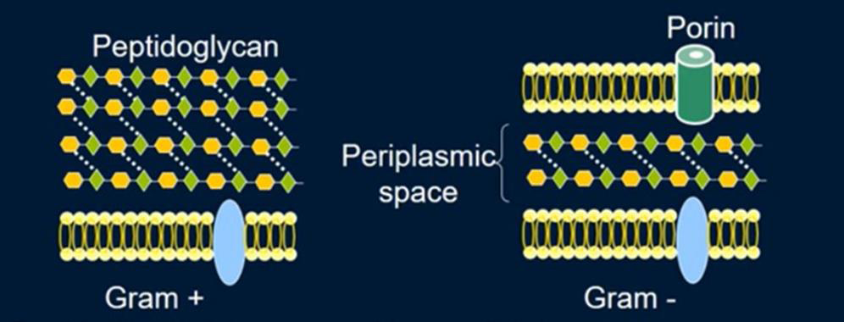

Slide 9
Penicillins
Benzylpenicillin, also known as penicillin G was the first of the penicillins. It has a ‘narrow spectrum’ of activity, mainly against Gram‐positive organisms. Benzylpenicillin is effective for treating pneumococcal, streptococcal, meningococcal. It is also valuable for the prophylaxis of clostridial gas gangrene. Most Staphylococcus aureus now produce penicillinase.
Benzylpenicillin is acid labile (destroyed by gastric acid) and is therefore poorly absorbed orally. It is given by intramuscular injection, but large doses are painful and are given intravenously.

Slide 10
Penicillin diffuses widely through the body tissues, but penetration into the brain is poor, except when the meninges are inflamed.
Following intramuscular injection, peak plasma levels occur after 15–30 min and the drug is rapidly excreted by the kidneys. The elimination half‐life (t1/2) is normally 30 min, but is prolonged to about 10 h in anuria.

Slide 11
Phenoxymethylpenicillin, also known as penicillin V has a similar antimicrobial spectrum, but is active orally. However, its absorption is variable and it is only useful for very sensitive organisms, where a rapid action is unnecessary (streptococcal tonsillitis).
Phenoxymethylpenicillin is useful in the prophylaxis of rheumatic fever.

Slide 12
Many bacteria (including most staphylococci) are resistant to benzylpenicillin because they produce enzymes (β‐lactamases, penicillinase) that open the β‐lactam ring. The genetic control of β‐lactamases often resides in transmissible plasmids.
Some penicillins, e.g. flucloxacillin, are effective against β‐lactamase‐producing staphylococci.
Gram‐negative, but not Gram‐positive, bacteria possess an outer phospholipid membrane that may confer penicillin resistance by hindering access of the drugs to the cell wall.

Slide 13
The broad‐spectrum penicillins, such as amoxicillin and ampicillin, are more hydrophilic than benzylpenicillin and are active against some Gram‐negative bacteria because they can pass through pores in the outer phospholipid membrane. Penicillinase‐producing organisms are resistant to amoxicillin and ampicillin.
The antipseudomonal penicillins: are used mainly for the treatment of serious infections caused by Pseudomonas aeruginosa Carbenicillin and ticarcillin, and piperacillin.

Slide 14
Side effects:
Penicillins have a very low toxicity, but high concentrations (renal failure, intrathecal administration) may produce encephalopathy, which can be fatal. Hypersensitivity is the most important side‐effect of the penicillins, which may cause rashes and, rarely, anaphylactic reactions that are fatal in about 10% of cases.
Anaphylaxis is a severe, potentially life-threatening allergic reaction. It can occur within seconds or minutes of exposure to something you're allergic to, such as drugs, peanuts or bee stings.

Slide 15
Cephalosporins
A widely used group of antibiotics is the cephalosporins. These antibiotics, isolated from the fungus Cephalosporium acremonium, resemble penicillins in chemical structure, except there are different atoms building the β-lactam core structure.
Cephalosporins are used:
• to fight pathogens where penicillin resistance is encountered
• or in cases where a patient has an allergy to penicillin.

Slide 16
Cephalosporins have a broader bactericidal spectrum against gram-negative bacterial pathogens.
Accordingly, the cephalosporins can be separated into “generations” by their drug spectrum. Each succeeding generation has a greater activity against gram-negative species than the preceding generation, often with less activity against gram-positive species.

Slide 17
Table: The “Generations” of Cephalosporins

Slide 18
Carbapenems
Another set of β-lactam drugs with a broad spectrum is the carbapenems, which are derived from a compound produced by the bacterium Streptomyces cattleya.
Because their structure makes them highly resistant to many β-lactamase enzymes, they have been one of the most important groups of clinically useful “last resort” antibiotics; that is, prescribed for bacterial pathogens, such as those Escherichia coli and K. pneumoniae strains, showing resistance to other β-lactam antibiotics.

Slide 19
In patients, carbapenems are normally degraded by the kidneys before they can have a therapeutic effect. Therefore, the drug usually is prescribed in synergistic combination with cilastatin, which prevents premature degradation of the drug by the kidneys.
The imipenem/cilastatin combination (Primaxin) is active against most gram-positive and gram-negative clinical isolates.

Slide 20
Since 2012, the medical community has been extremely worried over bacterial species that have acquired the genetic element New Delhi metallo-β-lactamase-1 (NDM-1) that causes hydrolysis of the β-lactams.
Bacterial pathogens possessing this element, especially those in the family Enterobacteriaceae (e.g., E. coli, Enterobacter species, and Klebsiella species), are resistant to a broad range of antibiotics, including those in the carbapenem family. Currently, there are no new antibiotics in development for these superbugs, referred to as the carbapenem-resistant Enterobacteriaceae (CRE).

Slide 21
Glycopeptide: Glycopeptides include vancomycin and teicoplanin. Both are very large molecules and therefore have difficulty penetrating into Gram-negative cells.

Slide 22
Vancomycin represents a glycopeptide (sugar attached to protein) antibiotic that is produced by Amycolatopsis orientalis.
• The drug is used to treat gram-positive pathogens and is prescribed for severe staphylococcal diseases for which penicillin allergy or bacterial resistance exists.
• In fact, vancomycin has emerged as a key treatment in therapy for MRSA, often representing the “drug of last resort.” Perhaps not surprisingly, vancomycin-resistant S. aureus (VRSA) strains have been reported.
• Glycopeptides inhibit cell wall synthesis by binding to the D- ALA- D- ALA terminal end of peptidoglycan precursors, thus inhibiting the action of transglycosidase and transpeptidases.

Slide 23
Vancomycin and teicoplanin are not absorbed from the gastrointestinal tract and do not penetrate the CSF in patients without meningitis.
However, bactericidal concentrations are achieved in most patients with meningitis because of the increased permeability of the blood–brain barrier.
Excretion is via the kidney.

Slide 24
Vancomycin and teicoplanin are used mainly for:
• the treatment of infections caused by Gram-positive cocci and Gram-positive rods that are resistant to beta-lactam drugs, particularly multi-resistant Staphylococcus aureus and Staphylococcus epidermidis
• for patients allergic to beta-lactams
• the treatment of Clostridium difficile in antibiotic-associated colitis.

Slide 25
Bacitracin: is a polypeptide antibiotic derived from Bacillus subtilis that functions to block cell wall formation by interfering with the dephosphorylation of the lipid compound that carries peptidoglycans to the growing microbial cell wall.
The antibacterial spectrum of bacitracin is gram-positive and includes staphylococci, streptococci, Corynebacterium, and Clostridium, with rare resistance seen in staphylococci. Bacitracin is too toxic to be used parenterally but is well tolerated topically.

Slide 26
Cycloserine: interferes with bacterial cell wall synthesis by competitively inhibiting two enzymes, L-alanine racemase and D-alanine-D-alanine ligase, thereby impairing peptidoglycan formation necessary for bacterial cell wall synthesis.
Cycloserine is a broad-spectrum antibiotic used as a second line agent for treatment of drug resistant tuberculosis, always in combination with other antituberculosis agents.
Cycloserine is appears to have little or no hepatotoxic potential, but it is usually used in combination with agents that are known to be hepatotoxic, and its role in the reported cases of liver injury with combination therapy cannot always be excluded.

Slide 27
