Slide 1
Viruses, Viroids, and Prions

Slide 2
Viruses are too small to be seen with a light microscope and can’t be cultured outside their hosts.
Advances in molecular biological techniques in the 1980s and 1990s led to the recognition of several new viruses, including human immunodeficiency virus (HIV) and SARS-associated coronavirus.

Slide 3
Are viruses living or non-living organisms?
Life can be defined as a complex set of processes resulting from the actions of proteins specified by nucleic acids. The nucleic acids of living cells are in action all the time.
Because viruses are inert outside living host cells, in this sense they aren’t considered to be living organisms. However, once viruses enter a host cell, the viral nucleic acids become active, and viral multiplication results. In this sense, viruses are alive when they multiply in the host cells they infect.
From a clinical point of view, viruses are alive because they cause infection and disease, just as pathogenic bacteria, fungi, and protozoa do.

Slide 4
General Characteristics of Viruses
1. They are small and obligatory intracellular parasites, that is, they absolutely require living host cells in order to multiply. However, both of these properties are shared by certain small bacteria, such as some rickettsias.
2. Viruses contain a single type of nucleic acid (DNA or RNA) and a protein coat, sometimes enclosed by an envelope composed of lipids, proteins, and carbohydrates.
3. No ribosomes
4. They lack enzymes for protein synthesis and ATP generation. To multiply, viruses must take over the metabolic machinery of the host cell.

Slide 5
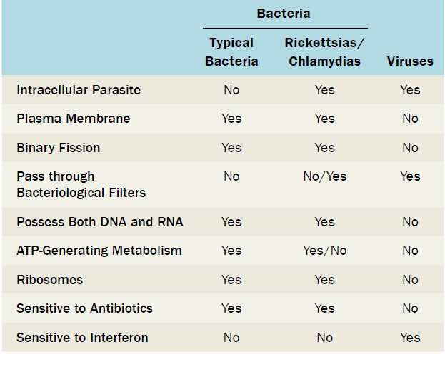
Table (1) Viruses and Bacteria Compared

Slide 6
Host Range
Host range refers to the spectrum of host cells in which a virus can multiply.
Most viruses infect only specific types of cells in one host species.
Host range is determined by the specific attachment site on the host cell’s surface and the availability of host cellular factors. Viruses that infect bacteria are called bacteriophages, or phages.

Slide 7
For the virus to infect the host cell, the outer surface of the virus must chemically interact with specific receptor sites on the surface of the cell.
For some bacteriophages, the receptor site is part of the cell wall of the host; in other cases, it is part of the fimbriae or flagella.
For animal viruses, the receptor sites are on the plasma membranes of the host cells.

Slide 8
Treating diseases with Viruses
The potential to use viruses to treat diseases is fascinating because of their narrow host range and their ability to kill their host cells.
Experimentally induced viral infections in cancer patients during the 1920s suggested that viruses might have antitumor activity. These tumor-destroying, or oncolytic, viruses may selectively infect and kill tumor cells or cause an immune response against tumor cells.
phage therapy: using bacteriophages to treat bacterial infections.

Slide 9
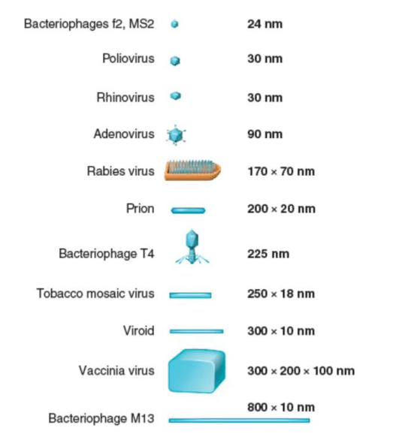
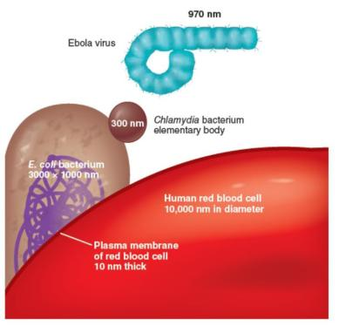
Viral Size

Slide 10
Viral Structure
Viroid: infectious RNA without capsid that cause some plant diseases, such as potato spindle tuber disease.
A virion is an infectious viral particle composed of nucleic acid and surrounded by a protein coat outside a host cell.

Slide 11
Nucleic Acid
• virus have either DNA or RNA, but never both.
• The nucleic acid of a virus can be single-stranded or double-stranded.
• The nucleic acid can be linear or circular.
• In some viruses (such as the influenza virus), the nucleic acid is in several separate segments.

Slide 12
Viral Nucleic Acid

Slide 13
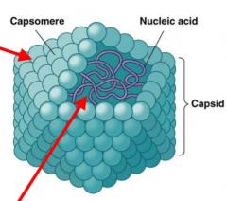
Capsid and Envelope
The nucleic acid of a virus is protected by a protein coat called the capsid
Each capsid is composed of protein subunits
called capsomeres.
In some viruses, the capsid is covered by an envelope, which consists of some combination of lipids, proteins, and carbohydrates.

Slide 14
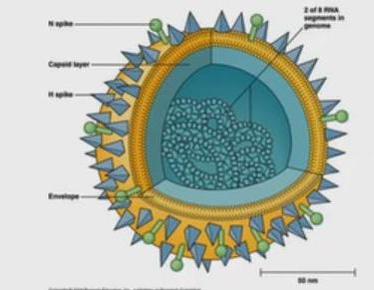
Spikes:
Depending on the virus, envelopes may or may not be covered by spikes, which are carbohydrate-protein complexes that project from the surface of the envelope.
Some viruses attach to host cells by means of spikes.

Slide 15
Haemagglutination
The ability of certain viruses, such as the influenza virus to clump red blood cells is associated with spikes.
Such viruses bind to red blood cells and form bridges between them. The resulting clumping is called hemagglutination and is the basis for several useful laboratory tests.

Slide 16
why you can get influenza more than once?

Slide 17
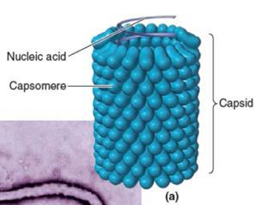
General Morphology
Viruses may be classified into several different morphological types on the basis of their capsid architecture.
1- Helical viruses resemble long rods that may be rigid or flexible.
The viral nucleic acid is found within a hollow, cylindrical capsid that has a helical structure (such as rabies and Ebola)
1- Helical Viruses

Slide 18
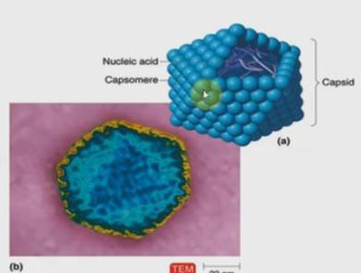
2- Polyhedral Viruses
Many animal, plant, and bacterial viruses are polyhedral, or many-sided, viruses.
The capsid of most polyhedral viruses is in the shape of an icosahedron, a regular polyhedron with 20 triangular faces and 12 corners. Examples of a polyhedral viruses are the adenovirus and the poliovirus.

Slide 19
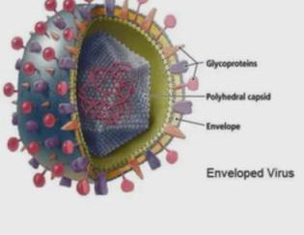
3- Enveloped Viruses
Enveloped viruses are roughly spherical.
When helical or polyhedral viruses are enclosed by envelopes, they are called enveloped helical or enveloped polyhedral viruses.
Such as the influenza virus and the human herpes virus

Slide 20
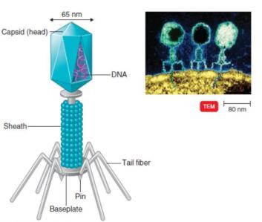
4- Complex Viruses
Some viruses, particularly bacterial viruses, have complicated structures and are called complex viruses.
One example of a complex virus is
a bacteriophage.

Slide 21
Taxonomy of Viruses
Classification of viruses is based on type of nucleic acid, strategy for replication, and morphology. Virus family names end in -viridae; genus names end in -virus. Family Herpesviridae, genus Simplexvirus.
A viral species is a group of viruses sharing the same genetic information and ecological niche. viral species are designated by descriptive common names, such as human immunodeficiency virus (HIV), with subspecies (if any) designated by a number (HIV-1).

Slide 22
Isolation, Cultivation, and Identification of Viruses
Viruses must be grown in living cells. The bacteriophages are grown in bacteria.
Growing Bacteriophages in the Laboratory
The plaque method mixes bacteriophages with host bacteria and nutrient agar. After several viral multiplication cycles, the bacteria in the area surrounding the original virus are destroyed; the area of lysis is called a plaque. Each plaque originates with a single viral particle; the concentration of viruses is expressed as plaque-forming units (PFU).

Slide 23
Growing Animal Viruses in the Laboratory
• Cultivation of some animal viruses requires whole animals.
• Some animal viruses can be cultivated in embryonated eggs.
• In cell cultures virally infected cells are detected via their deterioration, known as cytopathic effects (CPE).

Slide 24
Viral Identification
Serological tests: Western blotting (reaction of the virus with antibodies).
Nucleic acids: Viruses may be identified by RFLPs and PCR.

Slide 25
Prions
Proteinaceous infectious particle, inherited and transmissible by ingestion, transplant, and surgical instruments, first discovered in the 1980s.
Prion diseases, such as Creutzfeldt-Jakob disease (CJD) and mad cow disease, all involve the degeneration of brain tissue.

Slide 26
Multiplication of Bacteriophages
Bacteriophages can multiply by two alternative mechanisms: the lytic cycle or the lysogenic cycle.
The lytic cycle ends with the lysis and death of the host cell, whereas the host cell remains alive in the lysogenic cycle.

Slide 27
Notes:
Multiplication of Bacteriophages
The multiplication cycle of these phages, like that of all viruses, occurs in five distinct stages: attachment, penetration, biosynthesis, maturation, and release.
Attachment (adsorption)1
an attachment site on the virus attaches to a receptor site on the bacterial cell. T-even bacteriophages use fibers at the end of the tail as attachment sites. The complementary receptor sites are on the bacterial cell wall.
Penetration1 2
The T-even bacteriophage injects its DNA (nucleic acid) into the bacterium. To do this, the bacteriophage’s tail releases an enzyme, phage lysozyme, which breaks down a portion of the bacterial cell wall.
Biosynthesis2 3
Once6the bacteriophage DNA has reached the cytoplasm of the host cell, the biosynthesis of viral nucleic acid and protein occurs. Host protein synthesis is stopped by virus-induced degradation of the host DNA, viral proteins that interfere with transcription, or the repression of translation.
Maturation
In this process, bacteriophage DNA and capsids are assembled into complete virions. The phage heads and tails are separately assembled from protein subunits, and the head is filled with phage DNA and attached to the tail. 1
Release
The final stage of viral multiplication is the release of virions from the host cell. The term lysis is generally used for this stage in the multiplication of T-
even phages because in this case, the plasma membrane actually breaks open (lyses).

Slide 28
Bacteriophage Lambda (λ): The Lysogenic Cycle
In contrast to T-even bacteriophages, some viruses don’t cause lysis and death of the host cell when they multiply.
These lysogenic phages (also called temperate phages) may indeed proceed through a lytic cycle, but they are also capable of incorporating their DNA into the host cell’s DNA to begin a lysogenic cycle.
In lysogeny, the phage remains latent (inactive).
The participating bacterial host cells are known as lysogenic cells.

Slide 29
