Slide 1
Fungi

Slide 2
Fungi
aerobic or facultatively anaerobic chemoheterotrophs.
Most reproduce with sexual and asexual spores.
Prefer growing at pH 5
Only few are pathogenic and all pathogens are opportunistic.
Acquire food by absorption.
Cell wall made of chitin

Slide 3
Fungal benefits
They decompose dead plant matter, thereby recycling vital elements.
Nearly all plants depend on symbiotic fungi, known as mycorrhizae, which help their roots absorb minerals and water from the soil.
Humans use fungi for food (mushrooms) and to produce foods (bread and citric acid) and drugs (alcohol and penicillin).

Slide 4
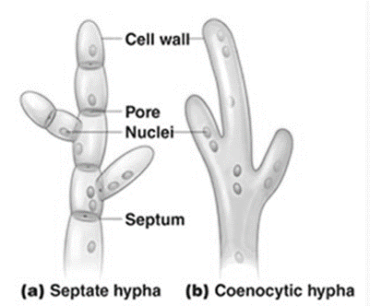
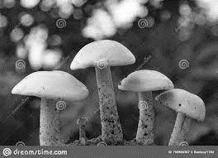
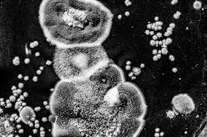
Characteristics of Fungi
Molds and Fleshy Fungi
Notes:
Molds and Fleshy Fungi
The thallus (body) of a mold or fleshy fungus consists of long filaments of cells joined together; these filaments are called hyphae. In most molds, the hyphae contain cross-walls called septa which divide them into distinct, uninucleate cell-like units. These hyphae are called septate hyphae. In a few classes of fungi, the hyphae contain no septa and appear as long, continuous cells with many nuclei. These are called coenocytic hyphae.

Slide 5
Yeasts
are non-filamentous, unicellular fungi that are spherical or oval. Budding yeasts, such as Saccharomyces, divide unevenly.
In budding, the parent cell forms a protuberance (bud) on its outer surface. As the bud elongates, the parent cell’s nucleus divides, and one nucleus migrates into the bud.
Cell wall material is then laid down between the bud and parent cell, and the bud eventually breaks away.
Notes:
One yeast cell can in time produce up to 24 daughter cells by budding. Some yeasts produce buds that fail to detach themselves; these buds form a short chain of cells called a pseudohypha. Candida albicans attaches to human epithelial cells as a yeast but usually requires pseudohyphae to invade deeper tissues.

Slide 6
Dimorphic Fungi: Some fungi, most notably the pathogenic species, exhibit dimorphism, two forms of growth. Such fungi can grow either as a mold or as a yeast. The moldlike forms produce vegetative and aerial hyphae; the yeastlike forms reproduce by budding. Dimorphism in pathogenic fungi is temperature dependent: at 37°C, the fungus is yeastlike, and at 25°C, it is moldlike. However, the appearance of the dimorphic (in this instance, nonpathogenic) fungus changes with CO2 concentration.

Slide 7
Life Cycle
Filamentous fungi can reproduce asexually by fragmentation of their hyphae. In addition, both sexual and asexual reproduction in fungi occurs by the formation of spores.
Fungal spores can be either asexual or sexual.

Slide 8
Asexual spores are formed by the hyphae of one organism. When these spores germinate, they become organisms that are genetically identical to the parent.
Asexual spores are produced by an individual fungus through mitosis and subsequent cell division; there is no fusion of the nuclei of cells.

Slide 9
Two types of asexual spores are produced by fungi.
conidiospore, or conidium: a unicellular or multicellular spore that is not enclosed in a sac. Conidia are produced in a chain at the end of a conidiophore. Such spores are produced by Penicillium and Aspergillus. Conidia formed by the fragmentation of a septate hypha into single, slightly thickened cells are called arthroconidia
One species that produces such spores is Coccidioides immitis.
species that produces such spores is Coccidioides immitis. Another type of conidium, blastoconidia, are formed from the buds of its parent cell Such spores are found in some yeasts, such as Candida albicans. A chlamydoconidium is a thick-walled spore formed by rounding and enlargement within a hyphal segment. A fungus that produces chlamydoconidia is the yeast Candida albicans.
Sporangiospore, formed within a sporangium, or sac, at the end of an aerial hypha called a sporangiophore. The sporangium can contain hundreds of sporangiospores. Such spores are produced by Rhizopus.

Slide 10
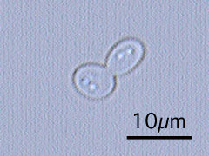
Another type of conidium, blastoconidia, is formed from the buds of its parent cell Such spores are found in some yeasts, such as
Candida albicans.

Slide 11
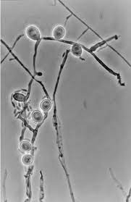
chlamydoconidium is a thick-walled spore formed by rounding and enlargement within a hyphal segment.
A fungus that produces chlamydoconidia is the yeast Candida albicans.

Slide 12
2- Sporangiospore, formed within a sporangium, or sac, at the end of an aerial hypha called a sporangiophore.
The sporangium can contain hundreds of sporangiospores. Such spores are produced by Rhizopus.

Slide 13
Sexual spores result from the fusion of nuclei from two opposite mating strains of the same species of fungus.
Sexual spores require two different mating strains and so are made less frequently than asexual spores.
Organisms that grow from sexual spores will have genetic characteristics of both parental strains.

Slide 14
Medically Important Fungi
The medically important phyla of fungi include:
Zygomycota: The Zygomycota have coenocytic hyphae and produce sporangiospores and zygospores. An example is Rhizopus the common black bread mold.
Microsporidia: lack mitochondria and microtubules; they cause diarrhea in AIDS patients.

Slide 15
Ascomycota: have septate hyphae and produce ascospores and frequently conidiospores.
An ascospore forms when the nuclei of two cells that can be either morphologically similar or dissimilar fuse. These spores are produced in a saclike structure called an ascus. The members of this phylum are called sac fungi because of the ascus.
Basidiomycota: have septate hyphae and produce basidiospores; some produce conidiospores.

Slide 16
Teleomorphic fungi produce sexual and asexual spores;
anamorphic fungi produce asexual spores only.

Slide 17
Nutritional Adaptations
Fungi are generally adapted to environments that would be hostile to bacteria. Fungi differ from bacteria in certain environmental requirements and in the following nutritional characteristics:
● Most fungi are more resistant to osmotic pressure than bacteria; most can therefore grow in relatively high sugar or salt concentrations.
●Fungi can grow on substances with a very low moisture content, generally too low to support the growth of bacteria.

Slide 18
● Fungi require somewhat less nitrogen than bacteria for an equivalent amount of growth.
● Fungi are often capable of metabolizing complex carbohydrates, such as lignin (a component of wood), that most bacteria can’t use for nutrients.

Slide 19
Economic Effects of Fungi
Aspergillus niger has been used to produce citric acid for foods.
The yeast Saccharomyces cerevisiae is used to make bread and wine. It is also make hepatitis B vaccine.
Taxomyces produces a component of the anti-cancer drug taxol.
Paecilomyces fumosoroseus used to kill termites

