Slide 1
General Botany II Biology Dep.1st stag Lec.3
External organization of stems:

Slide 2
External organization of stems:
The terms "stem" and "shoot" are sometimes used interchangeably, but technically the stem is an axis, whereas the shoot is the stem plus any leaves, flowers, or buds that may be present. The aboveground, conspicuous part of flowering plants constitutes the shoot system, which is composed of erect stems on which are attached leaves, flowers, and buds. Leaves are attached to the stem at regions called nodes. The section of stem between nodes is an internode, and the upper angle between the stem and the leaf at the node is called the leaf axil. Axillary (lateral) buds located in the leaf axils give rise to vegetative branch stems or to flowers. Terminal buds are present at the tips of the main stem and branches and contain the apical meristem tissues

Slide 3
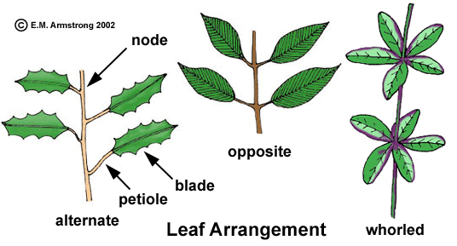
The growing point of the shoot—the apical meristem—is surrounded by developing leaves (leaf primordia) that have in their axils bud primordia. The buds are of two kinds: Some are vegetative and will develop into leafy branches; others contain rudimentary reproductive tissues and will produce flowers.
Arrangement of leaves on the stem, called phyllotaxy, is important in positioning leaves so that they do not shade each other. If only one leaf is present at each node, the stem has alternate phyllotaxy (the leaves alternate up the stem); two leaves per node is opposite phyllotaxy, and three or more per node is whorled phyllotaxy.

Slide 4
Function of stem:
●Conduction: Transport water and mineral nutrients from roots to leaves and transport of food, hormones, and other metabolites from one part of the stem to another.
●Stem provide: mechanical support and raise leaves in to the air, thus facilitating photosynthesis, flowers and fruits are also produced in positions facilitating pollination and seed dispersal.
●Storage of food:
Types of stem:
1) Weak stem: It is incapable of growing straight upright, and under natural conditions trail on the surface of the soil and have some types:
a) Twining stem: Such weak stems ascend by coiling around some support. e.g, Convolvulus sp.
b) Climbing stem: It’s the stem that produced specialized organ that connected to the supports called tendrils as in Vitis sp.
c)Running stem: The stems that creeping on the ground and produce adventitious root at the nodes and aerial parts opposite these roots as in Fragaria sp. (Strawberry), phragmites asstralis.
d)Prostrate stems: It’s the stem that extends horizontally on the ground and not produce adventitious root at the nodes as found in the Cucarbita sp.

Slide 5
2) Herbaceous stems: They are non- woody stem, which normally complete their life cycle in one growing season and secondary growth do not take place as found in Vicia faba, Helianthus annus.
3) Woody stems:
These stems are thicker and hard, secondary growth takes place as in Morus sp., Olea sp.
Modification of stems:
Some stems are modified beyond recognition in order to carry out some important and specific function:
Spiny stems (Thorn): as in Rosa sp.
Leafy stems: as in Ruscus sp.
Dwarf stems: as in Daucus carota (Carrot), Raphanus sp.
Tendrils Stems: as in Vitis sp.
Succulent stems: Opuntia sp.

Slide 6
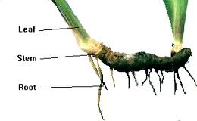
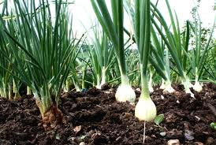
6)Sub-terranians (Underground stem), they develop underground include:
A) Bulbs: a short vertical underground, food-storage stem axis with extremely reduced internodes and surrounding fleshy scale leaves as found in Allium cepa.
B) Rhizomes: a horizontal underground stem, the top can generate leafy stems while the bottom can produce adventitious roots as in Canna indica.
Rhizomes
Bulbs

Slide 7
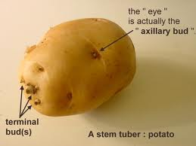
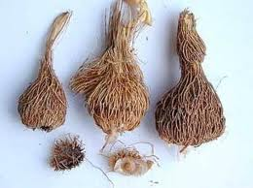
c) Corms: Short, upright, hard or fleshy stems covered with thin, dry papery leaves as found in Colocasis sp. (taro).
D)Tuber: a swollen, underground storage stem adapted for storage and reproduction as found in Solanum tuberosum. (Potato tubers).
Corms

