Slide 1
Introduction of Metabolism and Oxidative Phosphorylation
Ia’natusyarifah (13030194049)
Ruth Ellen (13030194053)

Slide 2
Metabolism
Metabolism
Anabolism
Catabolism
The synthesis of complex molecule from simple molecule, the process needs energy
The breakdown of complex molecule to simple molecule that produce energy (ATP)
Example: the growth and mineralization of bone and increases in muscle mass
Example: glycolysis, the citric acid cycle, the breakdown of muscle protein in order to use amino acids as substrates for gluconeogenesis
Definition:
Metabolism is a chemical process to maintain the living state of cell and organism.
Metabolism can be defined as all biochemical reactions that take place in cell.

Slide 3
Distinction of Organism
Organism
Anaerobic
Heterotroph
Aerobic
Facultative Anaerobic
Autotroph
Organism that can synthesize glucose and all the organic compounds from inorganic carbon, which is CO₂
e.q: plants, algae, bacteria
Organism that can synthesize their metabolites from the other organic compounds from others source
e.q: animal
an organism that can survive and grow in an oxygenated environment
any organism that does not require oxygen for growth. It may react negatively or even die if oxygen is present
Some species that able to grow either with or without free oxygen. E.q: human

Slide 4
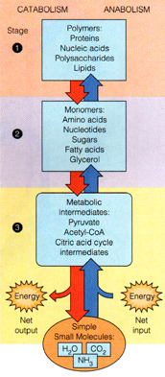
Anabolism and Catabolism
Anabolism and catabolism occur in 3 stage.
Stage 1: The conversion of macromolecule (polymer and complex lipid) to monomer intermediates.
Stage 2: The conversion of monomers (amino acids, nucleotides, sugars, fatty acids, and glycerol) to metabolic intermedites (Pyruvate, Acetyl-CoA, and Citric acid cycle intermediates).
Stage 3: Degradation of metabolic intermediates to H₂O, O₂, and NH₃.
Not a polymer
Lipid component
glycerol
Fatty acid
Crab Cycle
Triglycerol

Slide 5
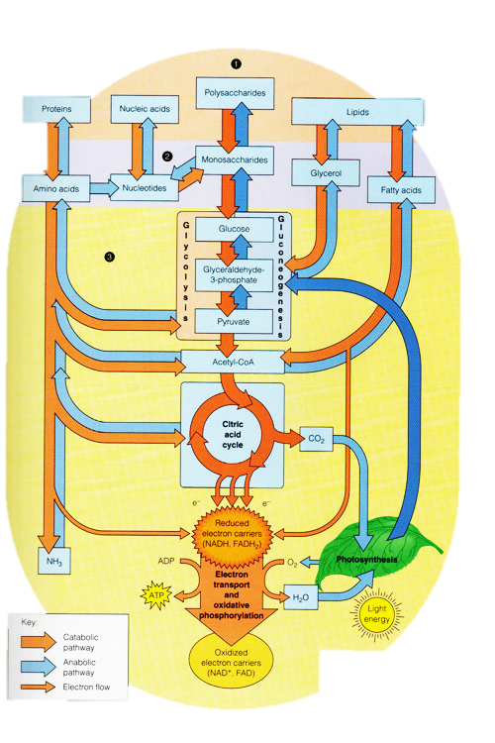
Metabolism
An energy source (act mostly in crab cycle)
The whole process of metabolism is really a continuum
There are electron transport in every process of metabolism
polymer
monomer
Intermediate result
Produce high energy
Phosphorylation oxidative

Slide 6
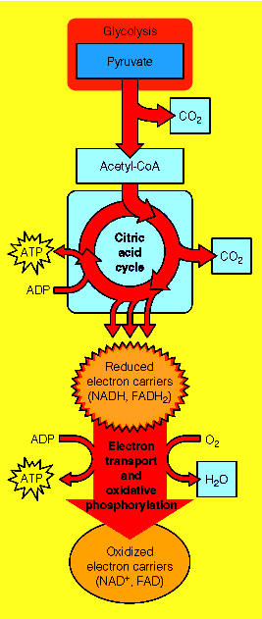
Oxidative Phosphorylation
Oxidative phosphorylation is the process in which ATP is formed as a result of redox reaction.
The first electron acceptor is NADH, and FADH₂.
The last electron acceptor is O₂.
Without oxygen, we can not produce ATP from ADP and P_{i} that is why we feel weak and tired.
NADH ⟶ NAD⁺ + H⁺ + 2e
FADH₂ ⟶ FAD + 2H⁺ +2e
Last electron acceptor
Oxidative phosphorylation

Slide 7
Oxidative Phosphorylation
The gibbs energy to hydrolyze ATP and ADP is the same but the gibbs energy to hydrolyze AMP is different because ATP and ADP the bond that is broken down is phosphoanhydride bonds which is high-energy, but AMP is phosphpester inorganic bond
∆G⁰: -31 kJ/mol
∆G⁰: -31 kJ/mol
∆G⁰: -14 kJ/mol
+ P_{I}
Inorganic phosphate
(high energy compound)
Used to breakdown:
Glucose & fatty acid → CO₂ + H₂O
Protein → NH₃
Another is GTP (guanosin triphosphate)

Slide 8
Others high energy compound
Phosphoenolpyruvate ⟶ pyruvate + (phosphate)
+ (phosphate) ∆G⁰: -31,4 kJ/mol
1,3-Biphophoglycerate ⟶ 3-phosphoglycerate
∆G⁰: -18,9 kJ/mol

Slide 9
Some free energy changes

Slide 10
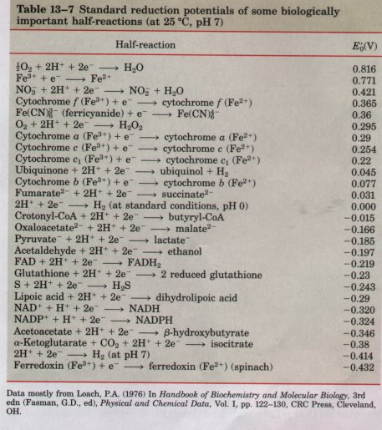
Standard Reduction Potentials
Electropositive
(reduced)
Condition which reaction can occur:
negative ∆G
Positive E⁰ cell
Redox reaction in metabolism occurs in a sequence of lower potential energy to a higher order of the metabolic processes can run spontaneously.
Except if there is any inhibitors, for example: cyanide.
Easier to reduce
Electronegative
(oxidized)

Slide 11
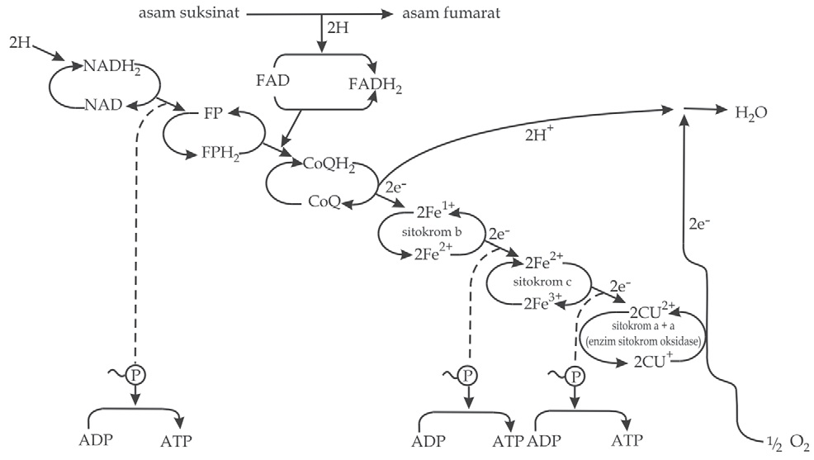
Couple-couple Reaction of NADH and FADH₂
Transport electron of NADH produce 3 ATP.
Transport electron of FADH₂ produce 2 ATP.

