Slide 1
EXP.(4 )
Spectrophotometric determination of Cr and Mn In steel sample
The purpose of this experiment is to simultaneously determine the concentration of manganese and chromium in a mixture by spectrophotometrically measuring the absorbance at two specified wavelengths .
Steel consists mainly of iron and small amounts of carbon plus alloying metals like manganese, chromium, vanadium. These added metals make the steel harder and stronger but reduce ductility

Slide 2
In many samples, Cr and Mn occur as cations (Cr³⁺and Mn^{2+,} respectively) and cannot be determined by absorption spectrometry because they are not able to absorb light to a large enough extent in this form.
That is why these ions should be first converted to light-absorbing forms (Cr₂O₇²⁻ and MnO₄⁻, respectively) by suitable chemical reactions.
The steel samples for the spectrophotometric determination of chromium and manganese were prepared by oxidation with acid and persulfate. The steel samples were placed in concentrated sulfuric acid in order to dissolve chromium metal and in nitric acid to dissolve manganese metal. The dissolution was followed by further oxidation of chromium to dichromate and manganese to permanganate.

Slide 3
2Cr⁺³ + 3S₂O₈ ⁻² + 7 H₂O Cr₂O₇ ⁻² + 6SO₄⁻² + 14 H⁺
2Mn⁺² + 5S₂O₈ ⁻² + 8H₂O 2MnO₄⁻ + 10SO₄ ⁻² + 16 H ⁺
Add 0.5 gm KIO₄ ( The rule of addition of KIO₄ to ensure complete oxidation of the manganese and to eliminate the fading of the permanganate which occurs when persulfate is used alone )
2Mn ⁺² + 5IO₄ ⁻ + 3 H₂O 2MnO₄ ⁻ + 5 IO₃ ⁻ + 6 H ⁺

Slide 4
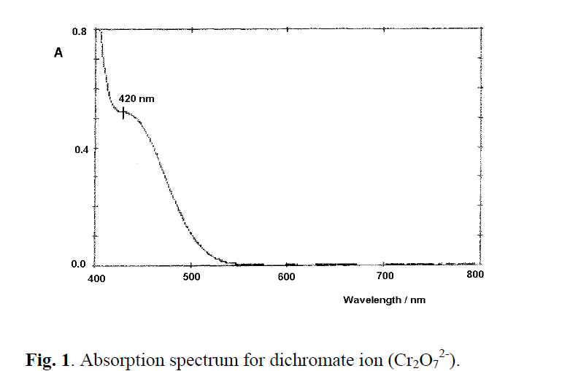
Wavelength selection
Before analysis, the wavelengths of maximum absorption for permanganate and dichromate were determined by taking separate spectral scans of each sample solution containing permanganate or dichromate from 400nm to 800nm using the visible spectrophotometer. Based on the absorption spectra the wavelengths of maximum absorption (λmax) for permanganate and dichromate were 525nm and 440nm, respectively.
According to Fig. 1, the dichromate ion spectrum shows a shoulder at 420 nm. This is therefore the selected wavelength for the dichromate ion.

Slide 5
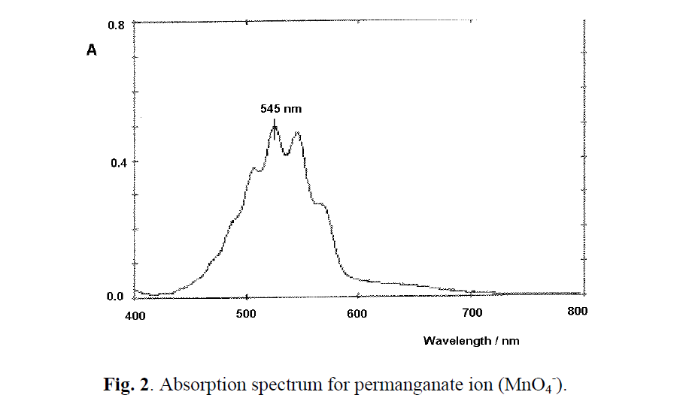
According to Fig. 2, the permanganate ion spectrum shows a maximum at 525 nm. This is therefore the selected wavelength for the permanganate ion.

Slide 6
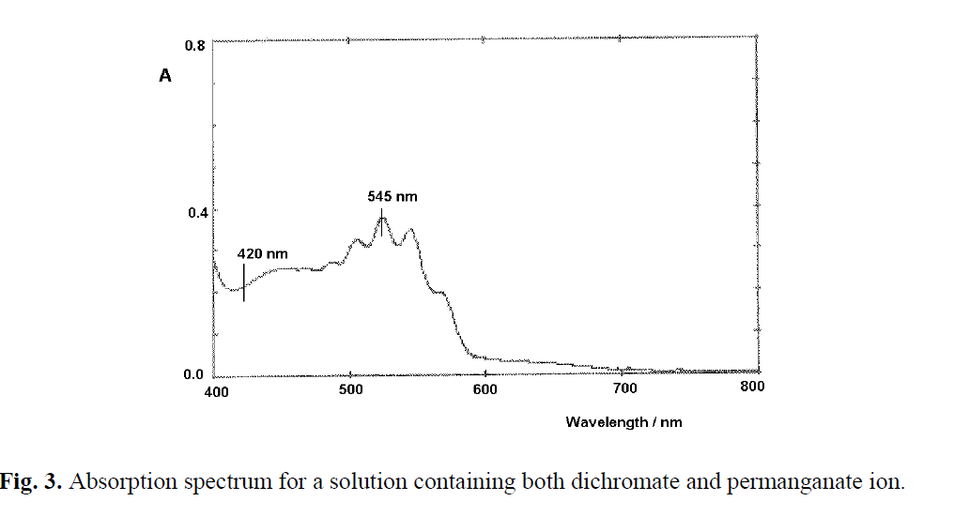

Slide 7
If the concentration of these ions is low enough at each of the selected wavelengths, light is absorbed by only one of the above ions (see Figs. 1 and 2) and no mutual interference occurs. For example, dichromate absorbance at 545 nm is negligible (Fig. 1) and, if permanganate is also present, only this one absorb light at this wavelength. Lambert- Beer law can therefore be applied independently to each ion.
At higher concentrations, mutual interference occurs. In this case, a different approach should be employed in order to determine the concentration of each ion.

Slide 8
λ_{nm} A _{steel} A _{KMnO4} A _{K2Cr2O7}
λ 440 - - -
λ 545 - - -
Calculation :
( 440 ) A_{Cr} = Є _{Cr} bc → Є _{Cr} = ?
A _{Mn} = Є _{Mn} bc → Є _{Mn} = ?
( 545 ) A _{Cr} = Є _{Cr} bc → Є_{Cr} = ?
A _{Mn} = Є _{Mn} bc → Є _{Mn} = ?
( 440) A_{T (steel sample)} = Єb c _{Cr} + Єb c _{Mn} ……….. 1
(545) A_{T (steel sample)} = Є b c _{Cr} + Є b c _{Mn} ……….. 2

Slide 9
procedure
EXP. ( 2 )
Spectrophotometeric determination of chromium and manganese in steel .
Weigh ( 0.1 gm) of sample . Dissolve it in ( 5 ml ) of
HNO₃ ( 1 : 1 ) .Add ( 20 ml ) ( D.W) boil for ( 5 – 10 ) min .
2. Cool the solution and add slowly about ( 0.5 gm) of K₂S₂O₈
or (NH₄)₂ S₂O₈ boil for ( 5 min ) .
3. Dilute to ( 10 ml) with ( D.W) and then add ( 5 ml) of conc.
H₃PO₄.
4. Add ( 0.5 gm) of KIO₄ heat until the violet colour
appeared. Filter the ppt . then dilute to (50 ml) in volumetric
flask.

Slide 10
5.Prepared standard solution of KMnO₄ ( 1 x 10 ⁻⁴ M ) in
( 100 ml) and K₂Cr₂O₇ ( 1 . 10 ^{– 4} M ) in ( 100 ml) .
6.Measure the absorbance of the solution at λ max (440 nm)
for Cr and ( 545 nm) for Mn for standard solution and the
sample.
A sample (steel) KMnO₄ K₂Cr₂O₇
At 440 nm
At 545 nm
A _{T} = Є ₁ C _{Mn} + Є ₂ C _{Cr} ………… ( 1) 440 nm
A _{T} = Є ₃ C _{Mn} + Є ₄ C _{Cr} ………….. ( 2) 545nm
7.Calculate the % percentage of each ( Cr , Mn ) in sample.

