Slide 1
Computer Application
2nd Chemistry &Biology Dep.
2022-2023
Lecture 4

Slide 2
Descriptive Statistics
Descriptive statistics are calculated using the Analyze menu.
Most are calculated using either the Descriptive or Frequencies command under Descriptive Statistics. When calculating descriptive for more complex designs including more than one independent variable, you can also use the Means/ Compare Means or the Descriptive Statistics/ Crosstabs command which allow you to calculate descriptive statistics of subgroups.

Slide 3
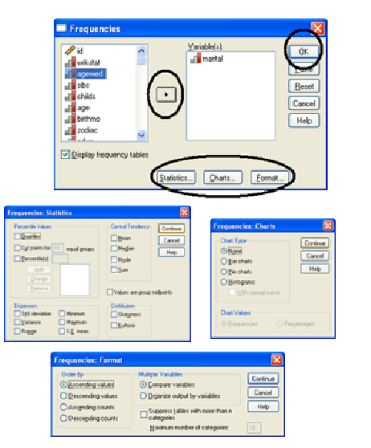
1. The FREQUENCIES Procedure

Slide 4
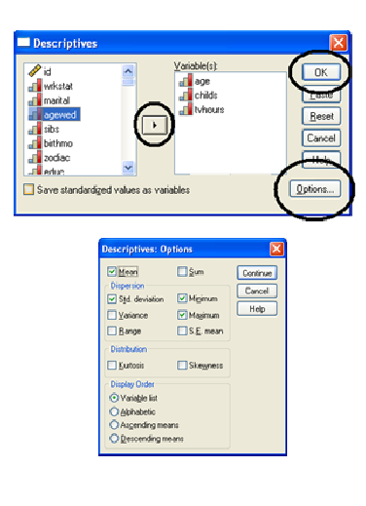
2. The DESCRIPTIVES Procedure

Slide 5
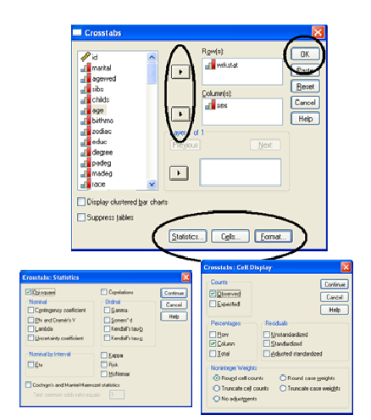
:3. The CROSSTABS Procedure

