Slide 1
Computer Application
2nd Chemistry &Biology Dep.
2022-2023
Lecture 3

Slide 2
SPSS Menus and Icons
Let’s review the menus and icones with the below descriptions.
1. File includes all of the options you typically use in other programs, such as open, save, exit.
Notice, that you can open or create new files of multiple types as illustrated to the right.
2. Edit includes the typical cut, copy, and paste commands, and allows you to specify various options for displaying data and output.
3. View allows you to select which toolbars you want to show, select font size, add or remove the gridlines that separate each piece of data, and to select whether or not to display your raw data or the data labels.
4. Data allows you to select several options ranging from displaying data that is sorted by a specific variable to selecting certain cases for subsequent analyses.

Slide 3
5. Transform includes several options to change current variables. For example, you can change continuous variables to categorical variables, change scores into rank scores, add a constant to variables.
6. Analyze includes all of the commands to carry out statistical analyses and to calculate descriptive statistics. Much of this book will focus on using commands located in this menu.
7. Graphs includes the commands to create various types of graphs including box plots, histograms, line graphs, and bar charts.
8. Utilities allows you to list file information which is a list of all variables, there labels, values, locations in the data file, and type.
9. Add-ons are programs that can be added to the base SPSS package. You probably do not have access to any of those.
10. Window can be used to select which window you want to view (i.e., Data Editor, Output Viewer, or Syntax). Since we have a data file and an output file open, let’s try this.

Slide 4
The Logic of Data Files
Each row typically represents the data from 1 case, whether that be a person, animal, or object. Each column represents a different variable. A cell refers to the juncture of a specific row and column. For example, the first empty cell in the right hand corner would include the data for case 1, variable 1.
Entering Data To enter data, you could simply begin typing information into each cell. If you did so, SPSS would give each column a generic label such as var00001. we want to specify names for our variables. To do this, you can double left click on any column head, this will automatically take you to the Variable View. Alternatively, you can simply click on Variable View on the bottom left hand corner of your screen.

Slide 5
Name,you should keep names short for ease of reading. SPSS also has preferences for variable names.
For example, a number cannot begin a variable name.

Slide 6
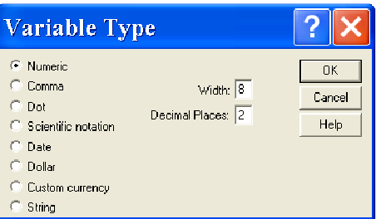
Type of variable: Left click on the empty cell, then left click on the gray box with dots that appears. The dialog box to the right appears. The most commonly used types of data include numeric, date.

Slide 7
Width and Decimals: You could have set this while specifying your variable type, or you can specify them in these columns. The default for width is 8 characters and the default for decimals is 2.
Label: This is a very nice feature that allows you to provide more information about the variable than you could fit in the 8 character variable name.

Slide 8
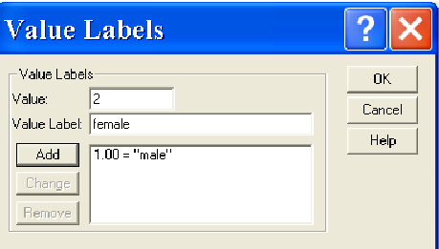
Values: This allows you to assign variable labels. You will typically use this option for categorical variables. For example, we may want the number 1 to represent males and the number 2 to represent females when we enter data on gender.

Slide 9
Editing process: Includes the typical cut, copy, and paste delete rename commands for variables and cases, and allows you to specify various options for displaying data and output.
Inserting &Add a Variable 1. In Variable View, highlight the first row and then click Insert Variable on the Edit menu. This will place a new variable before the selected variable. 2. In Data View, highlight the first variable column and then R.click select the Insert Variable icon . This will also place a new variable column at the beginning of the file.
Insert a Case 1. click on Insert Case on the Edit menu or 2. R.C on case then select insert cases Delete Variable In Variable View, highlight the first row and then click rait then delete(rename) variable.
Inserting & Add Case: the Siam process with highlight the case 3. click on Insert Case on the Edit menu or 4. R.C on case then select insert cases

Slide 10
