Slide 1
Type of Data
Pakhshan A .Hamad

Slide 2
What is Data?
Data is a collection of facts, such as numbers, words, measurements, observations or even just descriptions of things.

Slide 3
Qualitative vs Quantitative
Data can be qualitative or quantitative.
Qualitative data is descriptive information (it describes something)
Quantitative data is numerical information (numbers

Slide 4
Quantitative data
Data can be Discrete or Continuous:
Discrete data can only take certain values (like whole numbers)
Continuous data can take any value (within a range)

Slide 5
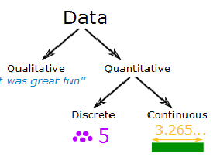

Slide 6
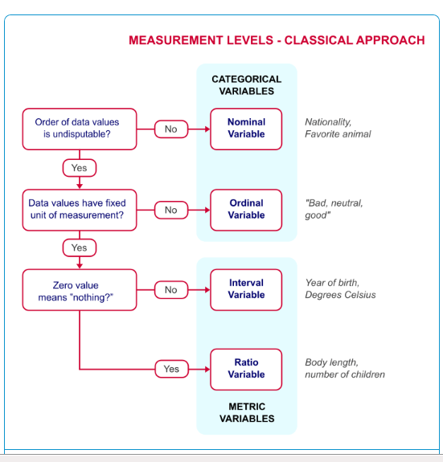

Slide 7
Conclusion
there are total three types of Data namely Nominal, Ordinal, scales (Interval and Ratio.
Nominal - Qualitative variable with out order (only categorisation possible) example : gender, departments.
Ordinal - Qualitative variable with order (categorisation and order) example Rank, credit rating as High risk, medium risk, Low risk .

Slide 8
Scale :
Interval - Quantitative variable without fixed origin.( has fixed distance but no fixed origin) example – temperature.
Ratio - Quantitative variable with fixed origin. all quantitative variables are in this category , salary, expenditure.

Slide 9
Thanks for your attention

