Slide 1
Rangeland management
Second stage
2022

Slide 2
What is Rangeland ?
Rangeland: It is uncultivated land dominated by native plants: grasses, grass-like plants, forbs, or shrubs.
Rangeland management: the science and art of obtaining maximum livestock production from rangeland with conserving land resources (plants, animals, soil and water).

Slide 3
Tools of Rangeland Management
Fences
Number of livestock
Species of livestock
Weed control
Fire

Slide 4
What is rangeland good for?
Livestock production
Wildlife habitat
Water
Native plant products
Recreation
Open space

Slide 5
Types of Rangeland Plants
Grasses
Grass-like
Forbs
Shrubs

Slide 6
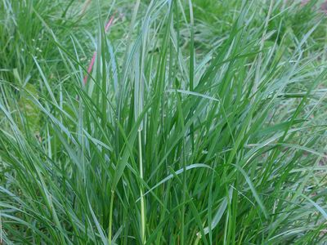
Grasses:
Cover more than 1/5th of the earth’s land surface
Jointed stems.
Stems are hollow between the joints (nodes)
Leaves are in 2 rows along the stem
Veins in the leaves are parallel

Slide 7
Stages of grass growth
Vegetative
Growth of leaves
Elongation
Lengthening of stem internodes, also called jointing
Boot stage is the end of elongation
Reproductive
Development of seedhead and seed

Slide 8
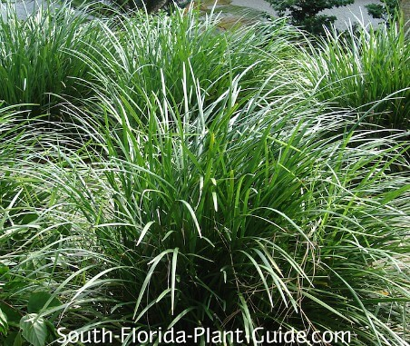
Grass-like Plants
Look like grasses but have solid stems without joints
Stems are often triangular
Veins in the leaves are parallel
Includes sedges

Slide 9
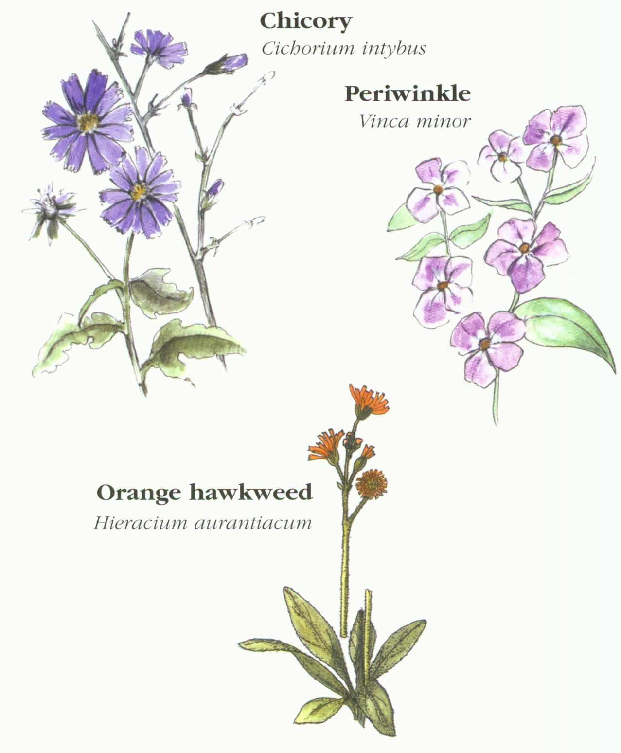
Forbs:
Herbaceous plants
Broad leaves and showy flowers
Above-ground growth dies back each year
Veins in the leaves are net veins
although some forbs have veins that are parallel

Slide 10
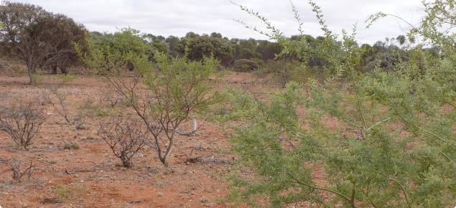
Shrubs:
Woody plants with several main stems, usually have broad leaves

Slide 11
Plants categorize according to:
growth form
life span
season of growth
origin
forage value

Slide 12
Life Span:
Length of time from the beginning of development to death of the plant
Annuals – live for one growing season
Winter annuals
Summer annuals
Biennials – live for two growing seasons
Perennials – live from one year to the next

Slide 13
Winter Annuals

Slide 14
Summer Annuals

Slide 15
Biennials

Slide 16
Perennials:

Slide 17
Seasons of Growth
Cool Season
Make most growth in cool weather of spring and fall
Flower mostly in early summer
Provide spring/fall forage at lower elevations and summer forage at high elevations
Adapted to cool, wet conditions

Slide 18
Warm Season
Make most growth in warm summer periods
Flower from mid-summer to early fall
Provide forage in summer months
Adapted to hotter, drier conditions.

Slide 19
Forage Value: How well a plant provides nutrients to grazing animals
High – plants that are nutritious, palatable, and produce abundant forage
Medium – plants that provide adequate nutrition if eaten
Low – plants that do not provide adequate nutrients
Poisonous - contain natural plant compounds that are toxic or poisonous to herbivores

Slide 20
Thanks for your attention

