Slide 1
Watershed management Hydrologic cycle
Lec. 2
3rd stage
2022/2023
Lecturer: Payman H. Aliehsan

Slide 2
The Hydrological Cycle
It is started by heating of the sea surface causes evaporation, the transfer of water from the liquid to the gaseous state, to form part of the atmosphere. It remains mainly unseen in atmospheric storage for an average of 10 days.
Through a combination of circumstances, the water vapour changes back to the liquid state again through the process of condensation to form clouds and, with favourable atmospheric conditions, precipitation (rain or snow) is produced either to return directly to the ocean storage or to embark on a more devious route to the oceans via the land surface.

Slide 3
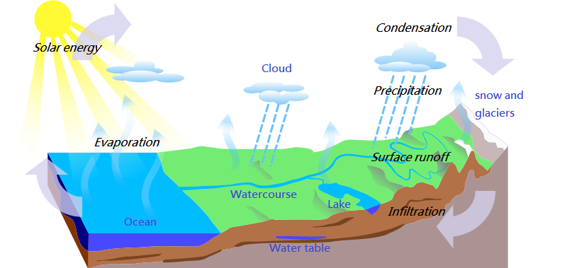
Hydrologic Cycle

Slide 4
Water resources:
Where is the water coming from?
Freshwater is accounting glaciers and ice caps, groundwater and surface water, inclusive other freshwater. The global freshwater available (where we have direct access to) is ice & snow, from lakes, soil moisture, swamps, rivers, biological water and atmospheric water

Slide 5
Surface water versus ground water

Slide 6
Surface water
falls directly into an upland lake, becoming surface water.
After some days it evaporates back to the local atmosphere and falls again as rain, but this time e.g. on permeable ground where it infiltrates to become groundwater.
If flows underground in an aquifer for more for several years and discharge eventually as a lowland spring.
It thus becomes surface water again, part of a stream and river system, which some days or month later reaches the sea.
If not infiltrating it becomes directly surface water. It is a part of a lake, stream or river system and reaches some days or month later the ocean

Slide 7
Ground water
infiltrates the soil, reaches the water-table and becomes groundwater.
After years in underground it is pumped from a water-well and used for potable supply.
It is then discharge as sewage effluent to a river, becoming surface water perched above the local watertable, which seeps through its bed to recharge the underlying aquifer.
The raindrop then joins the groundwater flow in aquifers and discharges directly to the sea.

Slide 8
How do we get access to water?
Access to potable and safe drinking water is not related to environmental and climatologic conditions. Other aspects, like water management structures or peoples way of living are more important.
Wars play an extraordinary role to water management, since infrastructure and governmental structures (regulatory authorities) are often destroyed and dismissed.

Slide 9
Water demand
The supply of wholesome water to a resident population is dependent on
population size
rate of consumption.
Additionally, there is the provision of water to industry according to its various needs, and for agricultural purposes of which irrigation is seasonal and weather dependent.
Some of the largest users of water are electricity generating stations for cooling

Slide 10
The primary functions of the watershed are:
Capture
Filtration
Storage
Conveyance

Slide 11
• CAPTURE
Any depression is an obvious place to capture precipitation. Ponds and wetlands are the most obvious examples of natural structures whose purpose is to capture and hold precipitation for long periods.
• FILTRATION
Undisturbed forest or field offers vast surface area to allow rain or snowmelt to soak down into the soil. Some of it will filter all the way down to aquifers for storage, some will stay near the surface and show as streams or wetlands. Both the soils and the roots of plants are the filtering media that clean the water.

Slide 12
STORAGE
The deepest storage receptacles are underground aquifers, porous stone sponges that receive and hold water that has been filtered by many layers of soils. Surface storage sites are wetlands, lakes and ponds.

Slide 13
CONVEYANCE
Overall, the function of a watershed is to move water to where it is needed in order to support life. The topography that shapes the land is not just a canvas on which the watershed is drawn, it determines where the storage areas are, and where the streams run, and where the swales need to be to direct water to the stream.
The smallest depression will move water either toward a storage area or toward the main stream. Eventually, whatever doesn’t get stored gets transferred to ever larger streams, rivers, and the ultimate destination, a lake or ocean.
The evaporation of water off the surface, and the transpiration of it through the exhalation of plants conveys water to the air to become precipitation, falling to earth once more and fulfilling the water cycle

Slide 14
methodology for development of a watershed management
drafted map showing the watershed management area, major tributaries and water bodies and the challenges occurring in the catchment.
a situation analysis showing the causes, problems, impacts, location and current intervention for each kind of management relevant problem.
a management option matrix showing the problem, intervention and activities, indicators, time frame, means of verification, and responsibilities.
a financial plan for implementation of single actions

Slide 15
How can we protect the resources in WS?
Conserve water every day. Take shorter showers, fix leaks & turn off the water when not in use.
Don’t pour toxic household chemicals down the drain; take them to a hazardous waste center.
Use hardy plants that require little or no watering, fertilizers or pesticides in your yard.
Do not over apply fertilizers. Consider using organic or slow release fertilizers instead.
Recycle yard waste in a compost pile & use a mulching mower.
Use surfaces like wood, brick or gravel for decks & walkways, which allows rain to soak in and not run off.
Never pour used oil or antifreeze into the storm drain or the street.
Drive less—walk or bike; many pollutants in our waters come from car exhaust and car leaks.

