Slide 1
Linear Algebra
Second Stage
Dr.Payman Abbas

Slide 2
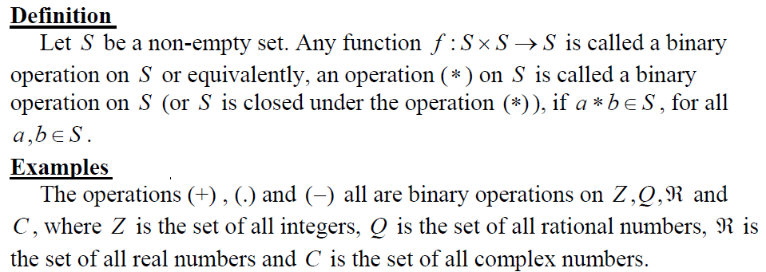

Slide 3
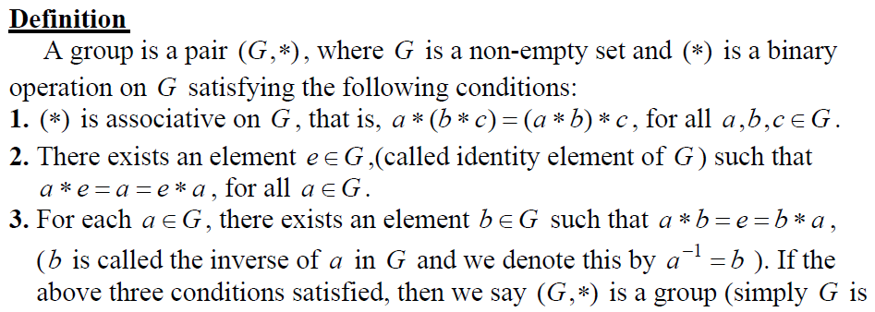

Slide 4
Examples

Slide 5
Field
Let *,ο are two binary operations on S, then (S,*,ο) is called a field if satisfy the following conditions:
(S,*)is an abelian group.
(S-{e},ο ) is an abelian group, where e is an identity element of a binary operation *.
Distributive Law: aο (b*c)=(aοb)*(aοc) for all a,b & c belong to S.
Example:
(R,+,.) & (C,+,.) are fields

Slide 6
Vectors Vector : Is a quantity that has both magnitude and direction but not position. Examples of such quantities are velocity and acceleration.
In their modern form, vectors appeared late in the 19th century when Josiah Willard Gibbs and Oliver Heaviside (of the United States and Britain, respectively) independently developed vector analysis to express the new laws of electromagnetism discovered by the Scottish physicist James Clerk Maxwell. Since that time, vectors have become essential in physics, mechanics, electrical engineering, and other sciences to describe forces mathematically.

Slide 7
Or; Vectors are geometrical entities that have magnitude and direction. A vector can be represented by a line with an arrow pointing towards its direction and its length represents the magnitude of the vector. Therefore, vectors are represented by arrows, they have initial points and terminal points.
A vector is a Latin word that means carrier. Vectors carry a point A to point B. The length of the line between the two points A and B is called the magnitude of the vector and the direction of the displacement of point A to point B is called the direction of the vector AB. Vectors are also called Euclidean vectors or Spatial vectors.

Slide 8
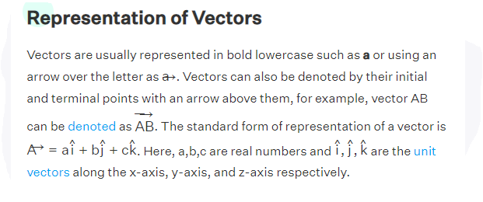
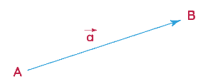

Slide 9
Definition: A vector
Is an arrow starting at A and finishing at B denoted by AB
(1) Properties of Addition:
∀ v, w, u ∈ V
v + w = w + v ( Commutativity )
( v + w ) + u = v + ( w + u ) ( Associativity )
v + 0 = v = 0 + v ( Zero element )
(2) Properties of scalar multiplication :
∀ v, w ∈ V and a, b ∈ R,[ R is the real number field (R,+,.) ]
( a + b ) v = a v + b v ( Distributivity )
a ( v + w ) = a v + a w
( a b ) v = a ( b v ) = a b v ( Associativity )
1 v = v , 0P=0
P + (-1)P =0

Slide 10
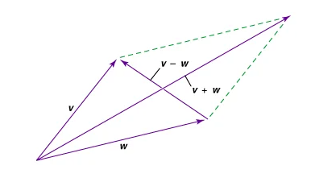
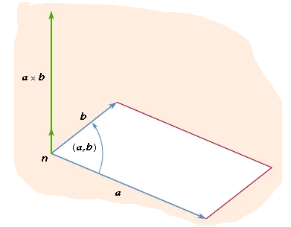
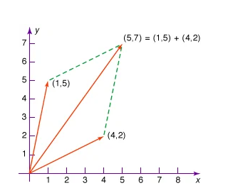

Slide 11
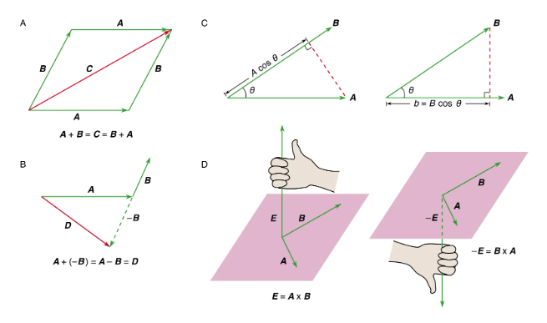
vector mathematics
Figure 1: (A) The vector sum C = A + B = B + A. (B) The vector difference A + (−B) = A − B = D. (C, left) A cos θ is the component of A along B and (right) B cos θ is the component of B along A. (D, left) The right-hand rule used to find the direction of E = A × B and (right) the right-hand rule used to find the direction of −E = B × A.

