Slide 1
Connected Graphs
Two vertices u and v in a graph G are connected if G contains a u − v path. The graph G itself is connected if every two vertices of G are connected. By Theorem 2.1, a graph G is connected if G contains a u − v walk for every two vertices u and v of G. A graph G that is not connected is a disconnected graph. The graph F of Figure 9 is connected since F contains a u − v path (and a u − v walk) for every two vertices u and v in F. On the other hand, the graph H is disconnected since, for example, H contains no y4 − y5 path.

Slide 2
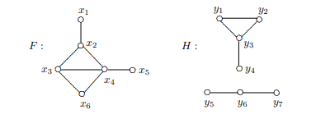
Figure 9: A connected graph and disconnected graph
A connected subgraph H of a graph G is a component of G if H is not a proper subgraph of any connected subgraph of G. Thus, every component of G is an induced subgraph of G. The number of components in a graph G.
is denoted by k(G). Therefore, G is connected if and only if k(G) = 1.

Slide 3
Figure 10: A (k − 1)-regular disconnected graph of order n = 2k
Theorem 2.3 If G is a nontrivial graph of order n such that deg u + deg v ≥ n − 1 for every two nonadjacent vertices u and v of G, then G is connected. Proof. Let x and y be distinct vertices of G. We show that G contains an x−y path. This is obvious if x and y are adjacent, so suppose that x and y are not adjacent. Since deg x + deg y ≥ n − 1, there is a vertex z that is adjacent to both x and y. Therefore, (x, z, y) is an x − y path and so G is connected. The graph H in Figure 10 shows that the lower bound n−1 in Theorem 2.3 cannot be replaced by n − 2.

