Slide 1
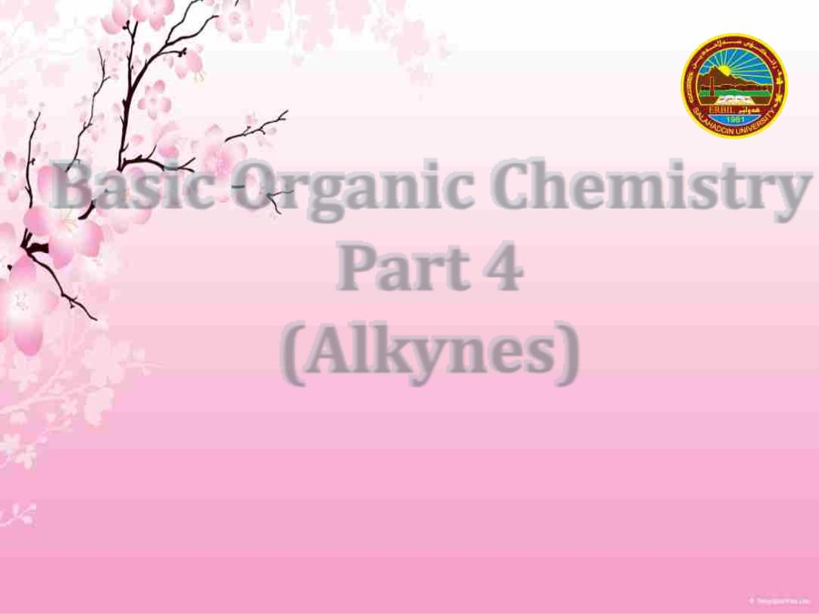
Basic Organic Chemistry
Part 4
(Alkynes)
For First Stage Chemistry Students
2022-2023
Dr Peshawa Osw

Slide 2
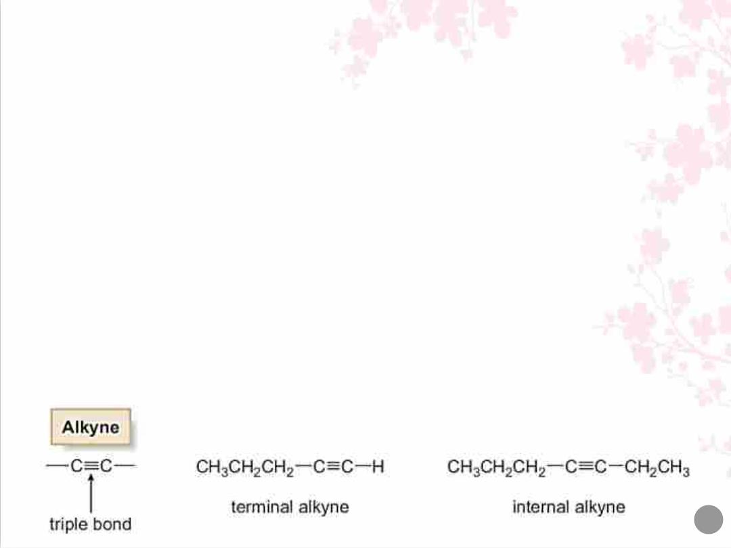
Alkynes
• Alkynes are compounds that contain a carbon–carbon triple bond.
• Molecular formula C H (where n = 2, 3, 4,…)
n
2n-2
• Because every degree of unsaturation removes two hydrogens, a
triple bond introduces two degrees of unsaturation.
• Terminal alkynes has the triple bond at the end of the carbon
chain, so that a hydrogen atom is directly bonded to a carbon atom
of the triple bond. .
• Internal alkynes has a carbon atom bonded to each carbon atom of
the triple bond.
2

Slide 3

• The simplest alkyne, H–C≡C–H, named in the IUPAC system as
ethyne, is more often called acetylene, its common name.
• The two-carbon alkyl group derived from acetylene is called an
ethynyl group (H–C≡C–).
• Acetylene, is a colourless gas with an ethereal odour that burns in
oxygen to form CO and H O. Because the combustion of acetylene
2
2
releases more energy per mole of product formed than other
hydrocarbons, it burns with a very hot flame, making it an excellent
fuel for welding torches.
3

Slide 4
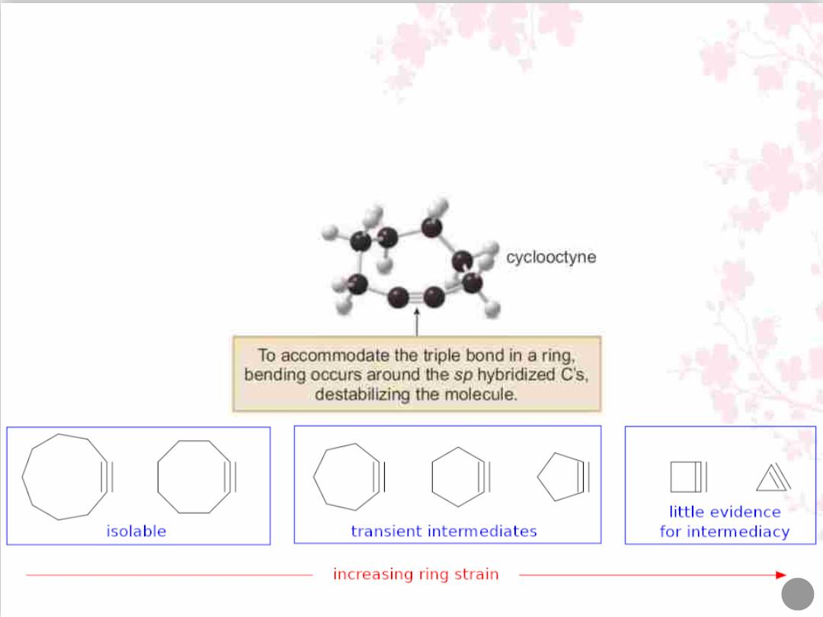
• Like trans cycloalkenes, cycloalkynes with small rings are unstable.
• The carbon chain must be long enough to connect the two ends of the
triple bond without introducing too much strain.
• Cyclooctyne is the smallest isolated cycloalkyne, though it decomposes
upon standing at room temperature after a short time.
4

Slide 5
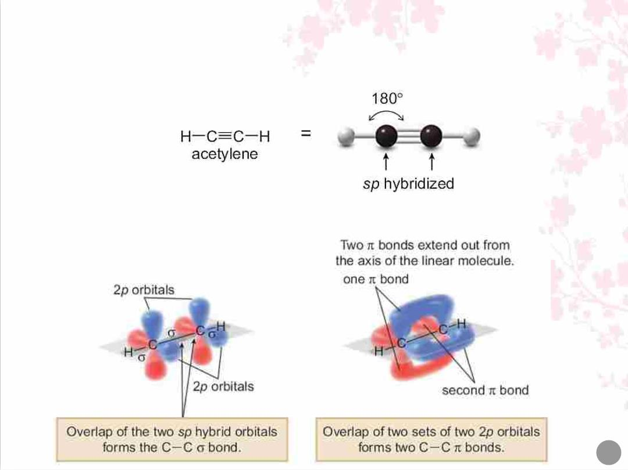
Structure of Alkynes
• Each carbon of a triple bond is sp hybridized and linear, and all bond
angles are 180°.
• The triple bond of an alkyne consists of one σ bond and two π bonds.
5

Slide 6

Nomenclature of alkynes using IUPAC system
• Alkynes are named in the same way that alkenes were named.
• In the IUPAC system, change the -ane ending of the parent alkane
to the suffix -yne.
• Choose the longest carbon chain that contains both atoms of the
triple bond and number the chain to give the triple bond the lower
number.
• Compounds with two triple bonds are named as diynes, those with
three are named as triynes, and so forth.
• Compounds with both a double and a triple bond are named as
enynes. The chain is numbered to give the first site of unsaturation
(either C=C or C≡C) the lower number.
6

Slide 7
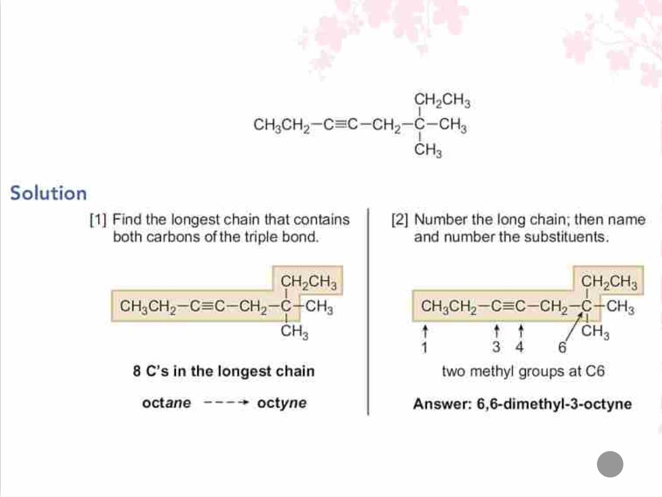
Q/ Give the IUPAC name for the following alkyne:
7

Slide 8
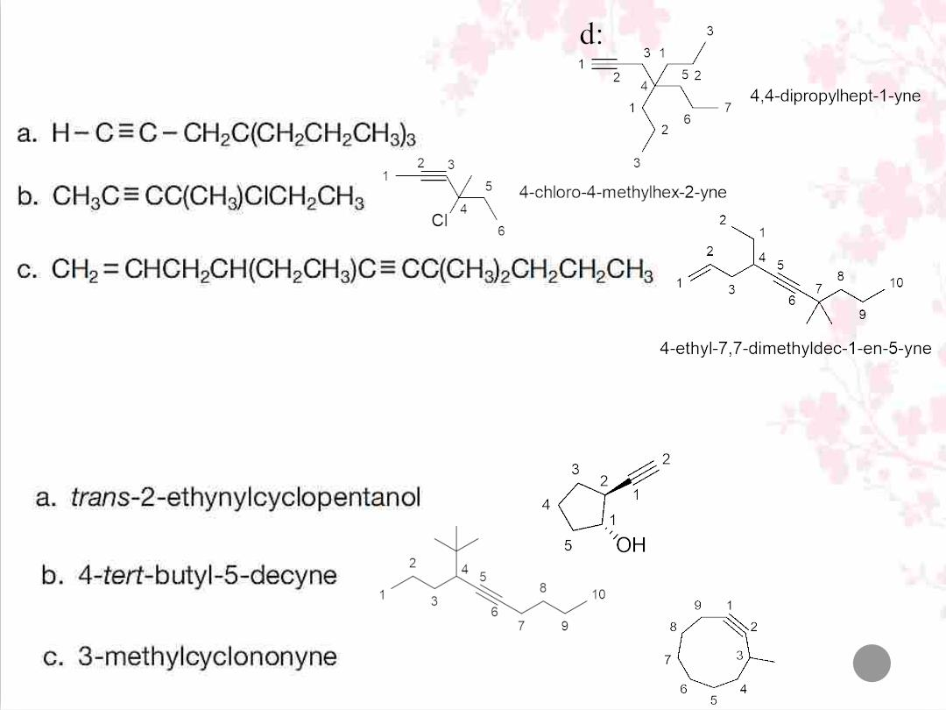
Q/ Give the IUPAC name for each compoun
Q/ Give the structure corresponding to each of the following names:
8

Slide 9
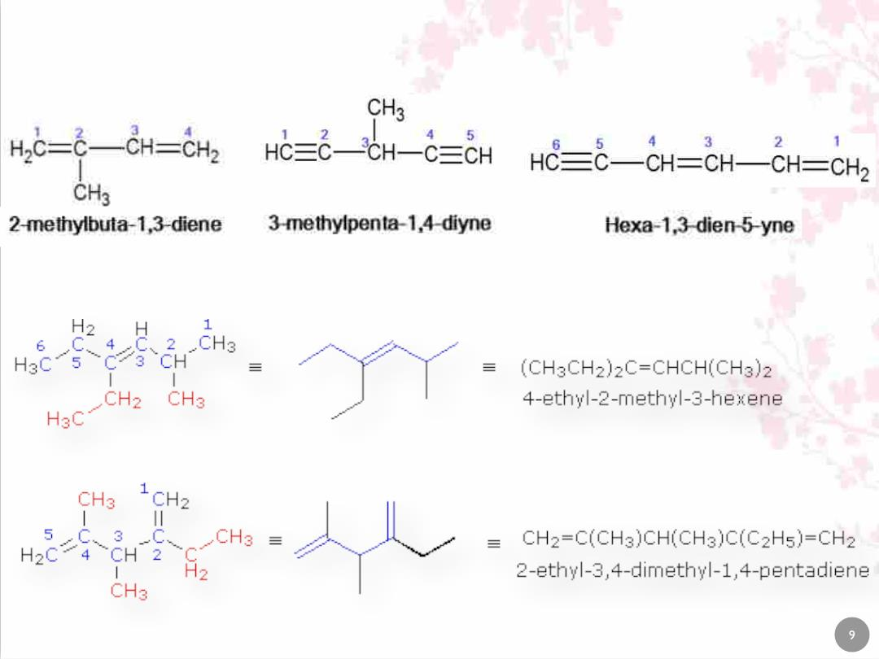
Naming of Multiple Bonds

Slide 10
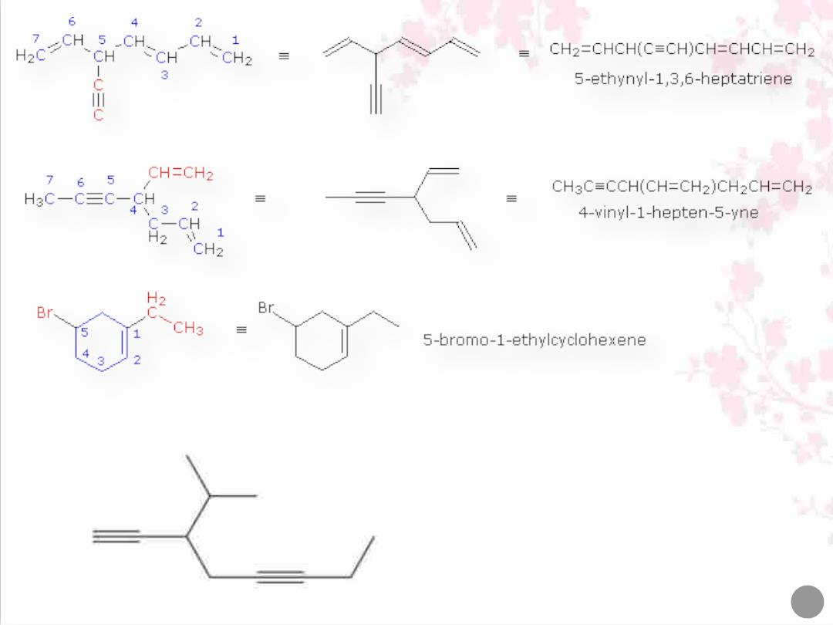
10

Slide 11
Physical properties of Alkynes
• The physical properties of alkynes resemble those of hydrocarbons
having a similar shape and molecular weight.
ü Alkynes have low melting points and boiling points.
ü Melting points and boiling points increase as the number of
carbons increases.
ü Alkynes are soluble in organic solvents and insoluble in water.
Q/ Explain why an alkyne often has a slightly higher boiling
point than an alkene of similar molecular weight.
Because the triple bonds concentrate more electron density, making
alkynes more polarizable and increasing the intensity of the London
Dispersion forces (more polarizable electrons means easier to form
temporary dipoles).
11

Slide 12
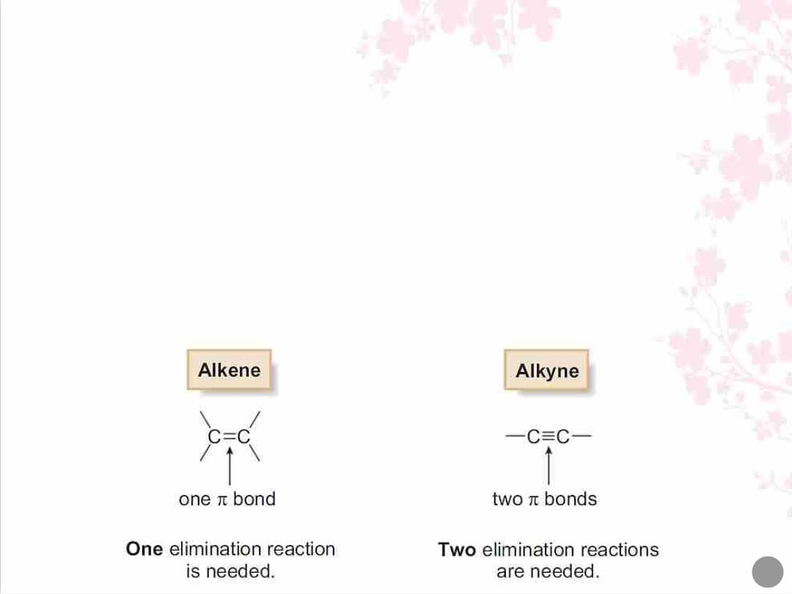
Preparation of alkynes via double dehydrohalogenation
of dihalides (double elimination):
• A single elimination reaction produces the π bond of an alkene.
• Two consecutive elimination reactions produce the two π bonds of
an alkyne.
• Alkynes are prepared by two successive dehydrohalogenation
reactions.
12

Slide 13
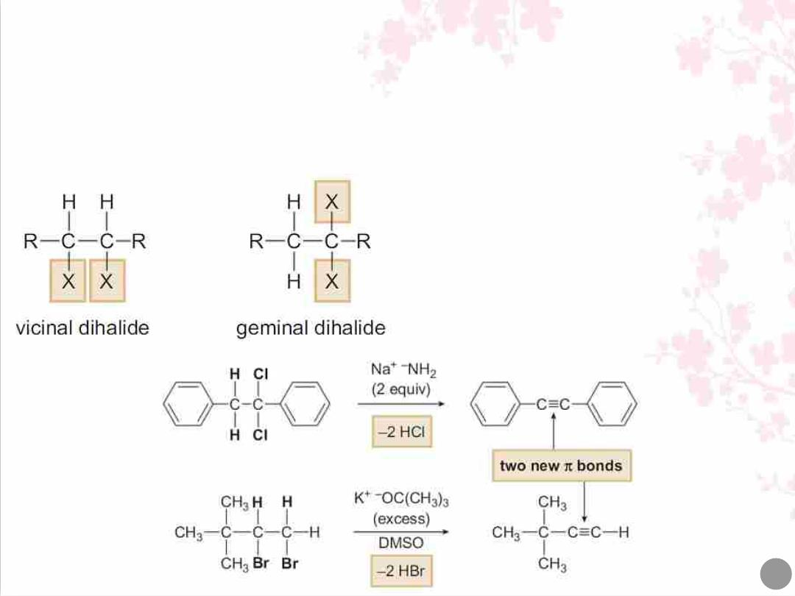
• Two elimination reactions are needed to remove two moles of HX from a
dihalide as substrate.
• Two different starting materials can be used.
• Two equivalents of strong base are used and each step follows an E2
mechanism.
• A vicinal dihalide has two X atoms
on adjacent carbon atoms.
• A geminal dihalide has two X atoms
on the same carbon atom.
13

Slide 14
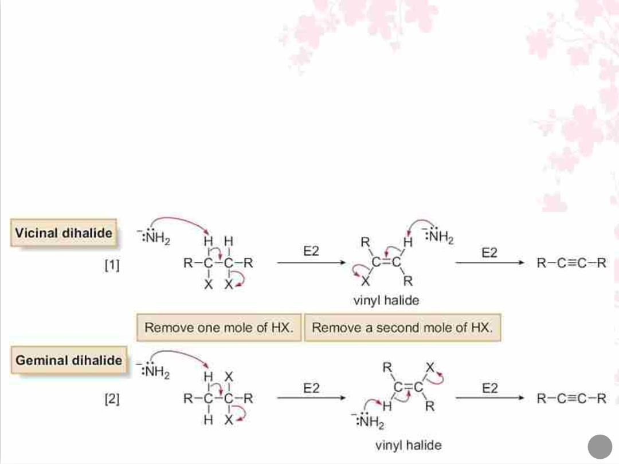
• Stronger bases are needed to synthesize alkynes by dehydrohalogenation
than are needed to synthesize alkenes.
• The typical base is amide (‾NH ), used as the sodium salt NaNH (sodium
2
2
amide). KOC(CH ) can also be used with DMSO as solvent.
3 3
• Because DMSO is a polar aprotic solvent, the anionic base is not well
solvated, thus increasing its basicity and making it strong enough to remove
two equivalents of HX.
14

Slide 15
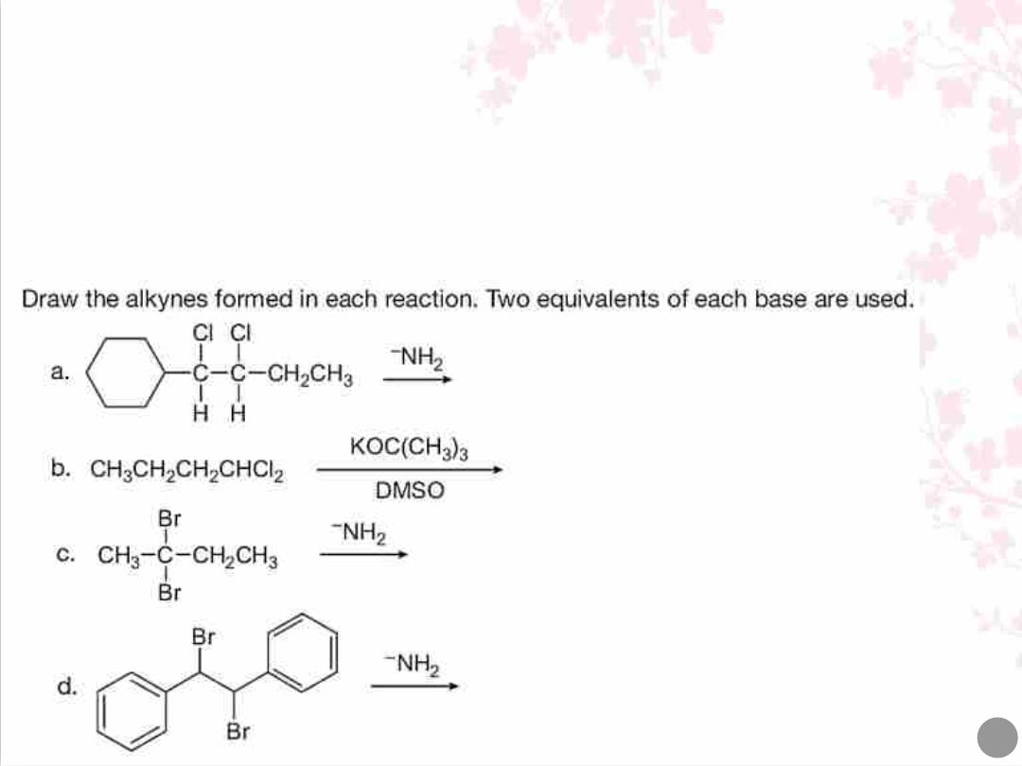
• The strongly basic conditions needed for alkyne synthesis result from the
difficulty of removing the second equivalent of HX from the intermediate
vinyl halide, RCH=C(R)X.
• Since H and X are both bonded to sp² hybridized carbons, these bonds are
shorter and stronger than the sp³ hybridized C–H and C–X bonds of an alkyl
halide, necessitating the use of a stronger base.
15

Slide 16
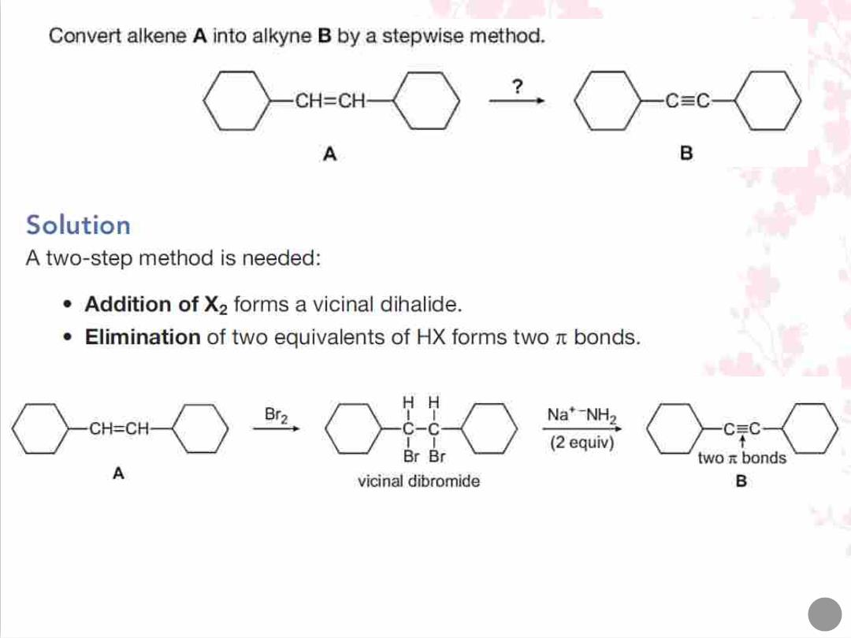
16

Slide 17
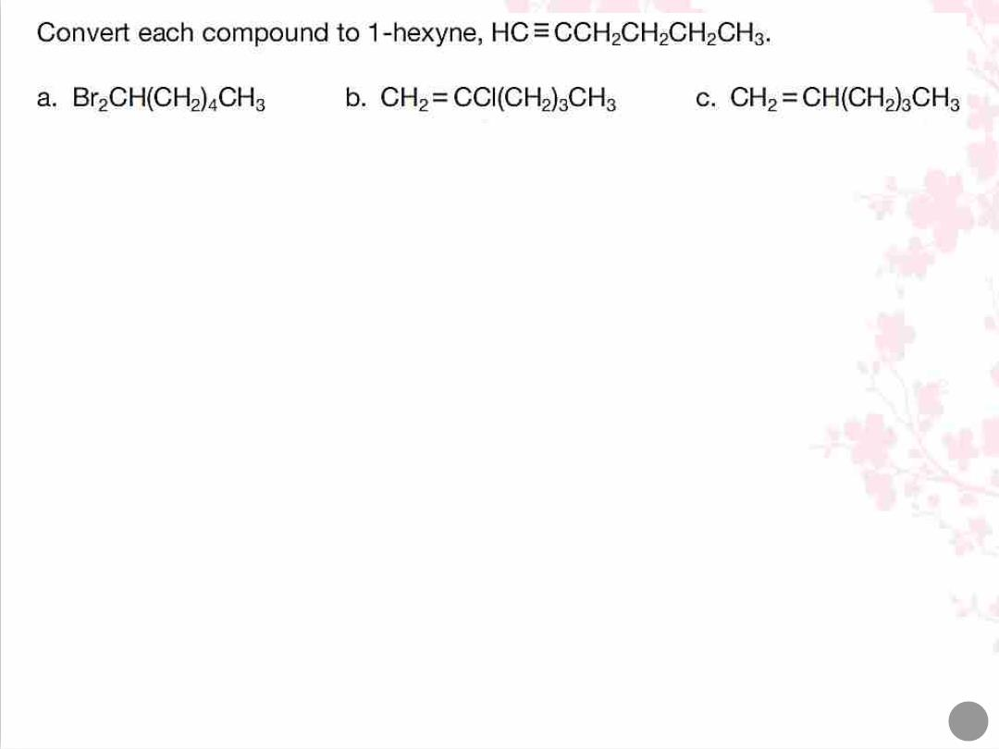
17

Slide 18
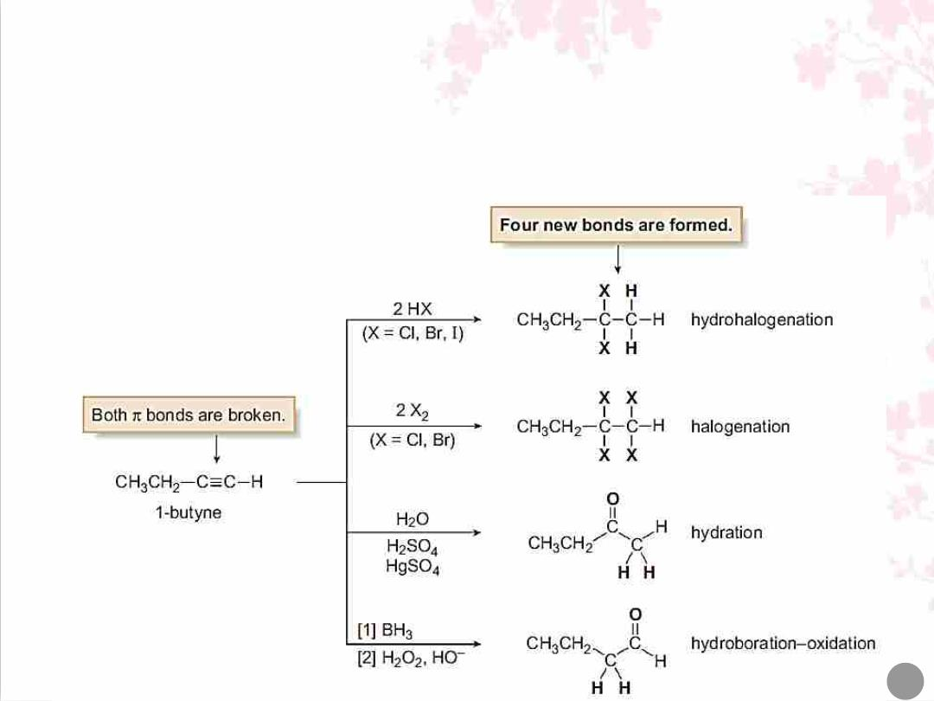
Reactions of Alkynes
• Both π bonds of a C–C triple bond are weaker than a C–C σ bond, making
them much more easily broken. As a result, alkynes undergo many addition
reactions.
• Alkynes are more polarizable than alkenes because the electrons in their π
bonds are more loosely held.
18

Slide 19
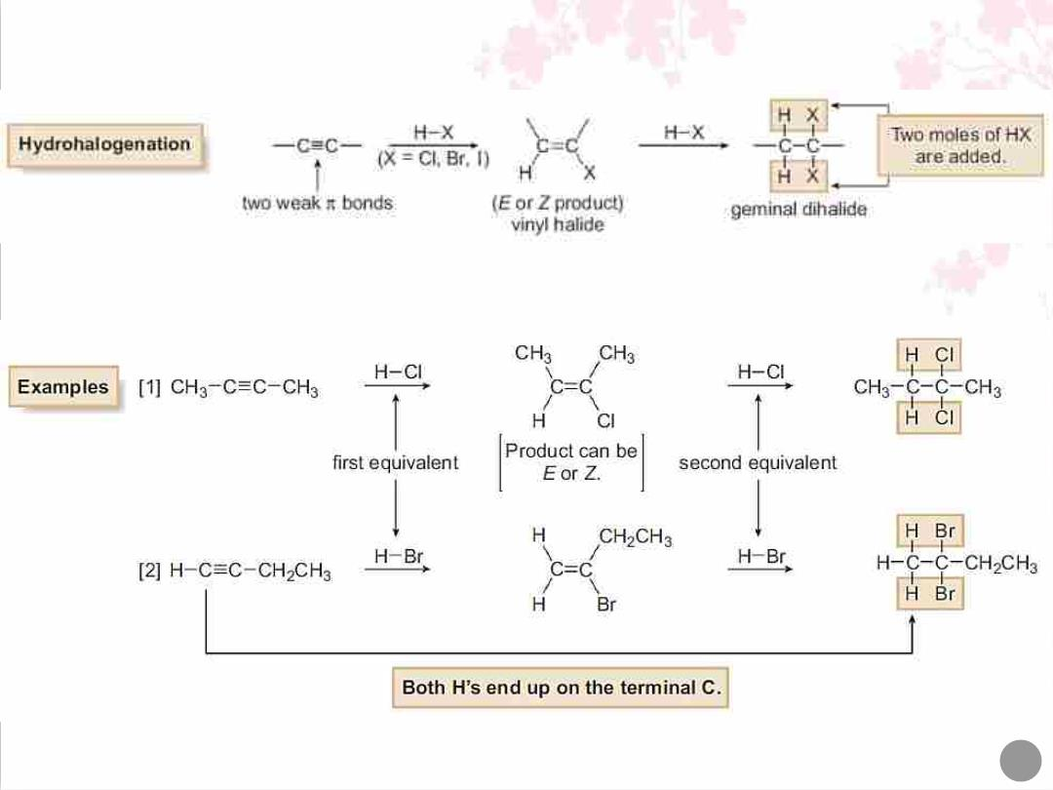
1. Hydrohalogenation (Addition of HX): :
19

Slide 20
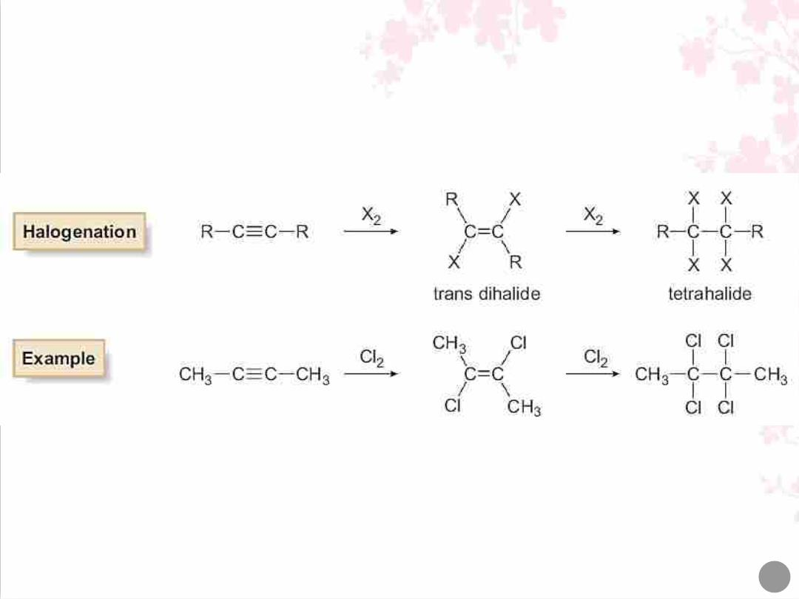
2. Hydrogenation (Addition of X₂):
20

Slide 21
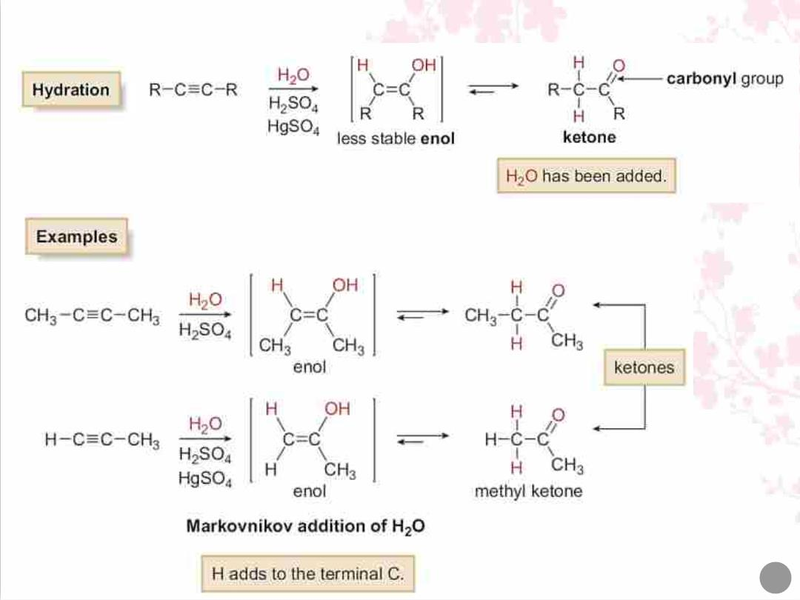
3. Hydration (Addition of water):
21

Slide 22
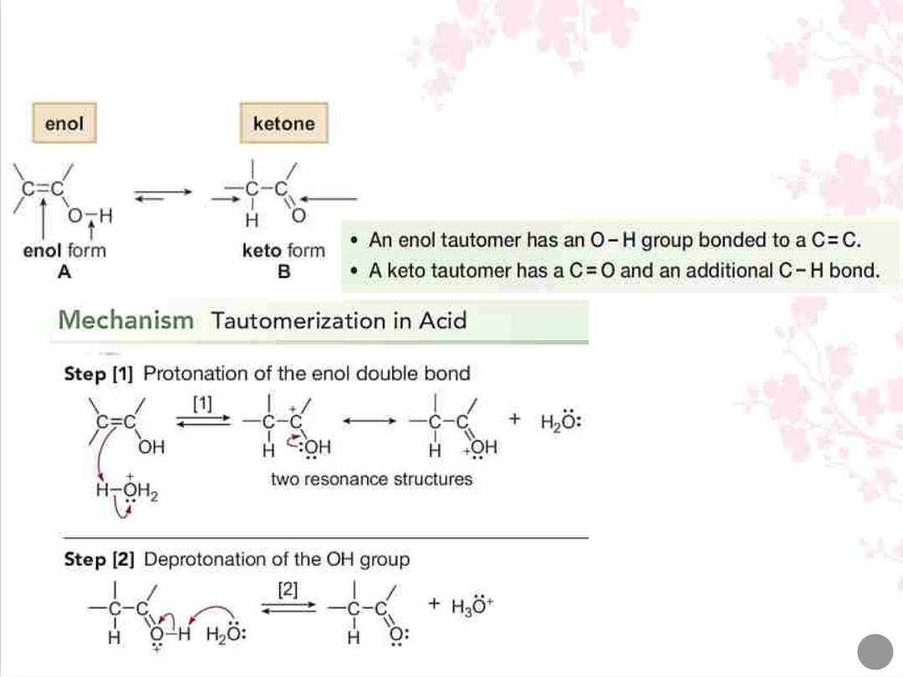
Tautomers are constitutional isomers that differ in the location of a double
bond and a hydrogen atom. Two tautomers are in equilibrium with each other.
22

Slide 23
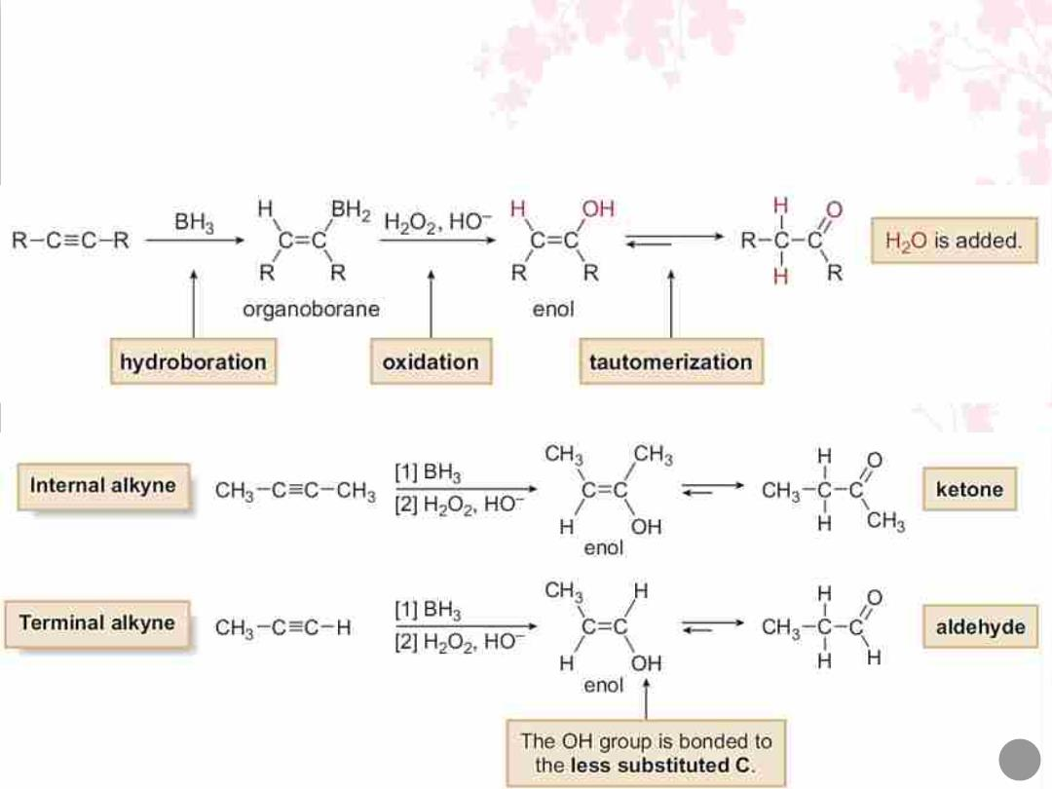
4. Hydroboration–Oxidation (Addition of H₂O):
Hydroboration–oxidation is a two-step reaction sequence that converts an
alkyne to a carbonyl compound.
23

Slide 24
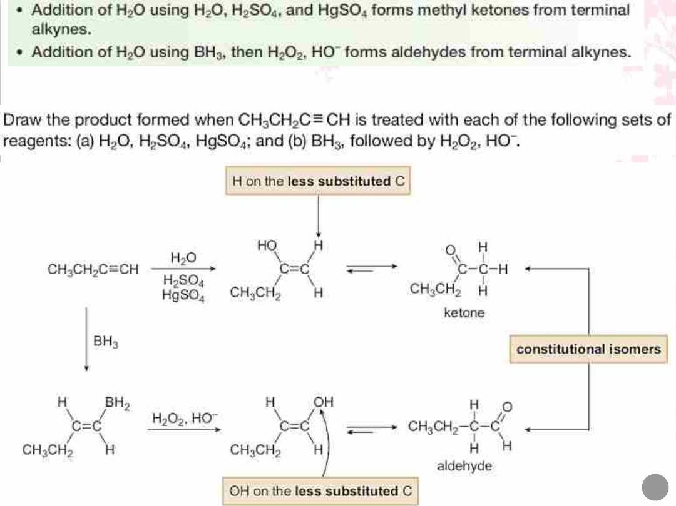
Q/
Solution
24

Slide 25
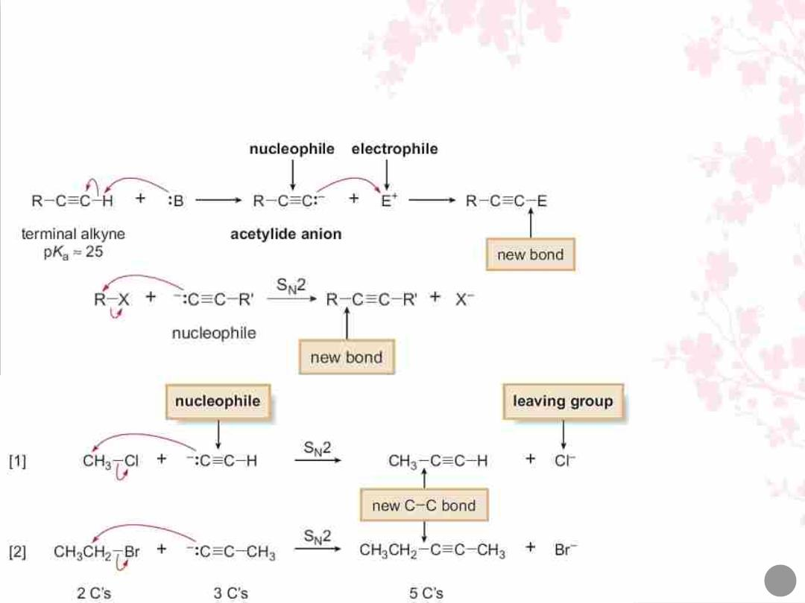
Reaction of Acetylide Anions:
Terminal alkynes are readily converted to acetylide anions with strong bases
such as NaNH₂ and NaH. These anions are strong nucleophiles, capable of
reacting with electrophiles such as alkyl halides and epoxides.
25

Slide 26
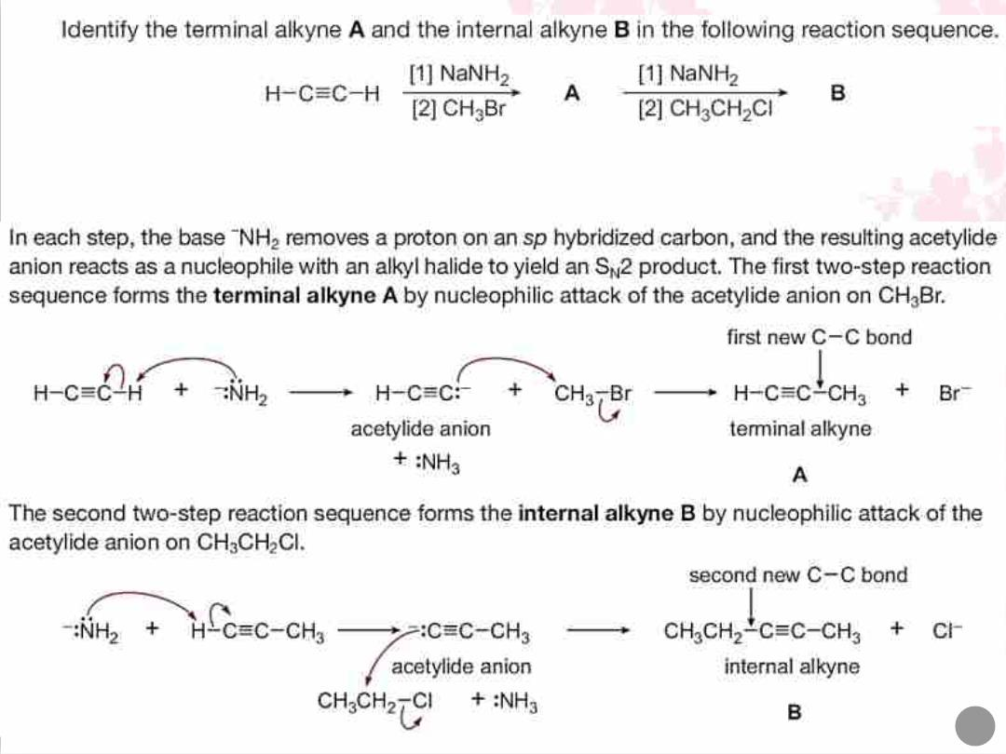
Q/
Solution
26

