Slide 1
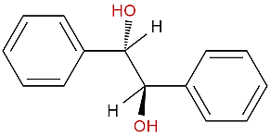
Experiment ( 4 ) Reduction of Benzil to Hydrobenzoin Using Sodium Borohydride
Salahaddin University – Erbil
College of Science
Chemistry Department
Practical Organic chemistry
3rd Stage
2022-2023
Prepared by: Peshawa Osw, PhD.

Slide 2
The reduction of a carbonyl group found in an aldehyde or ketone to an alcohol.
The reaction requires two steps.
In Step 1, Na⁺ and H⁻ add to the carbonyl to make an intermediate salt.
In the workup of Step 2, the salt is converted into an alcohol by protonation of the negative oxygen. The proton of Step 2 normally comes from a mineral acid such as HCl.

Slide 3
Reduction involves the loss of oxygen and/or the addition of hydrogen atoms.
Three common reducing agents are lithium hydride (LiH), lithium aluminium hydride (LiAlH4) and sodium borohydride (NaBH4).
Notice that all three contain hydrogen in a negative or hydride form. A hydride ion, H⁻, is a nucleophile that readily adds to a carbonyl carbon, which is positive relative to the oxygen of the double bond.
These three reducing agents all contain a metal; therefore, the intermediate product of the reaction is an ionic salt, which must be acidified to obtain the final organic covalent product.
The simplified mechanism for the reduction of a carbonyl group by a hydride ion, H⁻, which comes from NaBH4 is shown below:

Slide 4
The overall reduction of a carbonyl group to a hydroxyl group involves the addition of two H atoms. The first H atom comes from a hydride (H-), of NaBH₄. The second comes from the workup of the reaction, which is normally conducted in aqueous acid.
Sodium borohydride, NaBH4, is the mildest of the three hydride reagents and is easy to use in the lab, because it is soluble in water, methanol and ethanol and does not react with these solvents. Therefore, NaBH4 is the reagent of choice for reducing aldehydes and ketones.
Lithium aluminium hydride (LiAlH4), is a stronger reducing agent than NaBH4, and LiAlH4 is used to reduce carboxylic acids, epoxides, esters, lactones, nitro groups, nitriles, azides, amides and acid chlorides.
Lithium hydride (LiH), is a weak reduction agent. For example, LiH deprotonates an alcohol to make a lithium alkoxide and hydrogen gas.

Slide 5
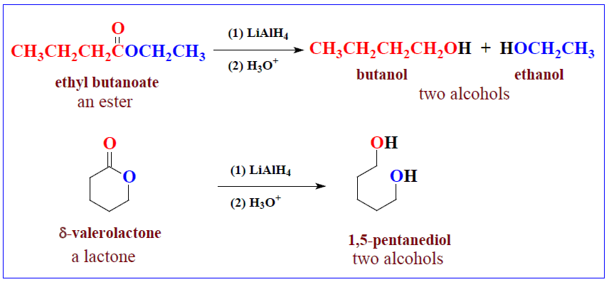
The following figure shows reduction reactions that require LiAlH₄; each requires an acidification step to convert the initially formed salt into a covalent organic compound.
When two steps are shown on one reaction arrow, they are shown in parenthesis [i.e., (1) and (2)].

Slide 6
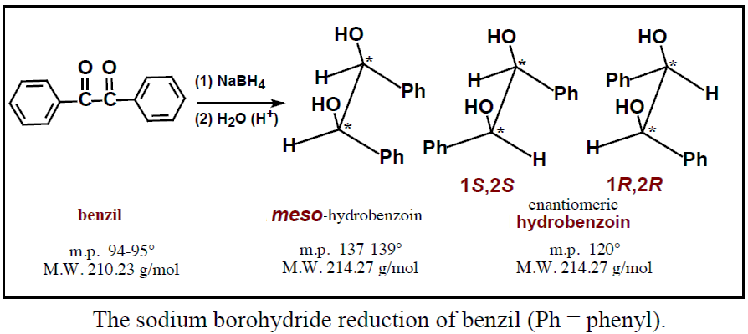
The Experiment
In this experiment, the diketone known by the common name benzil is the organic substrate.
Sodium borohydride reduces both carbonyl groups in benzil, and acidification produces a diol or two secondary alcohols.

Slide 7
The product of the reaction contains two chirality centres shown by asterisks (*). The maximum number of stereoisomers for a compound with two chirality centres is four (2²). However, when the two centres contain the exact same four groups, a meso form is possible, and the total number of stereoisomers is three.
Thus, the reduction of benzil produces two chirality centres but only three stereoisomers. Though all three stereoisomers are produced, the meso form is the major product of this reduction reaction, as shown previously.
The melting point of your product should give you some indication as to which isomer(s) are formed.
Benzil is a yellow solid and hydrobenzoin is white; therefore, the reduction reaction is evident by the colour change. Reduction of an aldehyde or ketone carbonyl group with NaBH₄ is a general, two-step, reaction that is frequently seen in reaction schemes on standardized examinations.

Slide 8
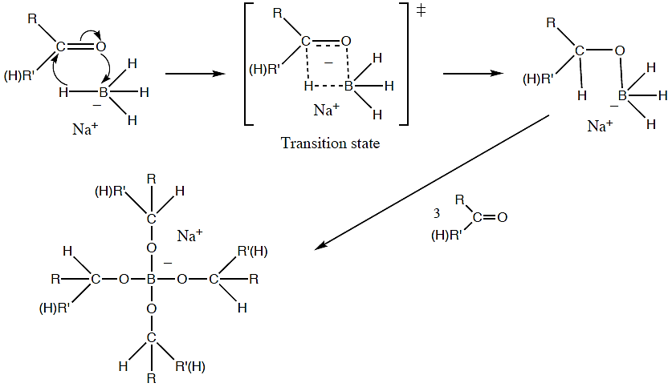
The mechanism for the reduction of a carbonyl group using NaBH₄

Slide 9
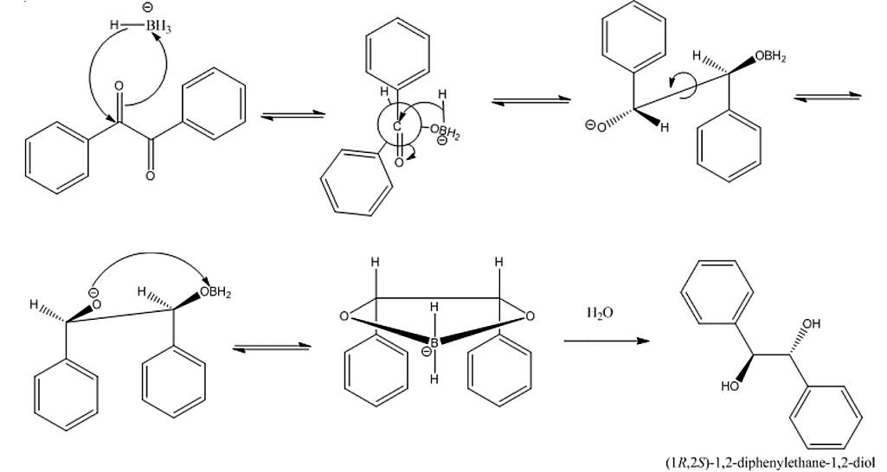
The stereospecific reaction mechanism for the reduction of benzil using NaBH₄

Slide 10
Procedure
Place 0.5 g of benzil (yellow solid) in a 50 mL Erlenmeyer flask and add 5 mL of 95% ethanol.
Swirl the flask and cool under running water to produce a fine suspension.
Add 0.1 g of sodium borohydride and gently swirl the Erlenmeyer flask until the benzil dissolves.
Allow the solution to sit for 10 minutes (the solution should clear and the yellow colour should fade in 2-3 minutes).
Add 5 mL of water and heat to the boiling point on a steam bath. If the solution is not clear at this point, filter it by gravity (hot) through fluted filter paper. (For this step, if necessary also add 6M HCl (0.3 mL)).
Cool the mixture in an ice-water bath, then add water (10 mL) to the solution and set it aside to crystallize.
Collect the crystals (mp 136-137 ºC) by vacuum filtration on a Bűckner or Hirsch funnel, then dry and weigh the product.
Calculate the yield% for the product.

Slide 11
Question
Why do reduction reactions of aldehydes and ketones with NaBH₄ and LiAlH₄ require an acidification step?
Show structures in the sawhorse projection for all stereochemical products for the reduction of the diketone shown below.
3. What term describes the stereochemical relationship between (1R,2R)-hydrobenzoin and (1S,2S)-hydrobenzoin? _____________________ What term describes the stereochemical relationship between meso-hydrobenzoin and (1R,2R)-hydrobenzoin?

Slide 12
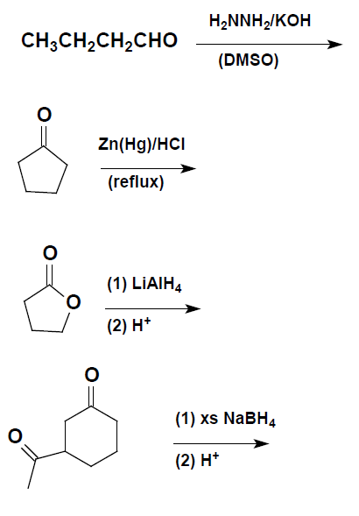
Show the major organic product(s) for each of the following equations.

