Slide 1
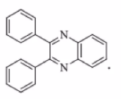
Experiment ( 6 ) Preparation of 2,3-Diphenyl quinoxaline
Salahaddin University – Erbil
College of Science
Chemistry Department
Practical Organic chemistry
3rd Stage
2022-2023
Prepared by Naween M. Yonus

Slide 2
Quinoxaline is an organic compounds formed by the fusion of two aromatic rings, benzene and pyrazine. For this reason is also called benzopyrazine, and is described as a bioisosteres of quinoline, naphthalene and benzothiophene.
Notes:
In medicinal chemistry, bioisosteres are chemical substituents or groups with similar physical or chemical properties which produce broadly similar biological properties in the same chemical compound.

Slide 3
Quinoxaline is isomeric with other naphthyridines including quinazoline, phthalazine and cinnoline. It is a colorless oil that melts just above room temperature.
Although quinoxaline itself is mainly of academic interest, quinoxaline derivatives are used as dyes, pharmaceuticals, and antibiotics such as olaquindox, carbadox, echinomycin, levomycin and actinoleutin.
Notes:
A structural isomer, also known as a constitutional isomer, is one in which two or more organic compounds have the same molecular formulas but different structures.

Slide 4
Chemistry of quinoxaline
Reactions of quinoxaline:
Quinoxaline is a low melting solid and is miscible with water. It is weakly basic pKa (0.56). Quinoxaline forms salt with acids. Nitration occurs only under forcing condition (Conc. HNO3, Oleum, 90C) to give 5-nitroquinoxaline(1.5%) and 5,7- dinitro – quinoxaline (24%)
90 C

Slide 5
Oxidation of quinoxaline result in the formation of the product depending on the nature of the oxidizing agent employed with alkaline potassium permanganate pyrazine 2,3-dicarboxylic acid is formed ,while with peracid quinoxaline di-N-oxid results.

Slide 6
Synthesis of quinoxaline
synthesis of quinoxaline derivatives via the condensation of aryl 1, 2-diamines with 1, 2- dicarbonyl compounds in EtOH at warm temperature in absence of acid, base or catalytic support.

Slide 7
2,3-diphenyl quinoxaline can be prepared by condensation of benzyl with 1,2-phenlene diamine

Slide 8
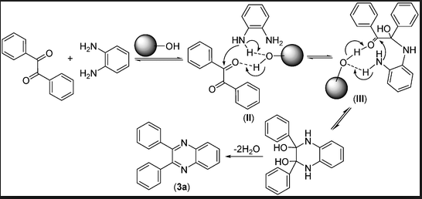
Mechanism

Slide 9
