Slide 1
Preparation of Succinic Anhydride
Salahaddin University – Erbil
College of Science
Chemistry Department
Practical Organic chemistry
3rd Stage
Prepared by: Peshawa Osw, PhD.

Slide 2
Dicarboxylic acids readily lose water when heated if they can form a cyclic anhydride with a five- or a six-membered ring.
Cyclic anhydrides are more easily prepared if the dicarboxylic acid is heated in the presence of acetyl chloride or acetic anhydride or if it is treated with a strong dehydrating agent such as P₂O₅.

Slide 3
Acetic anhydride can be prepared by the interaction of sodium acetate and acetyl chloride or by the addition of acetic acid to ketene.
The anhydride of an acid also can be prepared by treatment of the acid with a dehydrating agent, and in the case of a dibasic acid of the type of succinic acid this direct method is only one applicable. This particular dehydration can be accomplished by use of either acetic anhydride or acetyl chloride:

Slide 4
The reaction of the anhydride with aniline can be used for the identification of this primary amine, since the product is a crystalline substance of sharp melting point.
On treatment with acetyl chloride, succinanilic acid is crystallized to succinanil.

Slide 5
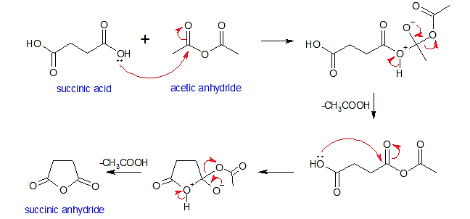
Proposed Mechanism

Slide 6
Procedure
In a 125ml round bottomed flask fitted with a reflux condenser, place 15 g of succinic acid and 20 ml of acetic anhydride.
Heat to the boiling point, noting that the crystals soon dissolve, and reflux gently for 15 minutes.
Let the solution cool for a time undisturbed and observe the crystallization.
Finally cool in ice, collect the crystals on a dry suction funnel, and use several small portions of ether to rinse the reaction flask and wash the crystalline anhydride.
Test the product with cold sodium bicarbonate solution for the presence of unchanged acid.

