Slide 1
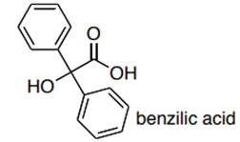
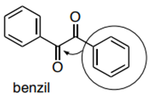
Benzil‐Benzilic Acid Rearrangement
Salahaddin University – Erbil
College of Science
Chemistry Department
Practical Organic chemistry
3rd Stage
Prepared by: Peshawa Osw, PhD.

Slide 2
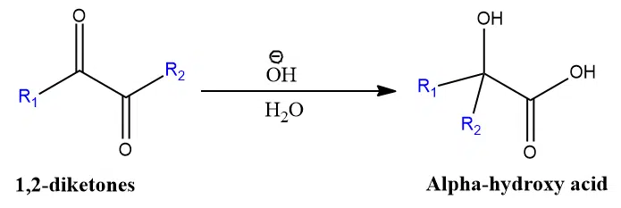
The benzilic acid rearrangement or benzil‐benzilic acid rearrangement reaction is an organic reaction used to convert benzil (α‐diketone ‘1,2-diketones’) to 2-hydroxy carboxylic acids using strong base (KOH or NaOH) and then acid work-up.
It was discovered in 1938 by Justus Liebig (one of the first C-C bond migration reactions).
This rearrangement is normally carried out in the favoured solvents of water and aqueous ethanol.

Slide 3
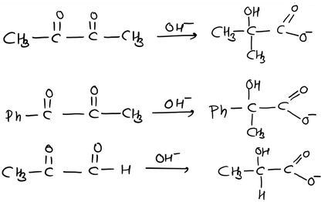
The reaction has been shown to work in aromatic, semi-aromatic, aliphatic, and heterocyclic substrates.
It has been found that aryl groups more readily migrate than alkyl groups, and that aryl groups with electron-withdrawing groups migrate fastest.
In an unsymmetrical diketone the attack of OH- ion takes place at the reactive carbonyl carbon.
The migration of aryl group will attach to the more reactive carbonyl carbon.

Slide 4
Benzilic acid rearrangement Reaction Mechanism
The mechanism of benzilic acid rearrangement is an example of 1,2-shift intra molecular rearrangement.
This arrangement involves three steps.
1- Addition of -OH group
2- Migration of a phenyl group
3- Migration of a proton
The benzilic acid rearrangement is an irreversible process.
The first step of the mechanism is the addition of the nucleophile across the C=O bond to give a tetrahedral intermediate.

Slide 5
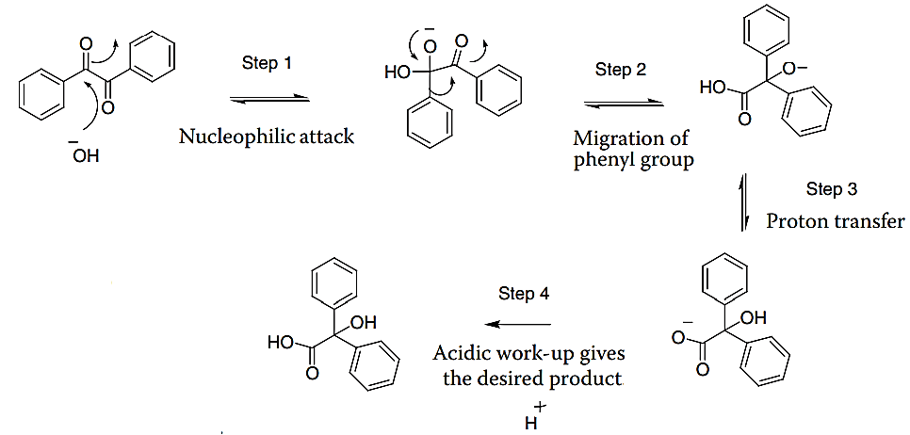

Slide 6
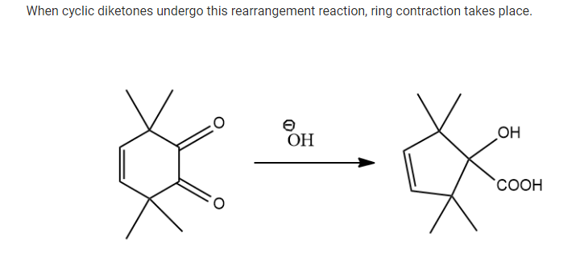
When cyclic diketones undergo this rearrangement reaction, ring contraction takes place.

Slide 7
Procedure
1- Add (2.10 g, 1.0 mmol) of Benzil, 95% ethanol (6 mL), and a boiling stone were added to a 25-mL round-bottom flask with a reflux condenser and heated until the solid benzil was dissolved.
2- Aqueous potassium hydroxide (5 mL, 18.2 mmol) was added dropwise to the flask and the mixture was boiled for 15 minutes. The mixture was cooled, transferred to a beaker, and placed in an ice-water bath until crystallized.
3- The crystals were isolated through vacuum filtration and washed with 4-mL portions of cold 95% ethanol.
4- The solid was transferred to a 100-mL flask of hot water (60 mL) and mixed until completely dissolved.
5- Concentrated hydrochloric acid (1.3 mL) was added drop-wise until a permanent solid was present and a pH of 2 was maintained.
6- The solution was cooled in an ice bath and the crystals were filtered through vacuum filtration and washed with ice-cold water.

