Slide 1
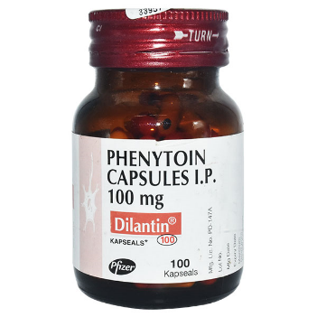
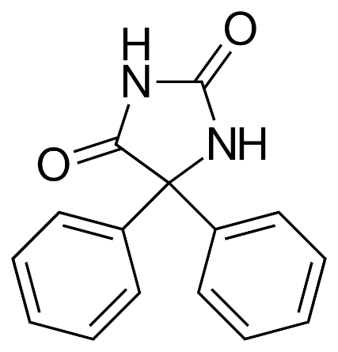
Preparation of Dilantin (Phenytoin)
Salahaddin University – Erbil
College of Science
Chemistry Department
Practical Organic chemistry
3rd Stage
Prepared by: Peshawa Osw, PhD.

Slide 2
In 1838, the German chemist, Justus Liebig reported the discovery of dilantin. It was not uncovered, however, until 100 years later that dilantin is an anticonvulsant. This property is currently exploited in the treatment of epilepsy.
Phenytoin has been widely prescribed for the control of epilepsy since its introduction as a pharmaceutical agent during 1950’s, and although superseded by a number of newer drugs, it remains in use today in this role.
The main structural challenge for the synthesis of this compound is the construction of the hydantoin ring. This hydantoin ring can be formed in a one-pot procedure starting from benzil.

Slide 3
The procedure for this reaction is a base catalysed addition of urea to benzil that is an interesting example of a benzilic acid re-arrangement where the phenyl groups undergoes a 1,2-migration during formation of the hydantoin ring.

Slide 4
Proposed Mechanism

Slide 5
Procedure
Place the 0.005 mol (1.05 g) sample of crude benzil in a round-bottomed flask with 0.009 mol (0.541 g) of urea, 15 mL of absolute ethanol and 0.0025 mol (0.1 g) sodium hydroxide.
Add a boiling chip, attach a condenser after wrapping the ground glass joint with Teflon tape, and heat the mixture on a sand bath under reflux for 1.5 hour.
Cool the reaction mixture before adding 10 mL of water. (If the solution is not clear, remove the suspended solids by filtration).
Then, cautiously acidify the clear solution with concentrated hydrochloric acid.
Collect the product by vacuum filtration and wash thoroughly with water.
Recrystallize the product from ethanol, weigh it dry and calculate the yield.

