Slide 1
Lab 7
Reticulocyte count

Slide 2
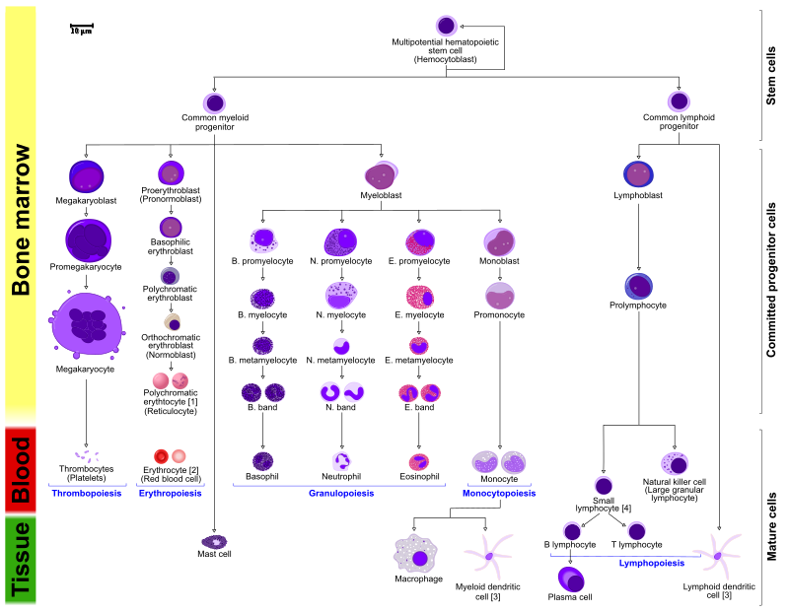

Slide 3
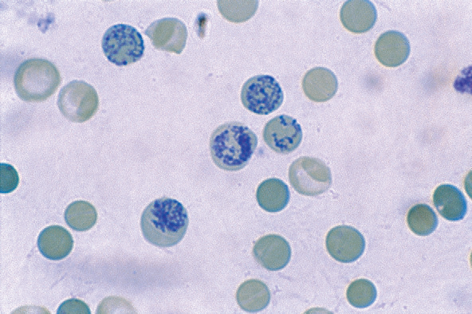
Reticulocytes are the fifth stage in the development series of the erythrocytic cell line
they are young immature RBCs that have lost their nucleus but still contain certain amount of cytoplasm ribonucleic acid (RNA)
This is the stage that leaves the bone marrow and inters the bloodstream to replace the RBCs that have reached to the end of their life span.
An erythrocyte still possessing RNA is referred to as a reticulocyte

Slide 4
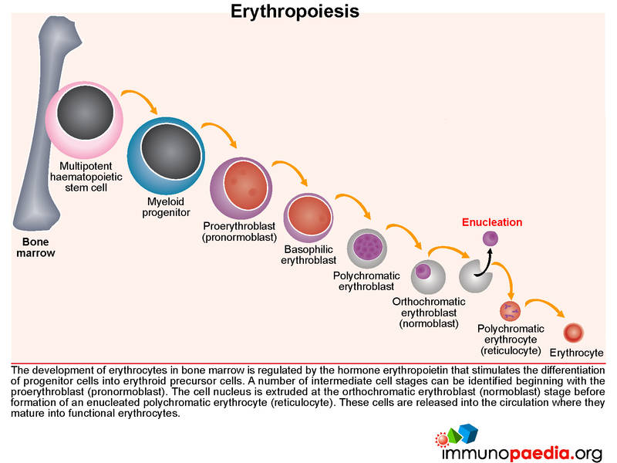

Slide 5
Principle
Reticulocytes are visualized by staining with SUPRAVITAL dyes (such as new methylene blue or brilliant cresyle blue).
This stain causes the ribosomal and residual RNA to coprecipitate with the few remaining mitochondria and ferritin masses in living young erythrocytes to form microscopically visible dark-blue clusters and filaments (reticulum).
Smears of this mixture are then prepared and examined. The number of reticulocytes in 1000 red blood cells is determined. This number is divided by 10 to obtain the reticulocyte count in percent

Slide 6
Interpretation
The Reticulocyte count is an important diagnostic tool: The number of The reticulocyte count is a means of assessing the erythropoietic activity of the bone marrow
An increase in the number of reticulocytes (immature erythrocytes) indicates increased RBC production by the bone marrow. This response is characteristic in hemolytic anemias and in acute and severe bleeding because it represents recent production.
It is used to differentiate anemia's caused by bone marrow failure from those caused by hemorrhage or hemolysis.

Slide 7
It used also to check the effectiveness of treatment in prenicious anemia and folate and iron deficiency.
To assess the recovery of bone marrow function in aplastic anemia and to determine the effects of radioactive substance on exposed workers..

Slide 8
SPECIMEN
Whole blood that is anticoagulated with either EDTA or heparin is suitable.
Capillary blood drawn into heparinized tubes or immediately mixed with stain may also be used.
Red blood cells must still be living when the test is performed therefore it is best to perform it promptly after blood collection.
Blood may be used up to 8 hours after collection.
Stained smears retain their color for a prolonged period of time.

Slide 9
REAGENTS, SUPPLIES AND EQUIPMENT
Commercially prepared liquid brilliant cresyle blue solution. It should be stored in a brown bottle. If precipitate is a problem on the smear, the stain should be filtered prior to use.
Microscope slides
Microscope
10 x 75 mm test tubes
Pasteur pipets (with bulb if pipets are glass)
Capillary tubes
Miller ocular (if available)

Slide 10
PROCEDURE
Preparation of smears
Add 3-4 drops of new methylene blue solution to 3-4 drops of thoroughly mixed EDTA anticoagulated blood to a glass 10 x 75 mm test tube.
Mix the contents by gently shaking and allow to incubate at room temperature for a minimum of 10 minutes.
At the end of 10 minutes, gently mix the blood/stain solution.
Using a capillary tube, place a drop of the mixture on each of three slides near the frosted edge as you would when making a peripheral smear.
Using the wedge smear technique, make acceptable smears not too thick or thin.
Label the slides with patient name, ID# and date.
Allow to air dry. (Do not blow to hasten to drying.)

Slide 11
counting The Reticulocytes Cells:
Place the first slide on the microscope stage and, using the low power objective (10x), find an area in the thin portion of the smear in which the red cells are evenly distributed and are not touching each other. Carefully change to the oil immersion objective (100x) and further located an area in which there are approximately 100 red cells per oil immersion field.

Slide 12
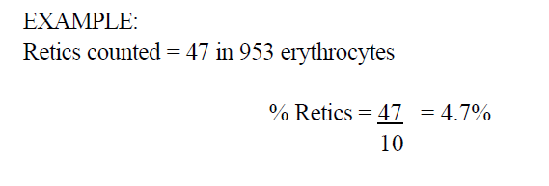
Be sure to count all cells that contain a blue-staining filament or at least 2 or more discrete blue aggregates of reticulum in the erythrocyte.
Count 1000 red cells in consecutive oil immersion fields. Record the number reticulocytes seen.
You may count 500 cells on two slides each. They should agree within ± 15% of each other. If they do not, repeat the reticulocyte count on the third smear.
Calculate the result as follow:

Slide 13
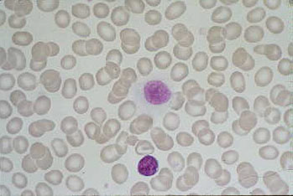
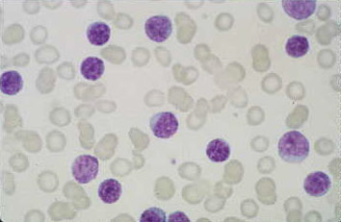
Normal anemia

Slide 14
Normal Ranges
RBCs life span ~ 100 days, ± 20 days
Reticulocyte ~ 1 day in peripheral blood, Then the B.M. replaces approximately 1 % of the adult red blood cells every day.
Normal value :
ADULT:
0.5 to 1.5/100 red blood cells (or, 0.5 to 1.5%)
Absolute count : 25 to 75 X 10⁹/L
Newborn (0-2 weeks):
0.5 – 8 %

Slide 15
Reticulocytosis (Increased RBC Production)
Reticulocyte Index >3%, Reticulocyte Count >1.5%
Acute blood loss or hemorrhage
Acute Hemolytic Anemia (Microangiopathic Anemia)
Hemoglobinopathy
Sickle Cell Anemia
Thalassemia major
Post-Anemia Treatment
Folate Supplementation
Iron Supplementation
Vitamin B12 Supplementation
Notes:
The spleen, similar in structure to a large lymph node, acts as a blood filter. Current knowledge of its purpose includes the removal of old red blood cells and platelets, and the detection and fight against certain bacteria. It is also known to function as a site for the development of new red blood cells from their hematopoietic stem cell precursors, and particularly in situations in which the bone marrow, the normal site for this process, has been compromised by a disorder such as leukemia. The spleen is enlarged in a variety of conditions such as malaria, mononucleosis and most commonly in "cancers" of the lymphatics, such as lymphomas or leukemia.

Slide 16
Reticulocytopenia (Decreased RBC Production)
Reticulocyte Index <1%, Reticulocyte Count <0.5%
Aplastic Anemia
Bone Marrow infiltrate
Bone Marrow suppression or failure
Sepsis
Chemotherapy or radiotherapy
Disordered RBC maturation
Iron Deficiency Anemia
Vitamin B12 Deficiency
Folate Deficiency
Liver disease

