Slide 1
Lecturer: Polla Dilshad Ibrahim MSc sustainable architecture
Lecture -7-

Slide 2
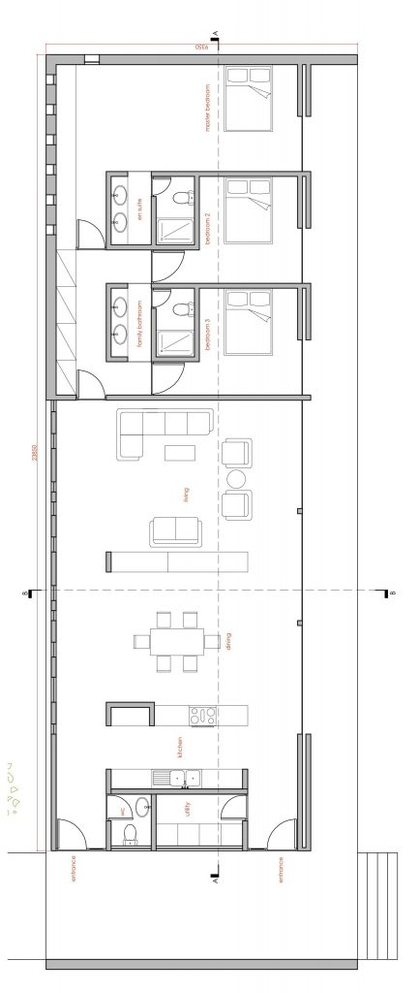
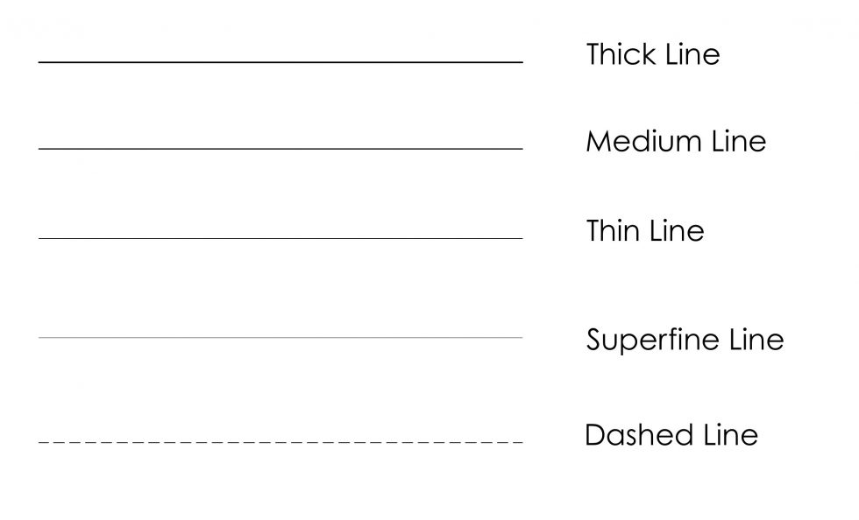
Q: Why do we use line weights in architectural drawings?
Line weights are used in architectural drawings to demonstrate relationships between elements, create depth, scale, to create a hierarchy in the drawing and to add clarity to allow the viewer to better understand the drawing.
Not only do we use line weights in architectural sketching, we also use them in all stages of architectural drawing, both hand drawings and computer generated drawings.

Slide 3
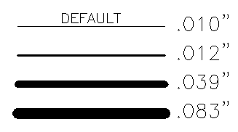
Line-Weight
Another property of lines is lineweight, or how wide they display on the screen and when printed.
One common example of a heavier lineweight would be a border around a title block.
Some times, you may use a lighter lineweight for hatching. But whatever you use them for, they are powerful display options.
Here are the range of lineweights available (There are more options in between):

Slide 4
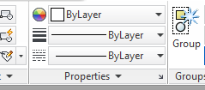
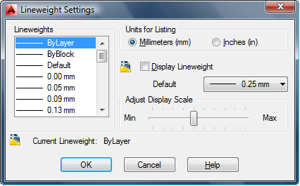
Line-Weight
Sets the current line-weight, line-weight display options, and line-weight units.
In command : LWEIGHT or shortcut “LW”
MUST BE ON “SHOW” MODE SO THAT THE LINE WEIGHTS IN VIEWPORT IS VISIBLE

Slide 5
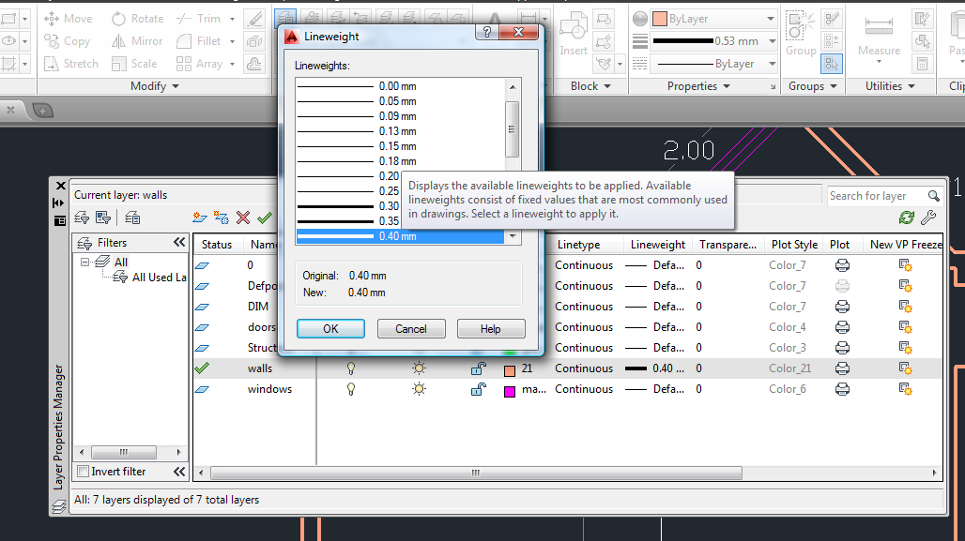
Line-Weight in Layer Properties Manager

Slide 6
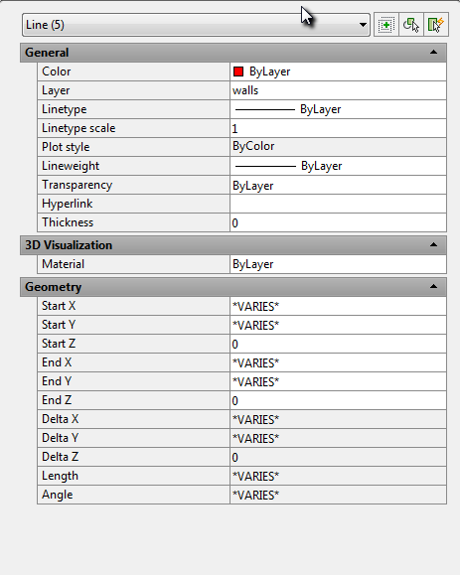
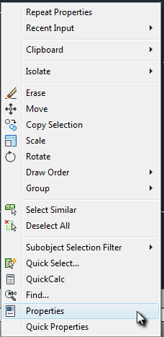
Line-Weight in Properties

Slide 7
Line-Type
almost all of the lines have been continuous. This is a particular linetype. Most simple drawings can be drawn with just this one linetype. More advanced drawings will require different linetypes such as center lines
In command : LTYPE or shortcut “LT”

Slide 8
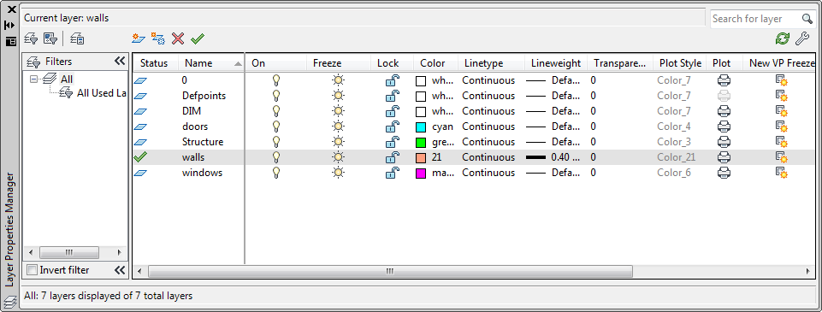
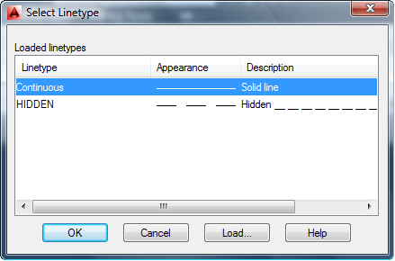
Line-Type in Layer Properties Manager

Slide 9
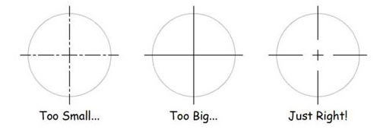
Line-Type Scale
As soon as you start using non-continuous dash-dot line-types (line patterns that contain gaps in them), you need to tell AutoCAD how to scale the gaps in the line-types based on the plot scale. If you don’t do this, the dash-dot line-type patterns can look too big or too small.

Slide 10
Line-Type Scale
To set the line type scale at the keyboard, follow these steps:
Type LTSCALE (or LTS) in command line and press Enter.
AutoCAD responds with a prompt, asking you for the scale factor. The value at the end of the prompt is the current line type scale setting, as shown in the following command line example:
Type the value you want for the linetype scale and press Enter.

Slide 11
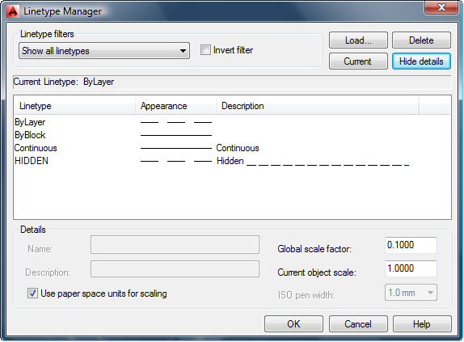
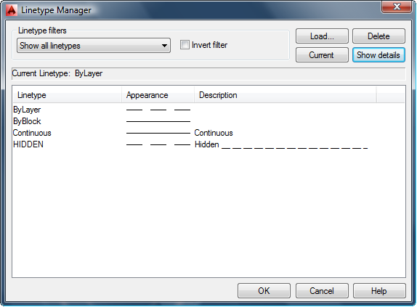
Line-Type Scale
alternatively, you can specify line type scale in the Line type Manager dialog box:
Click the Line type drop-down list on the Properties panel of the Ribbon’s Home tab and select Other.
Then in the Line type Manager dialog box, click the Show Details button, and type your desired line type scale in the Global Scale Factor text box.

Slide 12
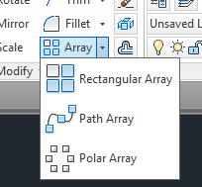
The “ARRAY” command
The ARRAY Command allows you to create duplicates of existing objects in a rectangular or circular (polar) pattern.
In command : array or shortcut “AR”

Slide 13
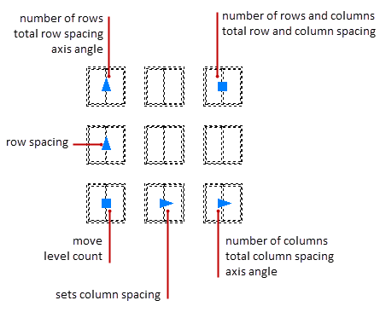
1-The Rectangle “ARRAY”
In Rectangular Arrays, items are distributed into any combination of Rows, Columns , and Levels

Slide 14
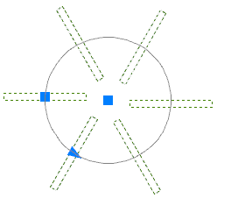
2-The Polar “ARRAY”
In Polar Arrays, items are evenly distributed about a center point or axis of rotation.

Slide 15
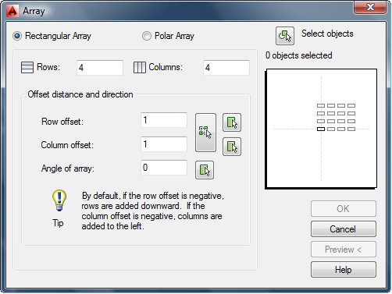
The “ARRAY” Classic
If you type in ARRAYCLASSIC on the command line you get the array dialog box

