Slide 1
PowerPoint Lecture 7
Department Of Architecture
1st stage
Lecturer
Polla Dilshad Ibrahim
MSc Architecture

Slide 2
The 10 Most Common Presentation Mistakes:
You Don't Know Your Topic!
Know your material so well, that you could easily do the presentation without an electronic enhancement such as PowerPoint.
The Slides Are NOT Your Presentation
Always remember that you are the presentation. The slide show should only be used as an accompaniment to your talk.
T. M. I. (Too Much Information)
You know so much about the topic, that you jump from here to there and back again talking about everything there is to know about your brand new widget, and no one can follow the thread of the presentation. make simple topics that can be easily followed
Poorly Chosen Design Template or Design Theme
Choose a design that is appropriate for the audience. A clean, straightforward layout is best for business presentations. Young children respond to presentations that are full of color and contain a variety of shapes.
Electrifying Color Choices
Dark text on a light background is best. Off white or light beige is easier on the eyes than the typical white. Dark backgrounds are very effective, if the text is light for easy reading.
Patterned or textured backgrounds make text hard to read.

Slide 3
The 10 Most Common Presentation Mistakes:
Poor Font Choices
Stick to easy to read fonts such as Arial or Times New Roman. Avoid script type fonts which are hard to read on screen
Extraneous Photos and Graphs
Use photos, charts and diagrams only to emphasize key points of your presentation.
Too Many Slides
Ensure your audience stays focused by keeping the number of slides to a minimum
Different Animations on Every Slide
Animations and sounds, used well, can heighten interest, but don't distract the audience with too much of a good thing. Design your presentation with the "less is more” philosophy
Hardware Malfunctions
Check all the equipment and rehearse your presentation

Slide 4
Animating Text and Objects:
In PowerPoint you can animate text and objects such as clip art, shapes, and pictures.
Animation, or movement, on the slide can be used to draw the audience's attention to specific content or to make the slide easier to read.
The Four Types of Animations
Entrance These control how the object enters the slide
Emphasis: These animations occur while the object is on the slide, often triggered by a mouse click.

Slide 5
Animating Text and Objects:
Exit: These control how the object exits the slide. For example, with the Fade animation, the object will simply fade away.
Motion Paths: These are similar to Emphasis effects, except the object moves within the slide along a predetermined path, for example a circle.

Slide 6
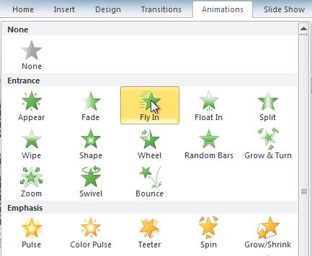
Animating Text and Objects:
To Apply an Animation to an Object:
Select an object.
Click the Animations tab.
In the Animation group, click the More drop-down arrow to view the available animations

Slide 7
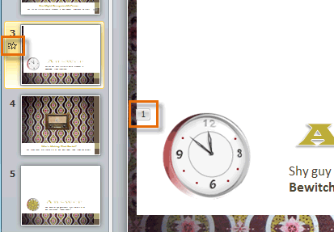
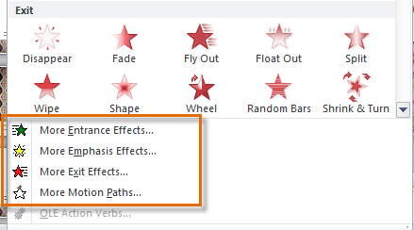
Animating Text and Objects:
The object will now have a small number next to it to show that it has an animation.
Also, in the Slide pane, the slide will now have a star symbol next to it.
At the bottom of the menu, you can access even more effects

Slide 8
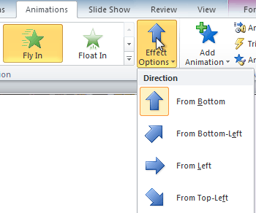
Animating Text and Objects:
Some effects will have options that you can change. For example, with the Fly In effect, you can control which direction the object comes from. These options can be accessed from the Effect Options command in the Animation group.

Slide 9
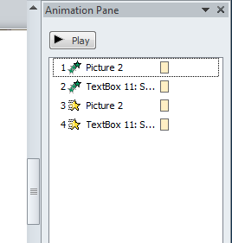
The Animation Pane:
The Animation Pane allows you to view and manage all of the effects that are on the current slide. You can modify and reorder effects directly from the Animation Pane, which is especially useful when you have a large number of effects.
To Open the Animation Pane:

Slide 10
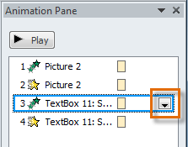
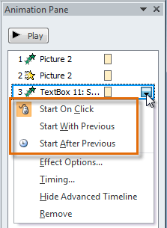
The Animation Pane:
To Change an Effect's Start Option:
By default, an effect starts playing when you click the mouse during a slide show. If you have multiple effects, you will need to click multiple times to start each effect individually.

Slide 11
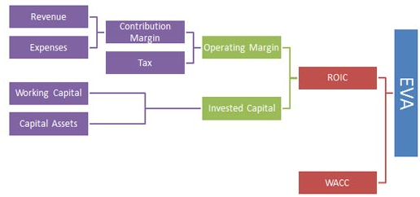
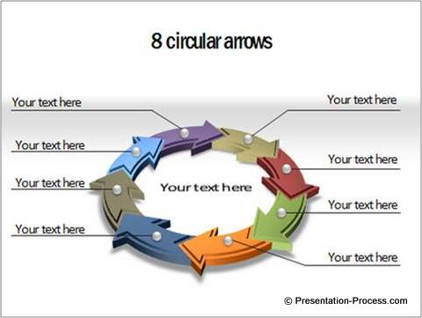
SmartArt Illustrations:
PowerPoint has a variety of SmartArt graphics which you can use to illustrate and organize many different types of ideas. To get the most out of SmartArt, you'll need to know how to insert a SmartArt graphic, modify the color and effects, and change the organization of the graphic.

Slide 12
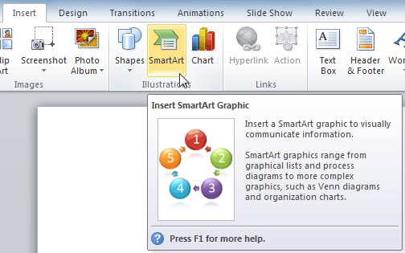
SmartArt Illustrations:
Select the Insert tab.
Select the SmartArt command in the Illustrations group. A dialog box will appear

Slide 13
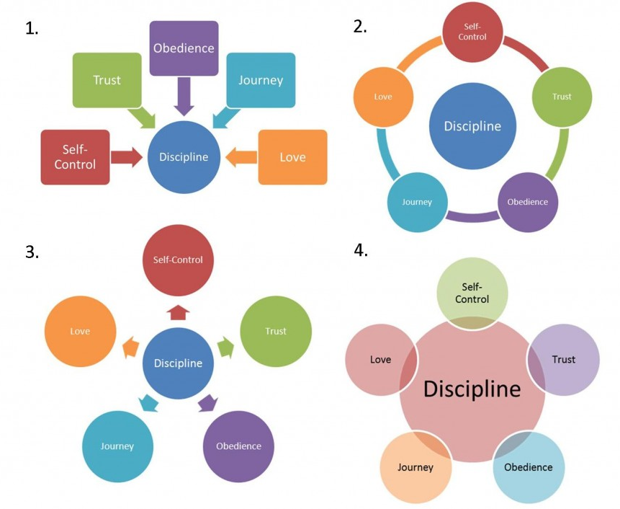
SmartArt Illustrations:

Slide 14
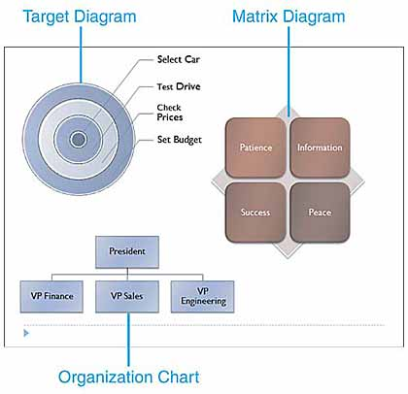
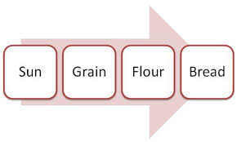
SmartArt Illustrations:

Slide 15
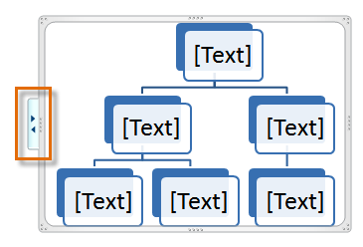
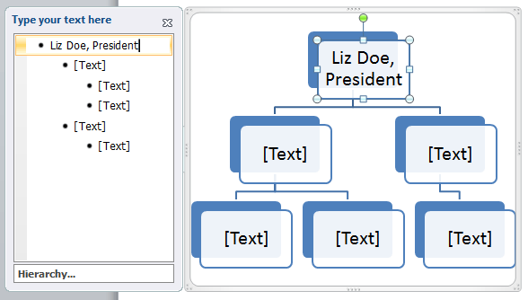
SmartArt Illustrations:
To Add Text to a SmartArt Graphic:
Select the graphic. A border will appear around it with an arrow on the left side.
Click the arrow on the left side of the graphic to open the task pane.
Enter text next to each bullet in the task pane. The information will appear in the graphic, and will resize to fit inside the shape.
To add a new shape, press Enter. A new bullet will appear in the task pane, and a new shape will appear in the graphic
You can also add text by clicking on the desired shape and then typing your text. This works well if you only need to add text to a few shapes.

Slide 16
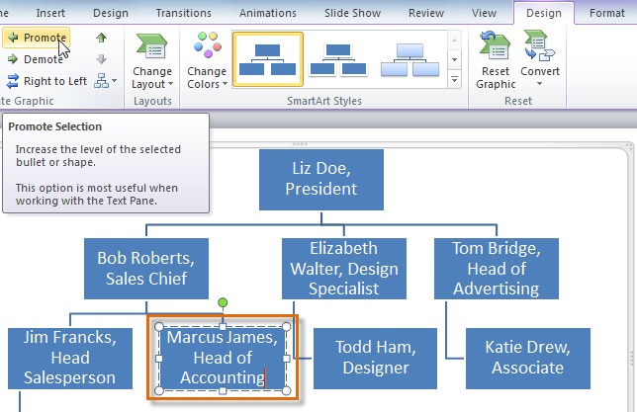
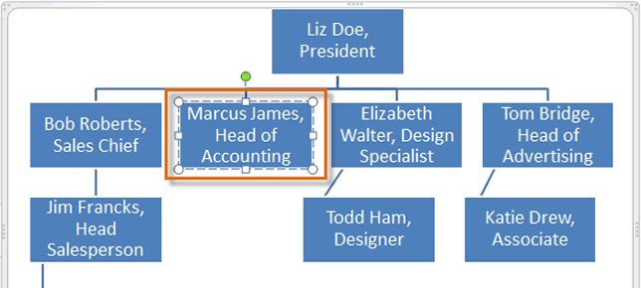
Changing the Organization of a SmartArt Graphic
To Move Shapes to a Higher or Lower Level:

Slide 17
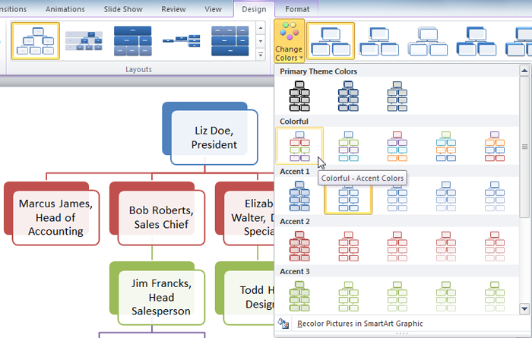
Modifying the SmartArt Graphic's Appearance
To Change the Color Scheme:

Slide 18
Manager
mohammed
Kawa
Sherwan
Ali
Imad
Sana
Suzi
Rawa

