Slide 1
Experiment ( ): Qualitative Organic Analysis ( Identification of an Unknown: Aldehydes, Ketones & Carboxylic acids )
Salahaddin University – Erbil
College of Science
Chemistry Department
Practical Organic chemistry
3rd Stage
2022-2023

Slide 2
Identification of an Unknown
Ketone
Carboxylic acid
Aldehyde

Slide 3
CLASSIFICATION TESTS
which are simple chemical reactions that produce color changes or form precipitates, can be used to differentiate alcohols, aldehydes, and ketones and also to provide further structural information. Because color plays such an important role in this experiment.

Slide 4
The carbonyl group (C=O), found in aldehydes, ketones, is a very important functional group that is involved in several common reactions.
This particular functionality is unique because of the polarization (dipolar resonance) between the carbon-oxygen π bond.

Slide 5
Due to the resonance of the C-O bond, there are a variety of reactions where the electrophilic carbon is attacked by nucleophiles (Lewis bases) and the oxygen reacts with corresponding electrophiles (Lewis acids).
Aldehydes commonly react faster than ketones (with the same reagent) due to less steric hindrance at the carbonyl group. Aldehydes are also more easily oxidized than ketones.

Slide 6
1- Identification of Aldehydes and Ketones
Notes:
1/ 2, 4- dinitrophenylhydrazine = Brady's test
2/ Hydrazine is an inorganic compound with the chemical formula N2H4
3/ Hydrazones are a class of organic compounds with the structure R₁R₂C=NNH
4/ Aromatic= red , Aliphatic= yellow

Slide 7
PROCEDURE:
-Clean and thoroughly rinse with distilled water four test tubes. Label a test tube for unknown (A, B, C, D).
1- Add 10 drops of each compound to its labeled test tube.
2- Add 5 drops reagent grade ethanol to each test tube.
3- Add 10 drops 2, 4- dinitrophenylhydrazine to each test tube.
Record your results. The presence of a yellow to orange-red precipitate is a positive test (aldehyde or ketone).

Slide 8
2- Tollen’s Test
Tollens’ test, also known as silver-mirror test, is a qualitative laboratory test used to distinguish between an aldehyde and a ketone. It exploits the fact that aldehydes are readily oxidized whereas ketones are not.
Tollens’ test uses a reagent known as Tollens’ reagent, which is a colorless, basic, aqueous solution containing silver ions coordinated to ammonia [Ag(NH3)2+]. It is prepared using a two-step procedure.

Slide 9
Step 1: Aqueous silver nitrate is mixed with aqueous sodium hydroxide
Step 2: Aqueous ammonia is added drop-wise until the precipitated silver oxide completely dissolves.
Tollens’ reagent oxidizes an aldehyde into the corresponding carboxylic acid.
Notes:
https://youtu.be/_0TqG8-N8DI

Slide 10
Ketones are not oxidized by Tollens’ reagent, so the treatment of a ketone with Tollens’ reagent in a glass test tube does not result in a silver mirror.
PROCEDURE:
First prepare the Tollen’s reagent by:
1- Adding 5 mL of 5% silver nitrate to 2 freshly cleaned medium sized test tubes.
2-Add 3 drops of 10% sodium hydroxide to each test tube. Mix the solutions thoroughly. A brown-gray precipitate should form.
3-To each tube add 10% ammonium hydroxide solution drop-wise, shaking after the addition of each drop, until the precipitate just dissolves.
Then Add 2-3 drops of one of the unknowns to the 1st test tube and 2-3 drops of the other unknow to the 2nd one. Shake the tubes to mix them and allow them to stand without shaking for 10 minutes(heat if needed) . Look for the formation of the silver mirror.
Notes:
Tollens’ reagent is [Ag(NH3)2]NO3. This is sensitive to atmospheric oxygen and other impurities and deteriorates silver oxide and/or silver particles. In this condition it cannot work as oxidizing agent for aldehydes.

Slide 11
3- Sodium Bicarbonate Test
Aldehydes and ketones are not acidic and will not react with sodium bicarbonate.
Carboxylic acid react with bicarbonate ion to produce carbon dioxide gas. This is another useful reaction, since it shows a visible change if the reaction occurs, you will see bubbles appear in the solution. This reaction is shown below.

Slide 12
PROCEDURE
In this part, you will test your unknown add 1mL of 10% NaHCO3 to test tube and then add 10 drops of unknow (Carboxylic acid , aldehyde or ketone).
While you are adding the substances to the sodium bicarbonate solution, watch for the formation of bubbles, which indicate a positive reaction (Carboxylic acid).

Slide 13
THANKS FOR YOUR ATTENTION

Slide 14
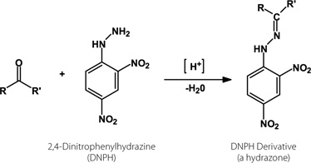
2,4-Dinitrophenylhydrazine (2,4-DNP or 2,4-DNPH) reacts readily with aldehydes and ketones via a condensation reaction (the lone pair of electrons on the terminal amino group in 2,4-DNPH makes it a strong nucleophile and the condensation starts by the nucleophilic 2,4-DNPH attacking the electrophilic carbonyl carbon) to produce the corresponding hydrazone. The hydrazine is usually a brightly colored yellow, orange or red compound, so the reaction is often used to test for the presences of an aldehyde or ketone

Slide 15
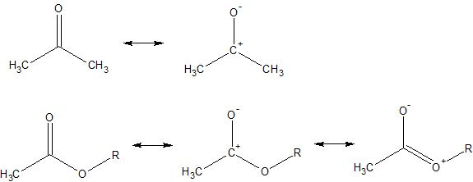
2,4-DNPH does not react with amides, esters or carboxylic acids. As shown below for the case of an ester, an extra resonance structure can be drawn for these 3 types of compounds as compared to a ketone. This extra resonance structure delocalizes some of the positive charge away from the carbonyl carbon onto the adjacent hetero-atom (oxygen in the case of the ester or carboxylic acid, nitrogen in the case of an amide). This makes the carbonyl carbon less electrophilic in these compounds, and consequently attack by the nucleophilic 2,4-DNPH is less favored.

