Slide 1
Second Semester
2022-2023
Assist. Prof. Dr. Rabar Fatah Salih
rabar.salih@ su.edu.krd
0782 4670202

Slide 2
Lecture (1)
Seeds and Sowing
Advantages of Using Good Quality Seeds
Sowing
Nutrient Management

Slide 3
Seeds and Sowing
Plants reproduce sexually by seeds and asexually by vegetative parts. Grains, which are used for multiplication, are called seeds while those used for human or animal consumption are called grains.

Slide 4
Characteristics
A good quality seed should posses the following characteristics.
Seed must be true to its type i.e., genetically pure, free from admixtures and should belong to the proper variety or strain of the crop and their duration should be according to agro climate and cropping system of the locality.
Seed should be pure, viable, vigorous and have high yielding potential.
Seed should be free from seed borne diseases and pest infection.
Seed should be clean; free from weed seeds or any inert materials.
Seed should be in whole and not broken or damaged; crushed or peeled off; half filled and half rotten.

Slide 5
Advantages of Using Good Quality Seeds
The following are the advantages of using good quality seeds.
Reduced cost of cleaning, standardization and disinfections.
Uniform germination thus avoiding replanting, gap filling.
Vigorous seedling growth, which reduces weed and disease, damages.
Uniform growth stages, maturity and products.
Maintain good quality under storage conditions.
Reduced cost.

Slide 6
Sowing
Seeding or sowing is an art of placing seeds in the soil to have good germination in the field. A perfect seeding gives:
a. Correct amount of seed per unit area.
b. Correct depth at which seed is placed in the soil.
c. Correct spacing between row-to-row and plant-to-plant.

Slide 7
Nutrient Management
Growth is the development of a plant as a whole or of a specific organ. Besides the genetic factors, the environmental factors grouped as climatic factors and soil factors influence plant growth. The supply of mineral nutrient elements to the plants is discussed in this chapter.

Slide 8
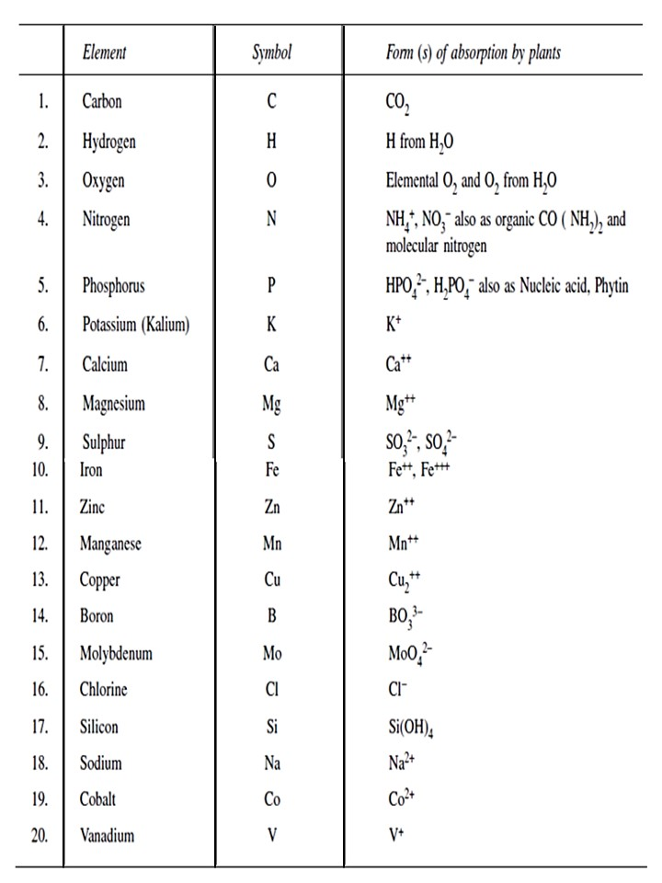
Table 1. The Chemical Symbol and the Ionic Forms of essential Elements.

Slide 9
Thank you for your attention

