Slide 1
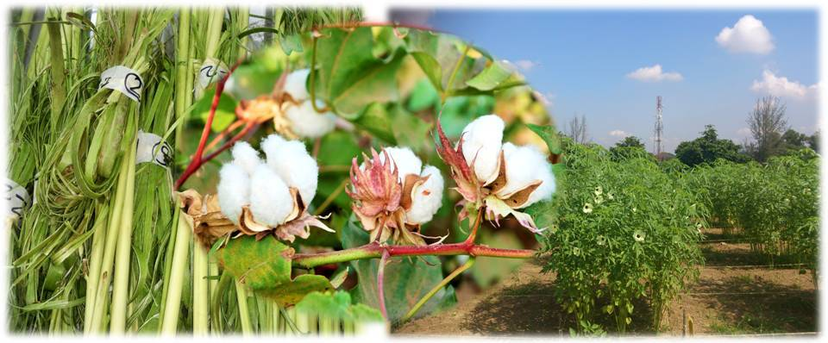
Technology of Fiber Crops (Theory)
Assist. Prof. Dr. Rabar Fatah Salih
Department of Field Crops
College of Agricultural Engineering Sciences
Salahaddin University – Erbil
2022-2023

Slide 2
Lecture 1
Content
Fiber Crops
Fiber Division
Natural Fibers
Plant or Vegetable Fibers
History of Natural Fiber Applications within the Motor Industry
Benefits and Importance to use Natural Fibers Compared to Others

Slide 3
Fiber Crops
What are the fiber crops?
Fiber crops are grown for their fiber yield. There are different kinds of fiber. Such as: (i) seed fiber-cotton, (ii) stem fiber-jute, mesta (kenaf), flax, (iii) leaf fiber-pineapple.

Slide 4
Fiber Division
a- Fiber division according to use:
Textile Fibers
Cordage Fibers
Brush and Mat Fibers
Bagging Fibers
Staffing and Upholstery Fibers
Paper-making Fibers
b- Morphological division:
Natural Fibers
Man-made Fibers
Fiber Blends

Slide 5
Natural Fibers
Natural fiber consists of all kinds of fiber extracted from fruits, grasses, woody plants, water plants, wild plants, agriculture crops, palms, seeds, leaves, animal feathers, and animal skins. By-products of pineapple, banana, rice, sugarcane, coconut, oil palm, kenaf, hemp, cotton, abaca, sugar palm, sisal, jute, and bamboo are among the known fibers used for making composites (Rabar, 2016 and Salit, 2014).
Natural fibers can be divided into three groups based on their sources which is extracted from the plants, animals, and minerals.
Plant or Vegetable Fibers
Animal Fibers
Mineral Fibers

Slide 6
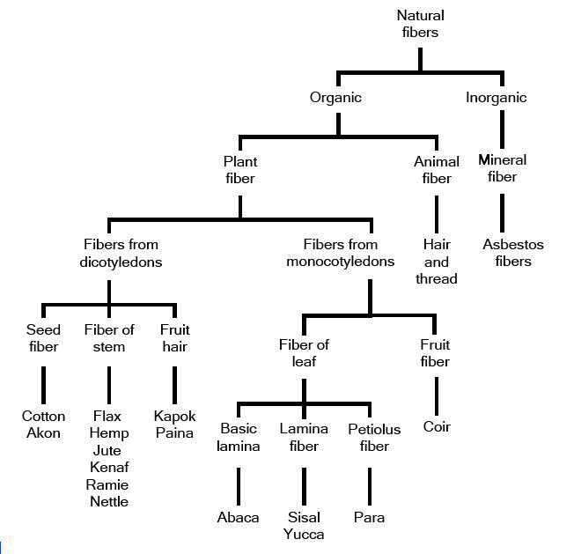
Natural fibers are subdivided based on their origins, whether they are derived from plants, animals, or minerals, Figure 1.1 shows a classification of natural fibers.

Slide 7
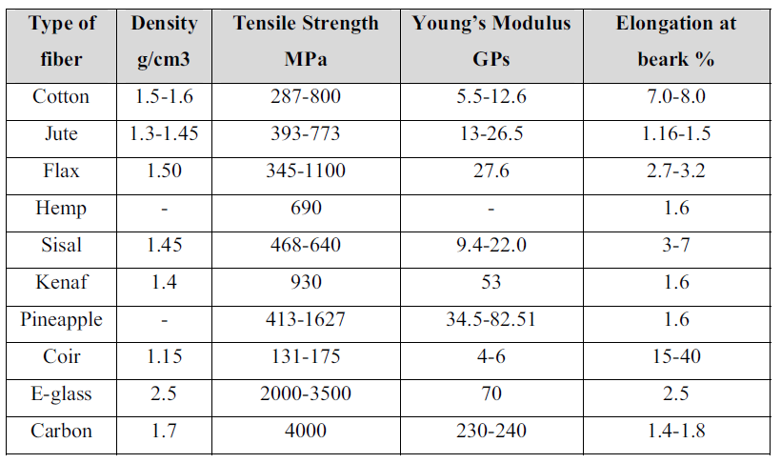
Table 1.1. Properties of natural fibers and synthetic fibers (Ichhaporia 2008).

Slide 8
Plant or Vegetable Fibers
Plant fibers are classified in terms of their fiber type, botanical name, family, origin and approximate level of production in Table 1.2 (Rabar, F.S. 2015).
Table 1.2. Classification of plant fibers and approximate world annual production
Plant Fiber | Botanical Name | Plant Family | Fiber Type | Production (10³ tonnes)
Cotton Kapok Bagasse\Sugarcane Bamboo Flax Hemp Jute Kenaf Ramie Abaca Banana Phormium Pineapple Sisal Coir | Gossypium spp. Ceiba pentandra Saccharum officinarum L. Gigantochloa scortechinii Dendrocalamus apus Linum usitatissimum Cannabis sativa L. Corchorus capsularis Hibiscus cannabinus Boehmeria nivea Gaud Musa textilis Musa ulugurensis Warb. Phormium tenax Ananas cosmosus Merr. Agave sisalana Cocos nucifera L. | Malvaceae Malvaceae Poeceae Poeceae Linaceae Cannabaceae Tiliaceae Malvaceae Urticaceae Musaceae Musaceae Asphodelaceae Bromliaceae Agavaceae Arecaceae | Seed Seed Bast Bast Bast Bast Bast Bast Bast Leaf Leaf Leaf Leaf Leaf Fruit | 19 010 123 10 000 830 214 2938 970 100 91 200 – – 319 315

Slide 9
History of Natural Fiber Applications within the Motor Industry
Table 1.3. Automotive Manufacturers, Car Models, and Components Utilizing Natural Fibers
Automotive | Model and Application
Manufacturer
Audi | A2, A3, A4, A4 Avant, A6, A8, Roadster, Coupe: Seat backs, side and back door panel, boot lining, hat rack, spare tyre lining
BMW | 3, 5 and 7 series and others: Door panels, headliner panel, boot lining, seat backs
DaimlerChrysler | A, C, E and S-series: Door panels, windshield/dashboard, business table, pillar cover panel
Fiat | Punto, Brava, Marea, Alfa Romeo 146, 156
Ford | Mondeo CD 162, Focus: Door panels, B-pillar, boot liner
Peugeot | New model 406
Renault | Clio
Rover | Rover 2000 and others: Insulation, rear storage shelf/panel
Saab | Door panels
SEAT | Door panels, seat backs
Vauxhall | Astra, Vectra, Zafira: Headliner panel, door panels, pillar cover panel, instrument panel
Volkswagen | Golf A4, Passat, Bora: Door panel, seat back, boot lid finish panel, boot liner
Volvo | C70, V70

Slide 10
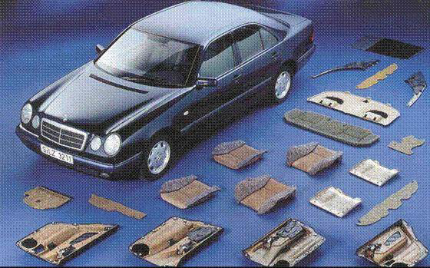
Top of the range automotive vehicles incorporate many components made
from natural fibers, as shown here for the Mercedes “E” class.

Slide 11
Table 1.4. Typical Natural Fibers used in the American Automotive Market with a Polypropylene Matrix
Application | Fiber | Fiber (%)
Door panel | Kenaf/hemp, 50:50 | 50
Inserts | Wood fiber | 50
Rear parcel shelves | Kenaf | 50
 | Flax | 50
 | Wood | 85
Seatbacks | Flax | 50
Spare tyre covers | Flax | 50
 | Wood | 50
Other interior trim | Kenaf | 50
 | Flax | 50
Source: Suddell, B.C., Food and Agriculture Organisation of the United Nations, Joint meeting, July, 2003, Salvador, Brazil. With permission.

Slide 12
Benefits and Importance to use Natural Fibers
Compared to Others
A reduction in cost: Typically, natural fibers are between 25 and 50% cheaper than glass fiber composites.
A reduction in weight: Four injection-molded ABS car door panels weight 9 kg. The same panels based on natural fibers weight only 5 kg for equivalent mechanical properties
.
Light weight (less than half the density of glass fibers): This is also an important environmental benefit as ~85% of energy usage is when a vehicle is being driven. Plant fibers have a maximum density of 1.5 g/cc (that of cellulose), which results in high specific strength and stiffness and hence low component weight.
Safer: Safer crash behavior in accident tests, particularly in relation to high stability and an absence of splintering, is also observed.

Slide 13
Thank you for your attention

