Slide 1
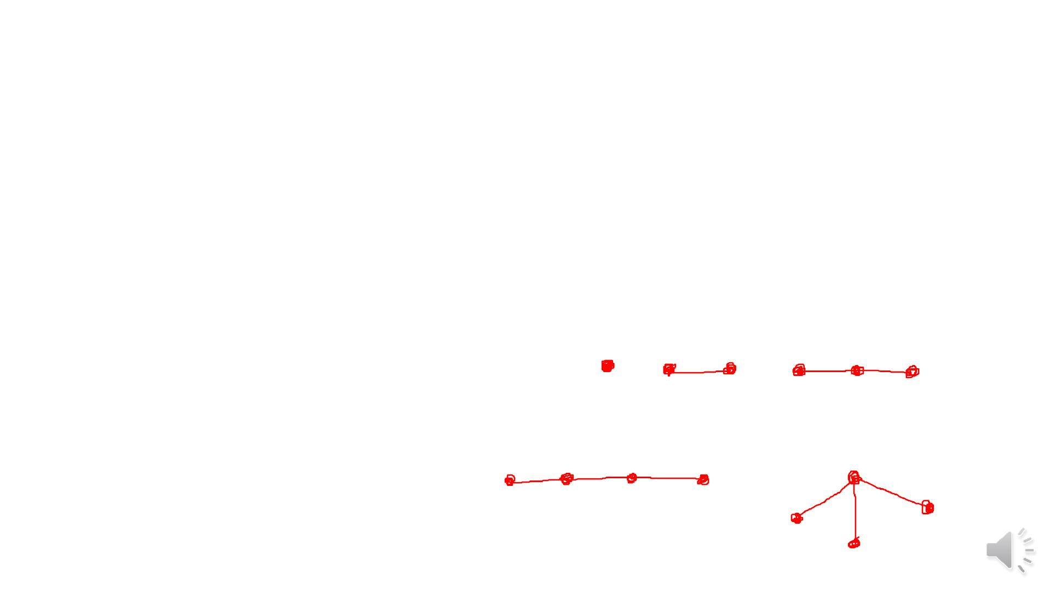
Chapter Three: Tree
Tree
Definition 3.1: A graph is acyclic if it has no cycles.
Definition 3.2: Tree is acyclic connected graph.
Example 3.3: Every path graph is a tree.
Note 3.4:
(i)There is one tree of each orders 1,2 and 3.
(ii) There are two trees of order 4.

Slide 2
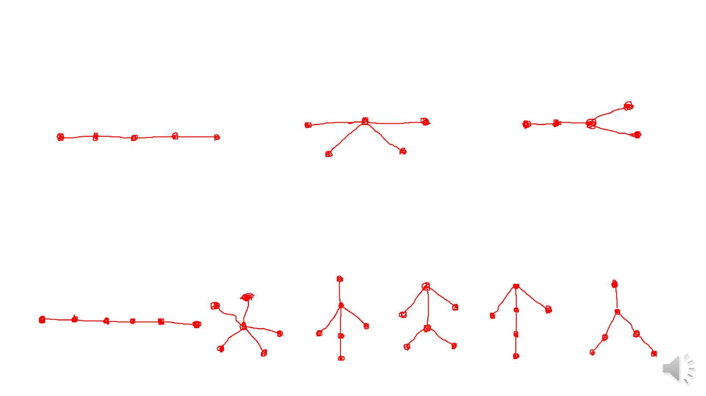
(iii) There are three trees of order 5.
(iv) There are six trees of order 6.

Slide 3
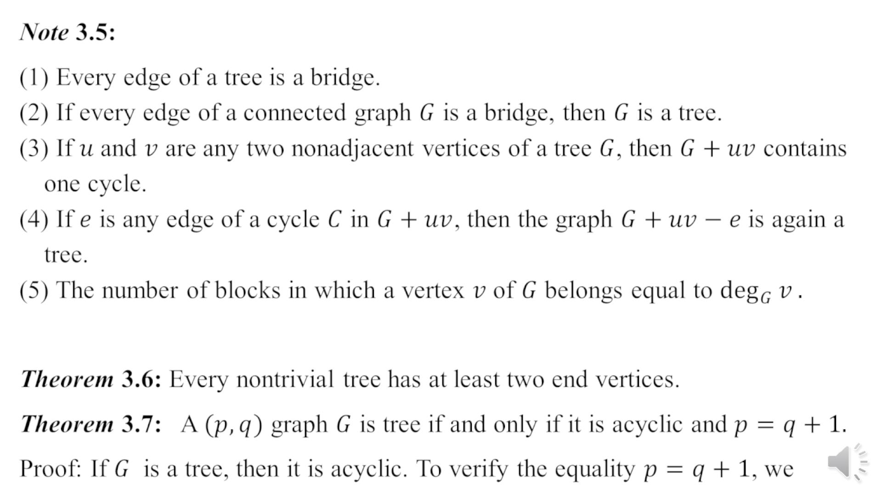

Slide 4
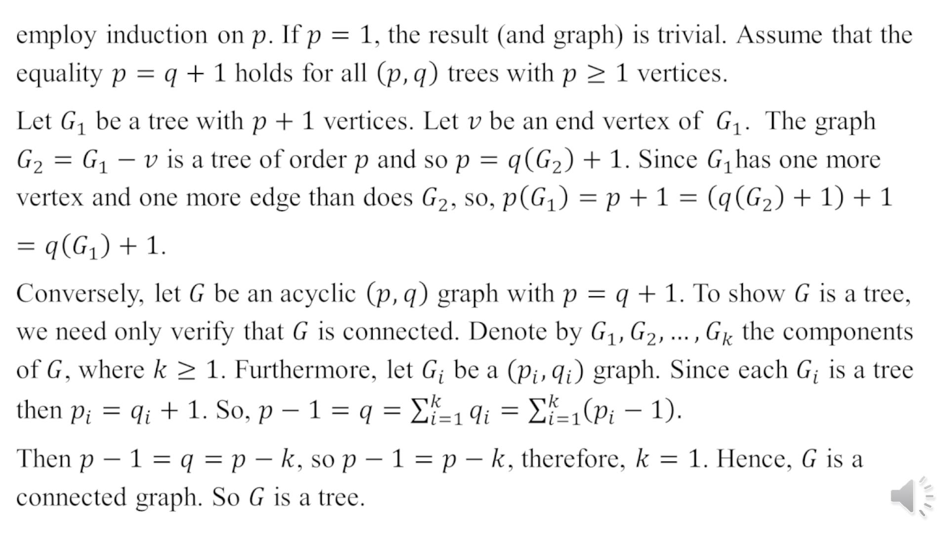

Slide 5
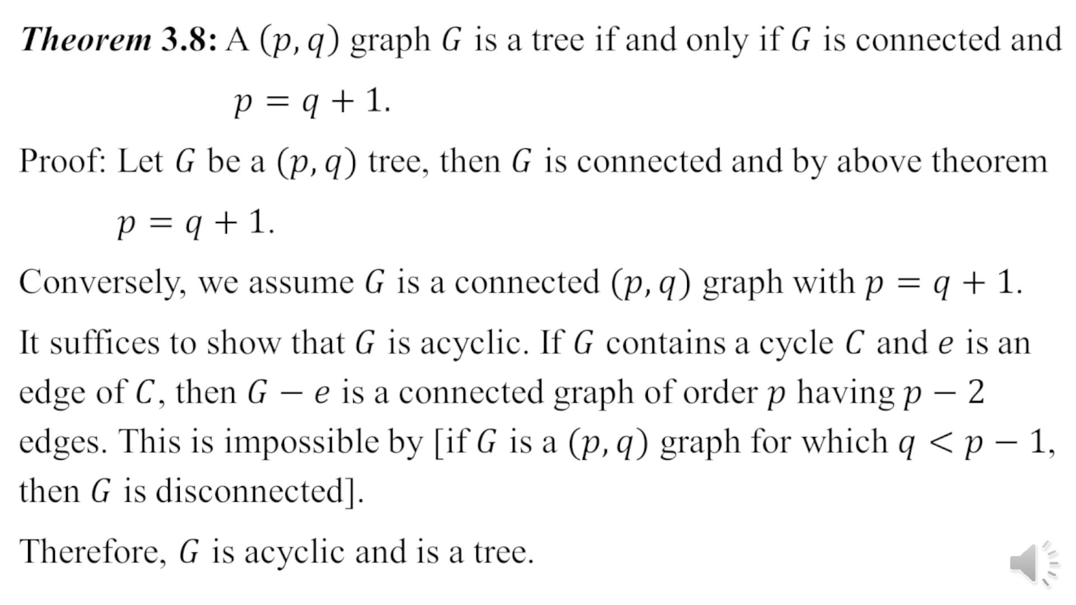

Slide 6
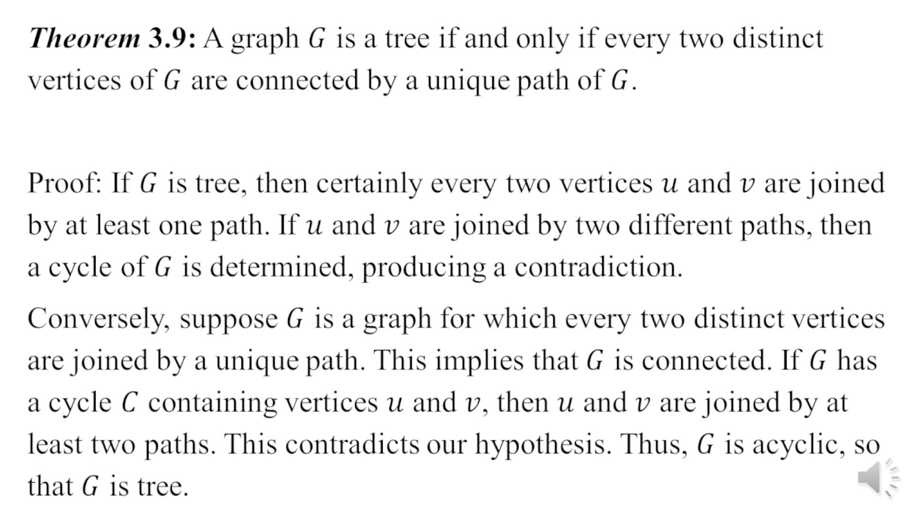

Slide 7
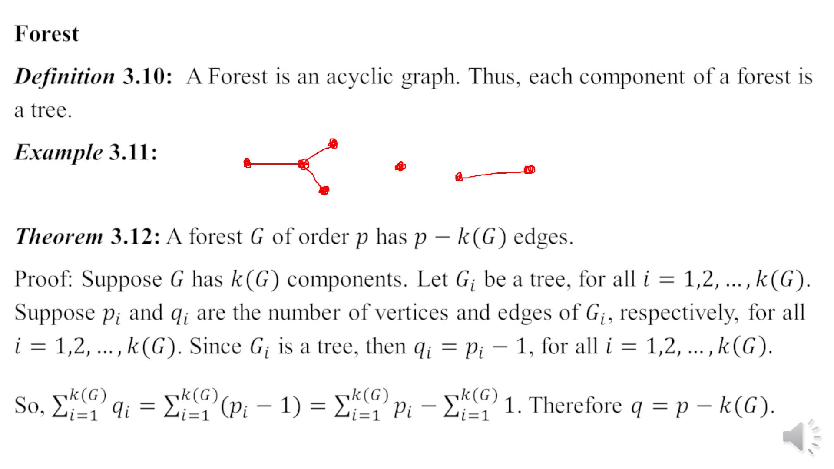

Slide 8
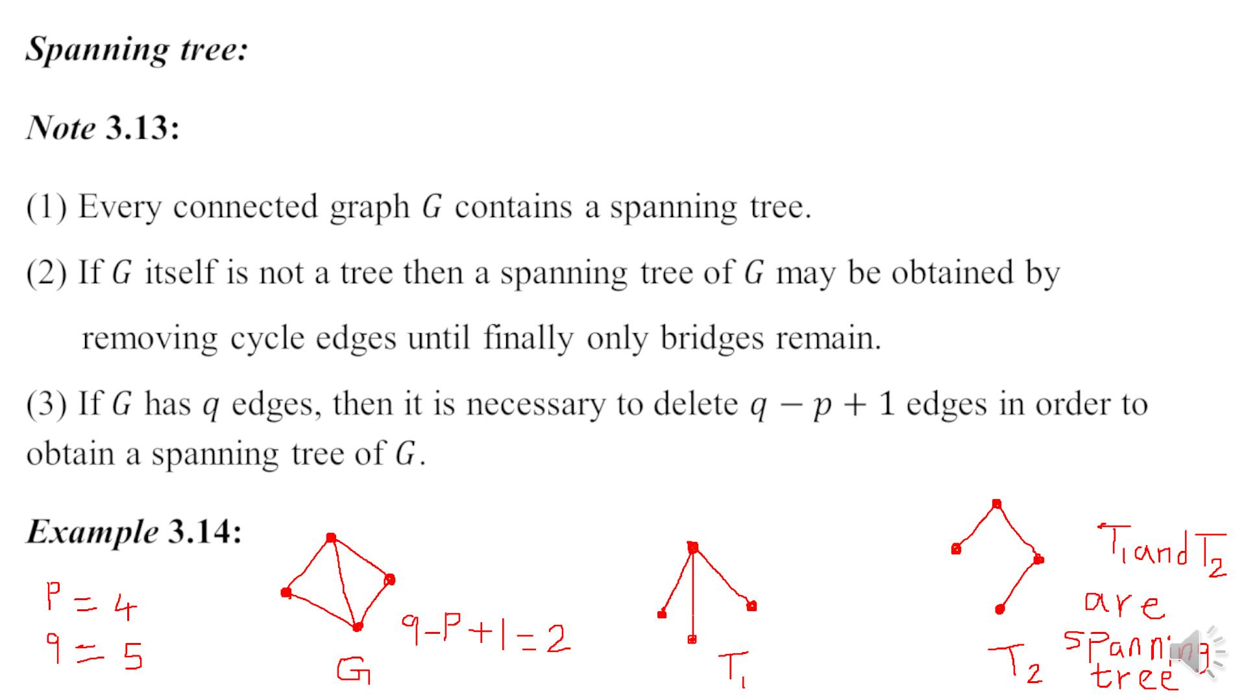

Slide 9
