Slide 1
Kurdistan Regional Government-Iraq
Ministry of Higher Education & Scientific Research
Salahaddin University
College of Education
Department of Mathematics
Mathematical Analysis
Assist. Prof. Dr. Rashad Rashid Haji
rashad.haji@su.edu.krd
2022 -2023

Slide 2
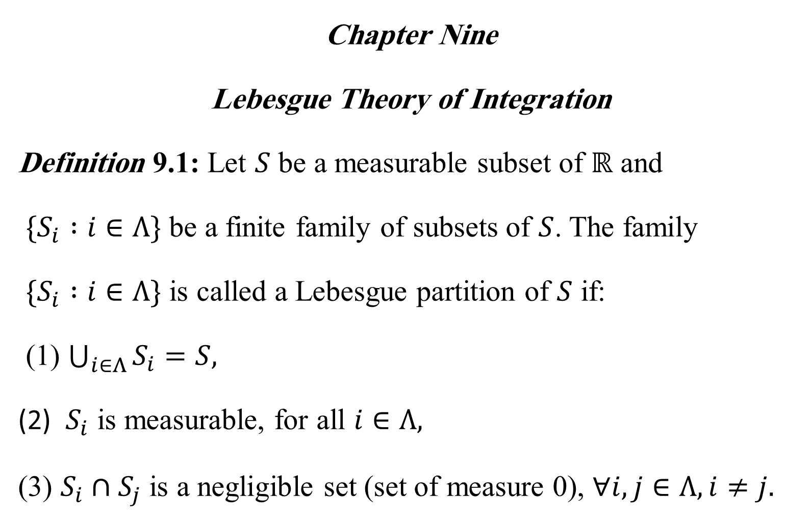
Chapter Nine
Lebesgue Theory of Integration
Definition 9.1: Let $S$ be a measurable subset of $ℝ$ and
$\{S_{i} :i∈Λ\}$ be a finite family of subsets of $S$. The family
$\{S_{i} :i∈Λ\}$ is called a Lebesgue partition of $S$ if:
(1) $\bigcup_{i∈Λ}{S_{i}=S,}$
(2) $S_{i}$ is measurable, for all $i∈Λ,$
(3) $S_{i}∩S_{j}$ is a negligible set (set of measure 0), $∀i,j∈Λ, i≠j.$

Slide 3
Example 9.2: Let $S_{1}=ℚ∩[2,6]$, and $S_{2}=ℚ^{c}∩[2,6]$, where $ℚ$ and $ℚ^{c}$ are the set of rational and irrational numbers, respectively. Then $p=\{S_{1}, S_{2}\}$ is a Lebesgue partition of $[2,6]$.

Slide 4
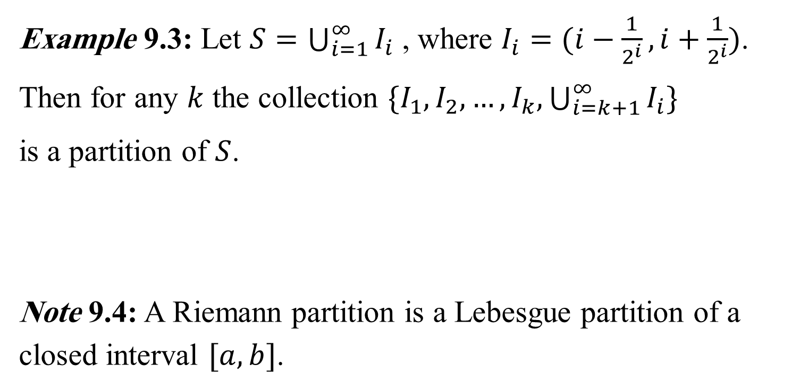
Example 9.3: Let $S=\bigcup_{i=1}^{∞}{I_{i}}$ , where $I_{i}=(i−\frac{1}{2^{i}},i+\frac{1}{2^{i}})$.
Then for any $k$ the collection $\{I_{1},I_{2},…,I_{k},\bigcup_{i=k+1}^{∞}{I_{i}\}}$
is a partition of $S$.
Note 9.4: A Riemann partition is a Lebesgue partition of a closed interval $[a, b]$.

Slide 5
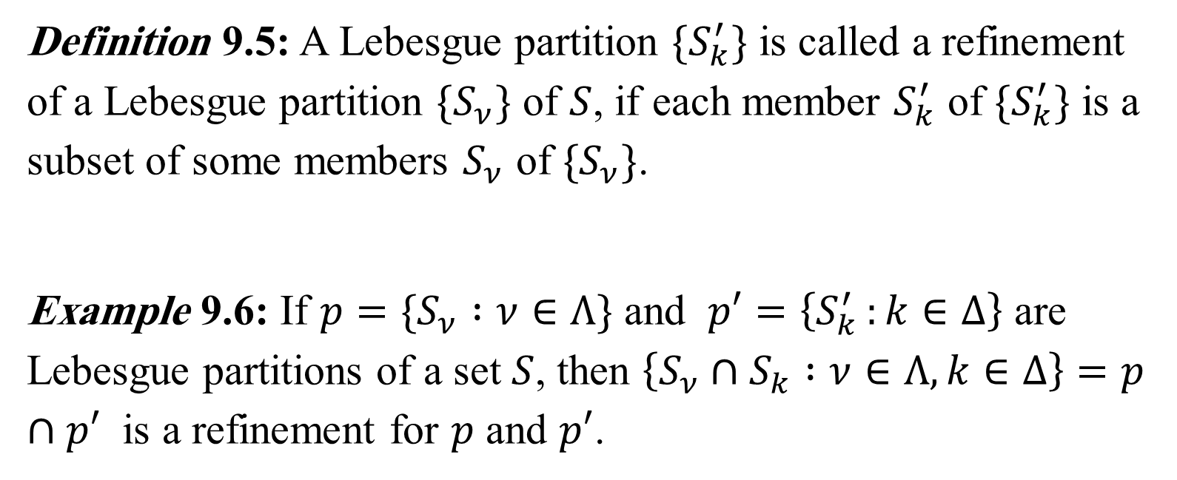
Definition 9.5: A Lebesgue partition $\{S_{k}^{′}\}$ is called a refinement of a Lebesgue partition $\{S_{ν}\}$ of $S$, if each member $S_{k}^{′}$ of $\{S_{k}^{′}\}$ is a subset of some members $S_{ν}$ of $\{S_{ν}\}$.
Example 9.6: If $p=\{S_{ν} :ν∈Λ\}$ and $p′=\left\{S_{k }^{′}:k∈Δ\right\}$ are Lebesgue partitions of a set $S$, then $\left\{S_{ν}∩S_{k} :ν∈Λ, k∈Δ\right\}=p∩p′$ is a refinement for $p$ and $p′$.

Slide 6
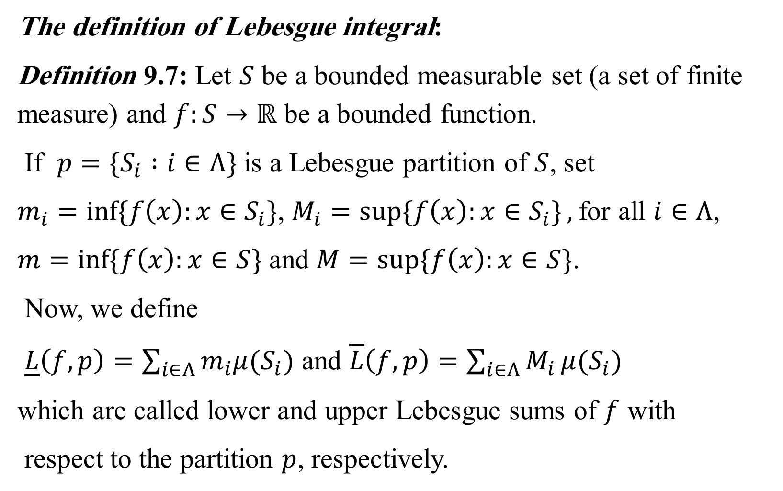
The definition of Lebesgue integral:
Definition 9.7: Let $S$ be a bounded measurable set (a set of finite measure) and $f:S→ℝ$ be a bounded function.
If $p=\{S_{i} :i∈Λ\}$ is a Lebesgue partition of $S$, set
$m_{i}=\inf{\{f\left(x\right):x∈S_{i}\}}$, $M_{i}=\sup{\{f\left(x\right):x∈S_{i}\}},$for all $i∈Λ$,
$m=\inf{\{f\left(x\right):x∈S\}}$ and $M=\sup{\{f\left(x\right):}x∈S\}$.
Now, we define
$\underline{L}\left(f,p\right)=\sum_{i∈Λ}{m_{i}μ(S_{i})}$ and $\overline{L}\left(f,p\right)=\sum_{i∈Λ}{M_{i}}μ(S_{i})$
which are called lower and upper Lebesgue sums of $f$ with
respect to the partition $p$, respectively.

Slide 7
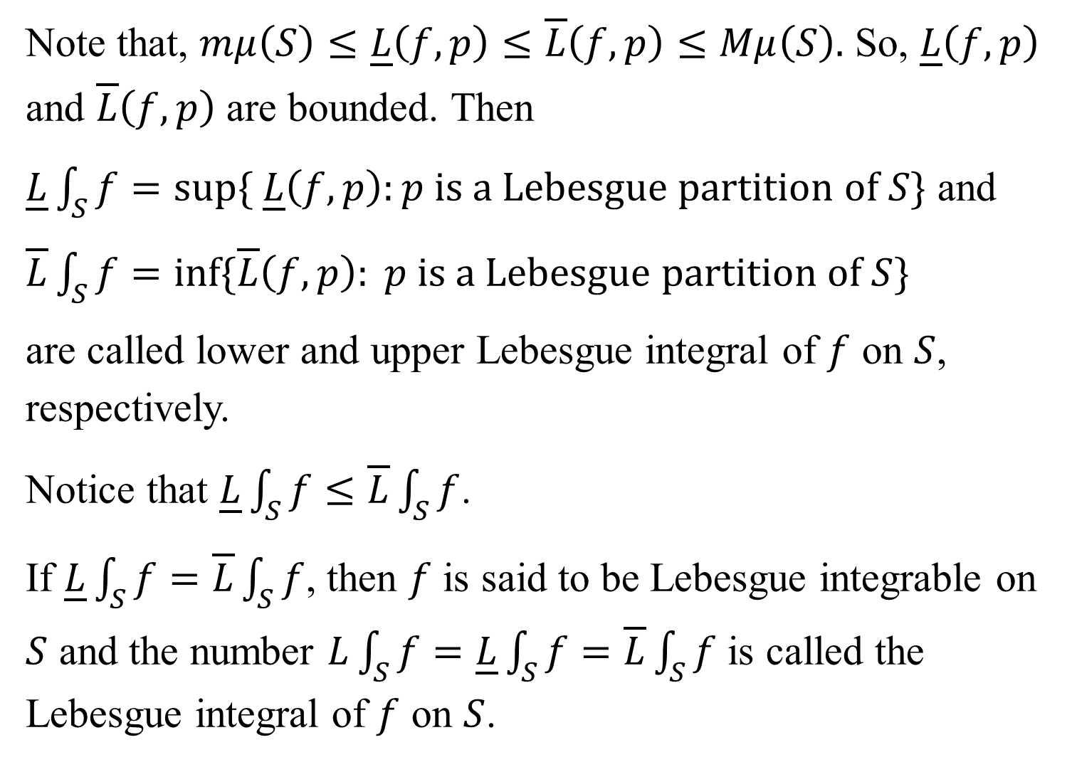
Note that, $mμ\left(S\right)≤\underline{L}\left(f,p\right)≤\overline{L}\left(f,p\right)≤Mμ\left(S\right).$ So, $\underline{L}\left(f,p\right)$ and $\overline{L}\left(f,p\right)$ are bounded. Then
$\underline{L}\int_{S}{f}=sup⁡\{ \underline{L}\left(f,p\right):p is a Lebesgue partition of S\}$ and
$\overline{L}\int_{S}{f=inf⁡\{\overline{L}\left(f,p\right): p is a Lebesgue partition of S\}}$
are called lower and upper Lebesgue integral of $f$ on $S$, respectively.
Notice that $\underline{L}\int_{S}{f}≤\overline{L}\int_{S}{f}$.
If $\underline{L}\int_{S}{f}=\overline{L}\int_{S}{f}$, then $f$ is said to be Lebesgue integrable on $S$ and the number $L\int_{S}{f=\underline{L}\int_{S}{f}=\overline{L}\int_{S}{f}}$ is called the Lebesgue integral of $f$ on $S$.

Slide 8
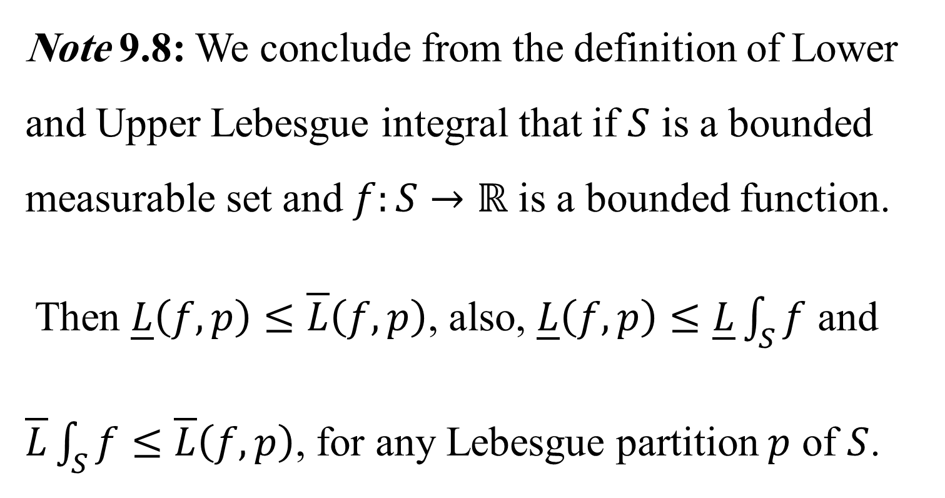
Note 9.8: We conclude from the definition of Lower and Upper Lebesgue integral that if $S$ is a bounded measurable set and $f:S→ℝ$ is a bounded function.
Then $\underline{L}\left(f,p\right)≤\overline{L}\left(f,p\right)$, also, $\underline{L}\left(f,p\right)≤\underline{L}\int_{S}{f}$ and $\overline{L}\int_{S}{f}≤\overline{L}\left(f,p\right)$, for any Lebesgue partition $p$ of $S$.

Slide 11
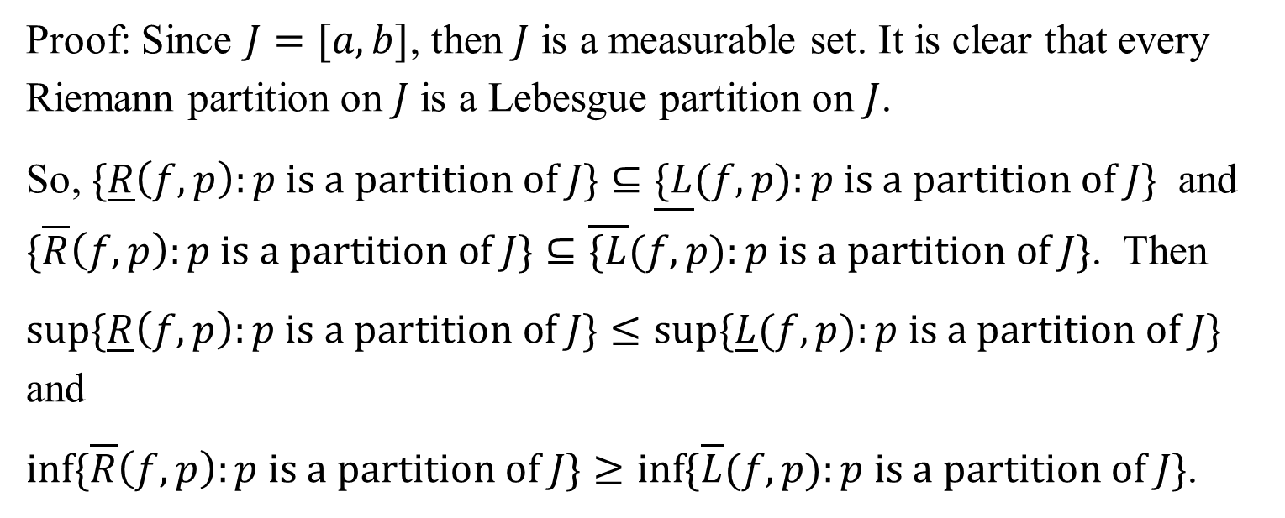
Proof: Since $J=[a, b]$, then $J$ is a measurable set. It is clear that every Riemann partition on $J$ is a Lebesgue partition on $J$.
So, $\{\underline{R}\left(f,p\right):p is a partition of J\}⊆\underline{\{L}(f,p):p is a partition of J\}$ and $\{\overline{R}\left(f,p\right):p is a partition of J\}⊆\overline{\{L}(f,p):p is a partition of J\}$. Then
$\sup{\{\underline{R}\left(f,p\right):p is a partition of J\}}≤\sup{\{\underline{L}(f,p):p is a partition of J\}}$ and
$\inf{\{\overline{R}\left(f,p\right):p is a partition of J\}}≥\inf{\{\overline{L}(f,p):p is a partition of J\}}$.

Slide 12
These mean that $\underline{R}∫f≤\underline{L}∫f$ and $\overline{L}∫f≤\overline{R}∫f$. Since $\underline{L}∫f≤\overline{L}∫f$, thus, we get the following relation
$\underline{R}∫f≤\underline{L}∫f≤\overline{L}∫f≤\overline{R}∫f$.
We conclude that if $f$ is Riemann integrable on $J$, then $\underline{R}∫f=\overline{R}∫f$,
so, $\underline{L}∫f=\overline{L}∫f$. Therefore, $f$ is a Lebesgue integrable function.

Slide 14
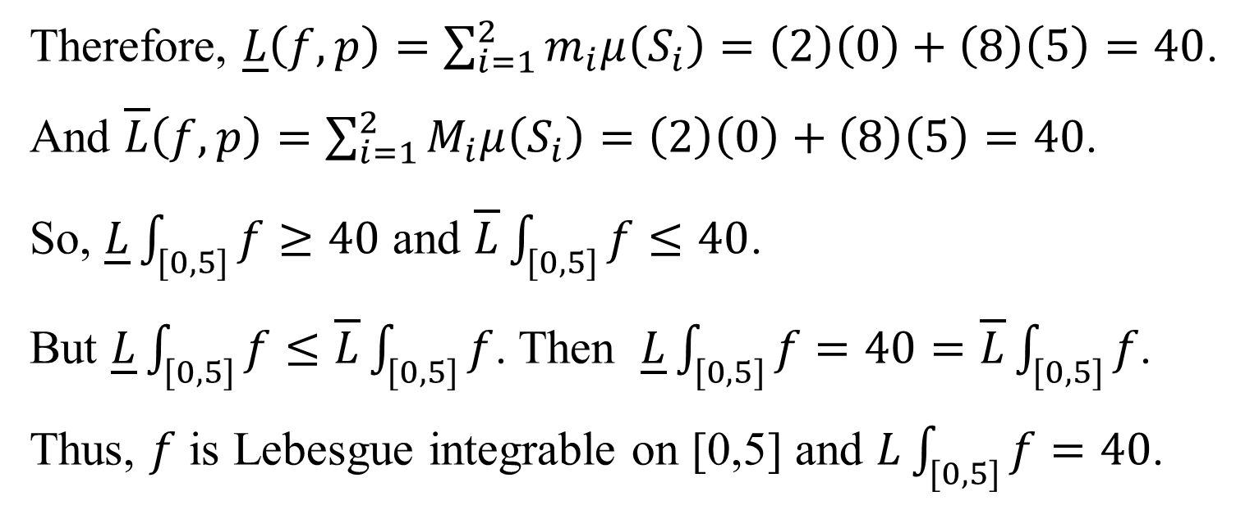
Therefore, $\underline{L}\left(f,p\right)=\sum_{i=1}^{2}{m_{i}μ\left(S_{i}\right)=\left(2\right)\left(0\right)+\left(8\right)\left(5\right)=40}$.
And $\overline{L}\left(f,p\right)=\sum_{i=1}^{2}{M_{i}μ\left(S_{i}\right)=\left(2\right)\left(0\right)+\left(8\right)\left(5\right)=40}$.
So, $\underline{L}\int_{[0,5]}{f≥40}$ and $\overline{L}\int_{[0,5]}{f≤40}$.
But $\underline{L}\int_{[0,5]}{f≤\overline{L}\int_{[0,5]}{f}}$. Then $\underline{L}\int_{[0,5]}{f=40=\overline{L}\int_{[0,5]}{f}}$.
Thus, $f$ is Lebesgue integrable on [0,5] and $L\int_{[0,5]}{f=40}$.

