Slide 1
Syntactic Structure and Analysis Higher Diploma English Department- College of Languages
Dr Rashwan Ramadan
rashwan.salih@su.edu.krd

Slide 2
1- Subject + verb (S V)
We laughed.
The lion roared.
The taxi arrived.
2- Subject+ verb + direct object (S V O)
Dickens wrote David Copperfield.
She narrated the story.
3- Subject + verb + subject complement (S V C)
The judgment seemed fair.
Our house was large.
He looked good.
She became president.
4- Subject + verb + direct object + object complement (S V O C)
He named his son Azad.
Rawa called Chra a genius.
5- Subject + verb + indirect object + direct object (S V O O)
She gave them flowers.
6- Subject + Verb + Object + Adverbial (S V O A)
He put the book on the table.

Slide 3
Tense
ASPECT TIME | Simple | Continuous | Perfect | Perfect Continuous
Past | S + V-ed 1 | S + (Be – was, were) V-ing 4 | S + (Have >> had) V –pp) 7 | S + (Have>>had) been + V-ing 10
Present | S + V (-0 / -s) 2 | S + (Be – is, am, are) V-ing 5 | S + (Have>> has, have) V-pp 8 | S + (Have>> has, have) + Been + V-ing 11
Future | S + (Modal) V 3 | S + (Modal)+ (Be) V-ing 6 | S + (Modal) + Have + V-pp 9 | S + (Modal) + have + been + V-ing 12

Slide 4
The Verb Phrase Page 67
There are two kinds of verb in English: lexical and auxiliary. Lexical verbs are the ones that belong to the indefinitely large general vocabulary of the language (e.g: run, eat, seem, explain, recycle, shatter, prepare, depend). Auxiliary verbs, by contrast, are a special and very restricted set of verbs. The clear ones are: be, have, and do (which can also be lexical) and can/could, will/would, shall/should, may/might, must, and need.
A full VP must contain a lexical verb and it may contain auxiliary verbs. In the following, the lexical verbs are in bold and the auxiliary verbs are in italics.
[1a] Diana plays the piano. [1b] Diana played the piano.
[2] Andy is explaining his generalisation.
[3] Maggie should have recycled those bottles.
[4] William may have been preparing his lecture.

Slide 5
Lexical Verbs
Lexical verbs are easily identified by their morphological (i.e. their wordform) possibilities. They are words that take some if not all of the verbal inflections -s, -ing, -ed, -en. For example: plays, playing, played and writes, writing, written.
In VPs containing only a lexical verb, that verb will always carry a present or past meaning. In fact, present and past are explicitly marked in [1] above: in [1a] play carries the present tense infection -s and in [1b] it carries the past tense inflection, -ed.

Slide 6
Multicategories of Lexical Verbs
Lexical Verbs may have multi-categories. For example, interest is certainly a verb: interests, interesting, interested. It is a verb in [5]:
[5] Millie’s hair interested him.
But both interest and interests can also be nouns (singular and plural respectively) as in [6a–b]
[6a] The monthly interest was too high.
[6b] His interests do not please the family.
While interesting and interested can be adjectives – as –in [7a–b]
[7a] A very interesting plan was proposed.
[7b] He wasn’t very interested in the bean production.

Slide 7
Note that the adjectives interesting and interested are gradable and so can be modified by very. By contrast, no verb can be modified by very:
[8a] *Millie’s hair very interested him.
[8b] *Her hair was very interesting him.
Now decide on the category – or categories – of each of the following words. Most of them belong to more than one category. You’ll find it helpful to construct sentences in which they can function.
open, impossible, appeal, up, content, export, edit.

Slide 8
1. Morgan opened his mouth.
2. Morgan’s open mouth admitted the fly.
3. That was clearly impossible.
4. Mary appealed to John to take the rubbish out.
5. Her repeated appeals were unsuccessful.
6. He booted his drunken colleague up the gangway.
7. They up the rent every other month.
8. Georgette is perfectly content.
9. Jenny criticised the content of the paragraph.
10. He contented himself with a second-hand copy.
11. Toffee-wrappers are the main export.
12. Boggis and Stone export toffee-wrappers to Mesopotamia.
13. Max has edited a grand total of 253 books.

Slide 9
The complements of lexical verbs
There are functional relations between lexical verbs and other constituents that appear in the basic Verb Phrase.
[9] Phil dreads affectionate cats.
The VP is dreads affectionate cats, and dreads is the verb. The relation between the V (dreads) and the NP (affectionate cats) is a head–complement relation. It is a two-way dependency between the verb (as head) and the NP (as complement).
The use of dreads without a following NP is ungrammatical, and so is the use of the NP without dreads:
[10] *Phil dreads. [11] *Phil affectionate cats.
But not all lexical verbs require a following NP. If we change the verb from dread to sunbathed, for example, we get a different pattern of grammaticality:
[12] *Phil sunbathed affectionate cats. [13] Phil sunbathed.

Slide 10
Intransitive and Transitive Verbs p.69
Lexical verbs are sub-categorized according to what other elements must appear with them in the VP. In other words, they are sub-categorised in terms of what complements they demand.
[13] Phil sunbathed (beside a stream).
[14] Phil dreads affectionate cats (in the hay-fever season).
The verbs dread and sunbathe can be distinguished by the obligatory presence or absence of a following NP but not by the (optional) presence or absence of a following PP.

Slide 11
Now, try putting these verbs in sentences in order to identify which category they belong to:
die
make
disappear
inspect
laugh
play
spot
throw

Slide 12
[15a] Max died. [15b] *Max died Bill.
[16a] *Max made. [16b] Max made a noise.
The verb die clearly belongs to the same sub-category as sunbathe, as do disappear and laugh: none of these verbs allows a following NP.
But make clearly belongs with dread, as do inspect, spot, and throw: these demand a following NP.
The verb play, on the other hand, belongs to both sub-categories, with different meanings:
[17] The children played.
[18] Max played the tuba.

Slide 13
All types of verbs based on this categorization:
(1) transitive
(2) intransitive
(3) ditransitive
(4) intensive
(5) complex transitive
(6) prepositional

Slide 14
1- Transitive Verb:
A transitive verb is one which requires a single Noun Phrase to complement it. The NP that complements a transitive verb is said to function (more specifically) as its direct object.
If the NP that completes a VP is a pronoun, then it should be in the OBJECTIVE CASE and not the SUBJECTIVE CASE.

Slide 15
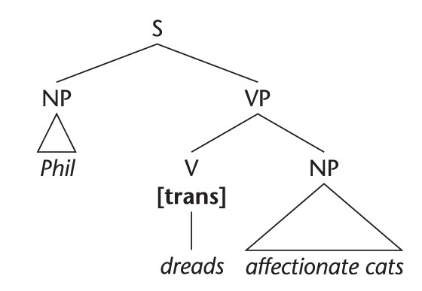
In [21] I have added to the V node the extra label ‘[trans]’, short for ‘transitive’.
This extra label is called a feature, and it simply sub-categorises the verb as being transitive. This sub-categorisation feature is needed in order to specify the function of the following NP in terms of the phrase marker itself.
Thus, when an NP is the sister of a V bearing the [trans] feature, we know that the NP is functioning as direct object.

Slide 16
2- Intransitive verbs: p. 71
An intransitive verb is one that does not require any further constituent as a sister in the VP. ‘Intransitive’ means ‘has (and needs) no complement’.
Since an intransitive verb requires no further element to form a complete predicate, an intransitive verb counts as a complete VP on its own and will be added [intrans] feature on the V node.
E.g: disappear, die, laugh, vegetate, arrive

Slide 17
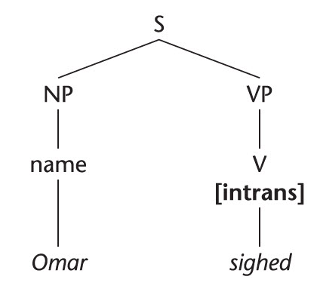
So, a very simple sentence like (Omar sighed.) is represented as in [22] – with the [intrans] feature on the V node.
[intrans] verbs do not need further constituents to complete the VP.
Constituent: is a syntactic unit that functions as part of a larger unit within a sentence.

Slide 18
3- Ditransitive verbs: They require TWO NPs as complements, and a label of [ditrans] feature is added on the V node. The classic examples of a ditransitive verb are give, send and buy:
[23a] William gave Millie some bleach.
[24a] The staff sent the general a message.
[25a] Max buys his butler all necessary work-clothes.
In [23a]–[25a] the first complement (the NP in bold) functions, more specifically, as the indirect object of the ditransitive verb. Indirect objects are usually the recipients or beneficiaries of the action. The second complement NP (in italics) functions as the direct object –

Slide 19
[26] William gave Millie some bleach. P.72
Both the NPs are governed by the V gave and would appear in the objective case if they were pronouns.

Slide 20
Now decide which of the following verbs are ditransitive:
show
offer
see
tell
announce

Slide 21
[27] Max showed Matilda his collection of books.
[28] The shopkeeper offered them a good deal.
[29] Marry told his boss the news.
Each of (27), (28), and (29) are ditransitive verbs, since they accept two consecutive NPs. But (30) and (31) don’t accept two NPs so they are not ditransitive (in fact they are transitive):
[30] *Max saw Matilda his collection of books.
[31] *Marry announced her boss the news.

Slide 22
Different constituents as complements to Ditransitive Verbs
1- S V O-id (NP) O-d (NP)
William gave Millie some bleach.
2- S V O-d (NP) PP
- William gave some bleach to Millie.

Slide 23
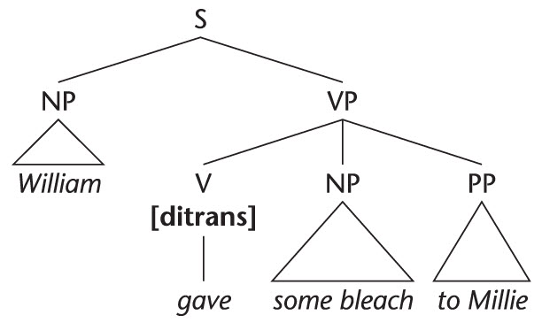
An important characteristic of VPs consisting of a ditransitive verb complemented by two NPs is that they are systematically related to VPs in which the indirect object NP (bold in [23a]–[29]) corresponds to a Prepositional Phrase (PP) in a position following the direct object. Thus [23a] corresponds with [23b]:
[23b] William gave some bleach to Millie.
The PPs that correspond in this way with indirect objects are always introduced by either to or for.
What are the appropriate [b] forms for [24a] and [25a]?
[24b] The staff sent a message to the general.
[25b] Max buys all necessary work-clothes for his butler.
These [b] sentences can be represented as in [32]:
P. 73

Slide 24
The PP corresponding to an indirect object NP has a special status. With transitive verbs, when a PP follows the direct object NP, it is not part of the complementation of the verb but is an optional modifier.
However, in using a ditransitive verb such as send, we need to specify not only (a) a sender (usually subject), and (b) what is sent (usually the direct object), but also (c) to whom it is sent (usually indirect object).
Indirect objects can take the form of either an NP or a PP containing to or for.
So, PPs that correspond to indirect objects are part of the complementation of ditransitive verbs.
The indirect object, then, is either (a) the first of two NP sisters of a V bearing a [ditrans] feature:
William gave Millie some bleach.
or (b) the PP which is a sister of a V bearing a [ditrans] feature:
William gave some bleach to Millie.
As for the direct object of a [ditrans] verb, it is either (a) the second NP sister of V or (b) the NP sister of V which has a following PP sister.
P. 73

Slide 25
4- Intensive verbs:
Intensive verbs require a single complement, which can take the form of an Adjective Phrase, a Noun Phrase or a Prepositional Phrase. The most obvious and commonly used intensive verb is be. As the central example of the intensive sub-category of verb, be is called ‘the copula’.
[33] Edward is rather extravagant. (AP)
[34] Sigmund was an auctioneer. (NP)
[35] Oscar and the mechanic were in the engine room. (PP)
Copula: It is a verb that joins the subject of a sentence or clause to a subject complement. The typical copula verb in English is “be”. However, there are lexical verbs that function as copula: look, smell, feel, become, get, seem, appear, turn, remain, taste, sound… etc

Slide 26
Examples of Copulas
- That car looks fast.
- The stew smells good.
- Tom felt a fool.
- She became a racehorse trainer.
It is getting late.
The plan sounds good.
He turned red.
They remain confident.

Slide 27
The differences between the complements of Intensive Verbs
The complement of an intensive verb functions (more specifically) as a predicative.
When a verb is complemented just by an AP, it is definitely an intensive verb, because [intensive] is the only sub-category of verb that can take just an AP complement.
However, intensive verbs can be complemented by an NP or a PP and, when a verb is complemented by an NP, you will have to decide whether [V + NP] is an example of [transitive V + direct object] or an example of [intensive V + predicative].
Understanding the concept of ‘predicative’ involves understanding the difference between predicative and direct object.

Slide 28
Compare these two examples:
[36] Sigmund was an auctioneer.
[37] Sigmund spotted an auctioneer.
In both, we have a verb complemented by an NP. In [37] the verb is transitive, so the NP complement functions more specifically as direct object. As a direct object, the NP identifies an individual distinct from Sigmund (referred to by the subject NP Sigmund). In saying that Sigmund spotted an auctioneer, we mention two distinct individuals – Sigmund and the auctioneer – and say that the former spotted the latter. It is in the nature of spotting that it’s a relation between two individuals: a spotter (subject) and a spottee (direct object). That’s what makes spot a transitive verb. While [36] does not express a relation between two individuals. (the VP) is used to characterise the subject.

Slide 29
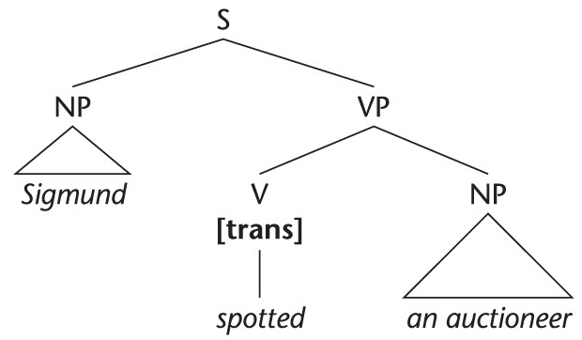

Slide 30
Predicatives are mainly adjectives but could also be NPs
Predicatives are used to attribute properties to the things referred to by other expressions. Unlike direct/indirect objects, they do not themselves refer to things or people.
An NP can function either as predicative (complementing an intensive verb and attributed to the subject) or as direct object (complementing a transitive verb).

Slide 31
Difference between Intensive and Transitive Verbs
Many of the intensive verbs also belong to the transitive subcategory, but with a different meaning. This difference between transitive (+ direct object) and intensive (+ predicative) can be identified by contrasting the two meanings of such verbs.
For each of the following decide whether the (italicised) complement NP is complementing a transitive verb as direct object or complementing an intensive verb as predicative:
[38] Max turned a subtle shade of green.
[39] Max turned another card.
[40] Tarzan felt a tap on his shoulder.
[41] Tarzan felt a real idiot.
P.75

Slide 32
[43] The hat became a very useful wastepaper basket.
[44] The captain sounds an absolute tyrant.
[45] The captain sounded the ship’s horn.
The NPs are functioning as direct objects (complementing the verbs in their transitive senses) in [39], [40], and [45]. They are functioning as predicatives (complementing the verbs in their intensive senses) in [38], [41], [43], and [44]. Notice that, in the latter cases, those NPs could be replaced by APs without changing the sense of the verb (green in [38], idiotic in [41], ever more useful in[43], and absolutely tyrannical in [44]). P.75

Slide 33
Complex transitive verbs P.76
Complex transitive verbs take two complements: a direct object (NP) and an object-predicative. The predicative can take the form of an AP, an NP or a PP.
[48] Jack finds his own jokes extremely funny. (AP)
[49] They made Stella their spokesperson. (NP)
[50] Liza put the liquor under her bed. (PP)
The difference between Subject-predicative (e.g: SVC) and Object-predicative (E.g: SVOC) is that the predicative in a complex transitive VP characterizes (attributes) a property to the direct object, not the subject, hence the name ‘object-predicative’.

Slide 34
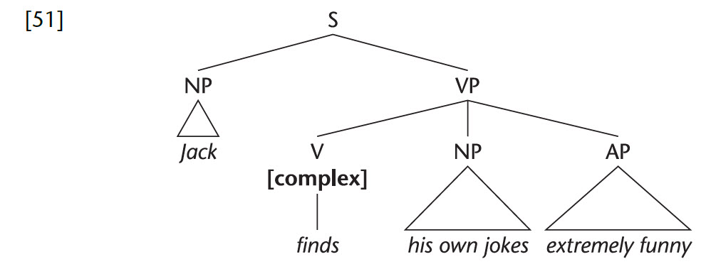
The semantic relation between direct object and object-predicative in a complex transitive VP parallels that between the subject and the subject-predicative in an intensive sentence. It’s an intensive relation.
In assigning the feature [complex] to the V node, we are making the whole phrase marker represent the function of his own jokes as direct object and the function of extremely funny as object-predicative (those are the functions associated with complex transitive verbs). This is particularly needed in a case like [52a].
[52a] Max found [Bill] [an amusing companion]. P.77

Slide 35
[52a] Max found [Bill] [an amusing companion].
This example is ambiguous. First identify the two interpretations in your mind and then explain the ambiguity by assigning different functions to the two complements of the verb. On the basis of that, you should be able to assign two different sub-categorisation features to the V found.
[ditrans] Max found an amusing companion for Bill.
[complex] Max found Bill to be an amusing companion.

Slide 36
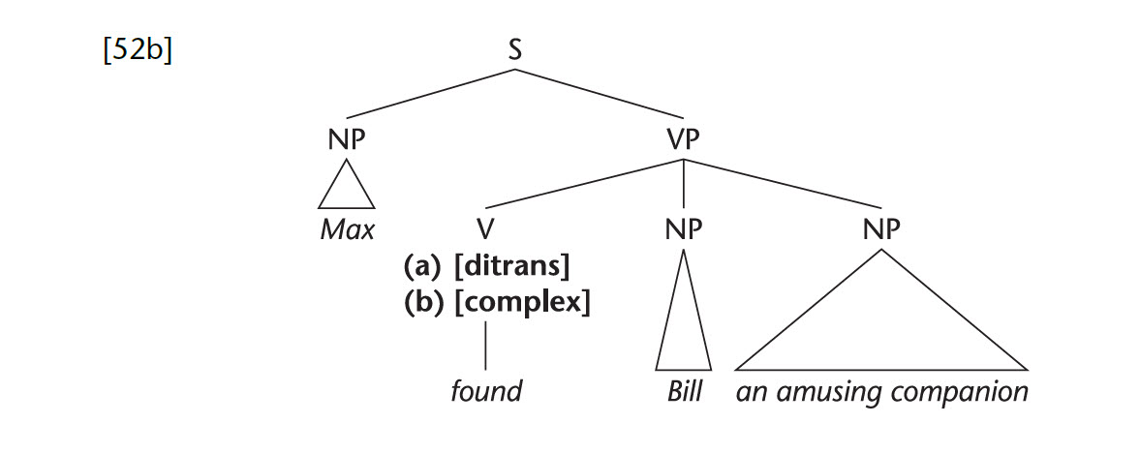
The sentence is ambiguous, because it has two parsing options.

Slide 37
[52a] Max found an amusing companion for Bill. On this interpretation, the verb find is ditransitive: Bill refers to the beneficiary and is functioning as indirect object, and an amusing companion is the direct object. Notice that three participants are involved on this (ditransitive) interpretation.
When [52a] corresponds with (b) Max found Bill to be an amusing companion. On this interpretation, Bill and an amusing companion have the functions associated with the complementation of complex transitive verbs: direct object (Bill) and object-predicative (an amusing companion). On this complex transitive interpretation, there are only two participants, Max and Bill; an amusing companion merely attributes a property to Bill.

Slide 38
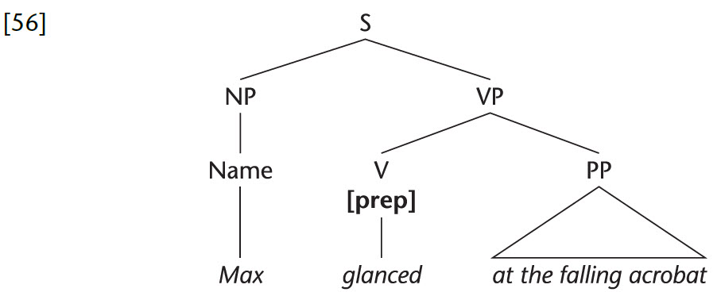
Prepositional Verbs P.78
Glance (at NP), reply (to NP), refer (to NP), and worry (about NP) are examples of prepositional verbs – complemented by a Prepositional Phrase. Take glance, for example:
[53] *Max glanced. (glance is not intransitive)
[54] *Max glanced the falling acrobat. (glance is not transitive)
[55] Max glanced at the falling acrobat. (glance demands a PP complement)

Slide 39
We call the PP that complements a [prepositional] verb, a prepositional complement.
There are three kinds of VP consisting of [V + PP]:
(a) V[intens] + PP. The PP is a complement (subject predicative)
(b) V[prep] + PP. The PP is a complement (prepositional complement)
(c) V[intrans] + PP. The PP is an optional modifier.
Difference between Prepositional Verbs and Intensive Verbs:
Prepositional [prep] verbs are called ‘prepositional’ because they can only be complemented by a PP.
While the [intens] verbs can be complemented by NP, AP or PP.

Slide 40
Each [prep] verb generally demands that the head of that PP be one particular preposition.
For example:
glance [at NP], not *glance [to NP]
refer [to NP], not *refer [at NP]
Worry [about NP], not *worry [at NP] or *worry [to NP]

Slide 41
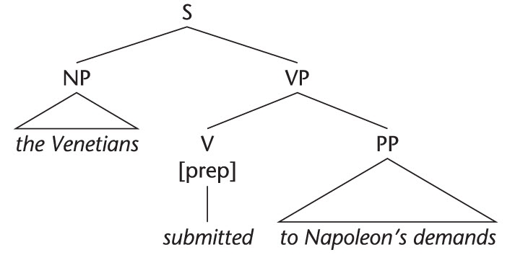
More examples on Prepositional verbs
The Venetians submitted to Napoleon’s demands.

Slide 42
How many types of prepositional phrases as obligatory complements to VPs are there ?
Prepositional Phrases have a variety of functions. We have looked at four so far. As (obligatory) complements of verbs, they may function as:
[A] subject-predicative in [intens] VPs
[B] object-predicative in [complex] VPs
[C] indirect-object in [ditrans] VPs (but only with to or for)
[D] prepositional complement in [prep] VPs

Slide 43
Adjunct Adverbials (PPs functioning as adjuncts)
Adjunct PPs (Adjuncts) express a wide range of ideas, including manner, means, purpose, reason, place, and time (including duration and frequency).
They tend to answer questions like Where? Why? When? How? What for? How long? How often? How many times?

Slide 44
As mentioned, since most PPs are optional and can occur with almost any verb, they cannot be used to sub-categorise the verb. In other words, they are not functioning as complements. They give additional, though not essential, information.
When a constituent functions within a VP as the PPs in the following sentences, it is said to function as an adjunct adverbial.
Ed was rather extravagant in the bazaar.
Sigmund was an auctioneer for three years.
Oscar was in the engine-room in a flash.
William gave Millie flowers on her birthday.
Liza put the liquor under the bed for safekeeping.

Slide 45
Summary of verbs sub-categorization based on major constituents’ functions

Slide 46
Identifying sub-categories of verbs in sentences

Slide 47
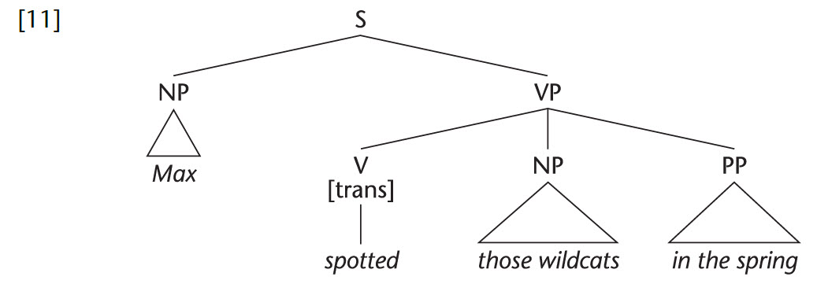
Levels of verb phrase P.88
How do adjunct adverbials fit into the structure of VPs?
Adjuncts are described as modifiers within the VP, but there are two possibilities of the modification.
E.g: Max spotted those wildcats in the spring.
1- The PP (in the spring) as a modifier of the verb (spotted), it should be a sister of the verb, along with those wildcats, as in [11]:

Slide 48
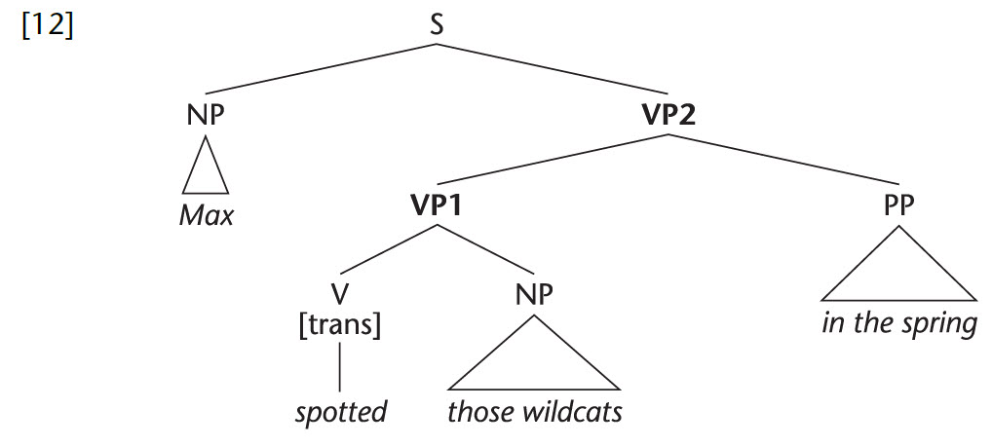
On the other hand, if the PP (in the spring) modifies (spotted those wildcats), then it must be the sister of a constituent consisting of [verb + direct object NP], i.e., V + NP must form a constituent. They don’t form a constituent in [11], do they? So, if we choose this second option, [11] cannot be the right analysis.
So, the whole phrase marker must look like [12], in which, for ease of reference, they are numbered with two VPs. VP1 is the ‘basic VP’ introduced in the last chapter.

Slide 49
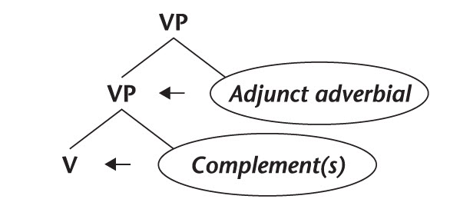
The difference in function between (obligatory) complements of the verb and (optional) modifying adjunct adverbials is to be represented in phrase markers as follows:
complements of the verb are sisters of Verb (V)
adjunct adverbials are sisters of Verb Phrase (VP) (Adjunct adverbials are modifiers of VPs.)
P.90

Slide 50
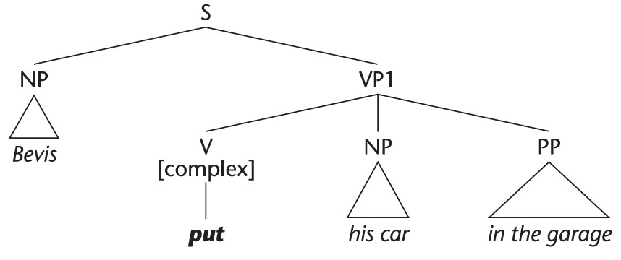
[13] Bevis mended his car in the garage. [14] Bevis put his car in the garage.

Slide 51
Mobility of adjunct adverbials P.92
Which positions can very surreptitiously occupy in [27]?
[27] She put it under the bed.
[28] Very surreptitiously, she put it under the bed.
[29] She very surreptitiously put it under the bed.
[30] She put it very surreptitiously under the bed.
[31] She put it under the bed very surreptitiously.
Adjunct adverbials can fit in most places in the sentence except between the verb and direct object.

Slide 52
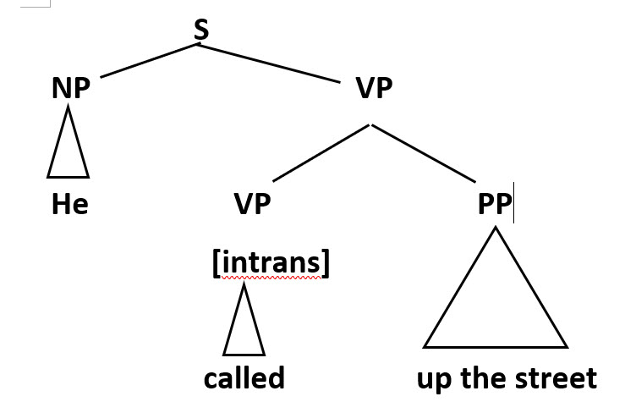
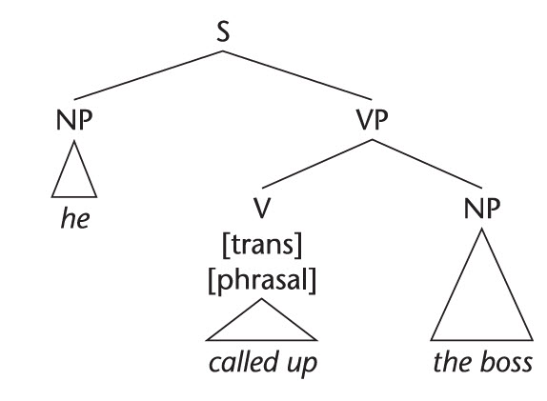
Phrasal Verbs P.93-94
A phrasal verb consists of a verb + a particle (preposition or adverb). PPs functioning as adjuncts or complements within VP must be distinguished from another apparently similar structure. Consider the difference between [33] and [34]:
[33] He called up the street. [34] He called up the boss.

Slide 53
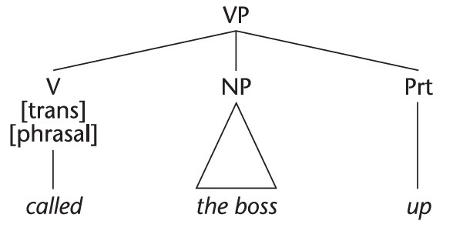
Characteristics of Particles p.95
A characteristic of particles is that they can appear in a position after the direct object. So, particle movement provides a very reliable test for distinguishing between [phrasal verb + (direct object) NP] and [verb + PP].
- He called up the boss. >> paraphrased as >> He called the boss up.
He called up the street. >> NOT paraphrased as >> *He called the street up.
Also, when the direct object is a pronoun,
the particle must appear after it:
[40a] He called him up.
[40b] *He called up him.

Slide 54
Types of phrasal verbs
1- Inseparable
The object must come at the end because the verb and the preposition must stay together).
Correct: I always run into Tom at the mall. Incorrect: I always run Tom into at the mall. Incorrect: I always run Tom at the mall into.
E.g: get on/off, look after, run out of, run into, put up with…
2- Separable
The verb and the preposition can be separated, putting the object in the middle.
Example:
Correct: This is very important information. Please write it down. Incorrect: This is very important information. Please write down it.
E.g: write down, pick up, put on, turn down, make up…

Slide 55
Phrasal Verbs Vs Prepositional Verbs and Intensive verbs
The particle can only move over a direct object NP. It cannot move over a PP.
E.g: He put up with John.
*He put up John with.
The particle cannot move over a subject-predicative NP as well.
E.g: He turned out a brilliant lawyer.
* He turned a brilliant lawyer out.
P.95

