Slide 1
Conversation questions
Small talks
Mixed tenses

Slide 2
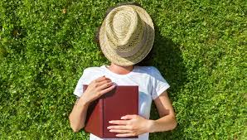
What do you like doing in your free time during the day?
I like ….
I don’t like...

Slide 3
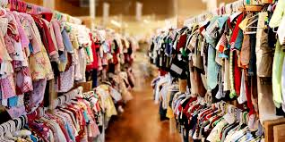
Can you talk about three things you are wearing now?
I’m wearing...

Slide 4
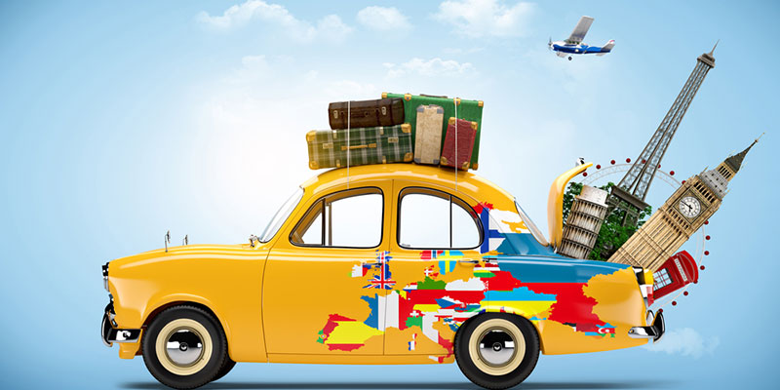
Can you talk about three places you would like to go on vacation?
I would like...

Slide 5
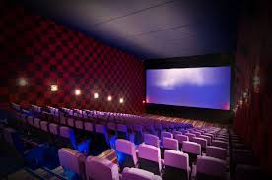
What is your favorite movie?
My favourite movie ...

Slide 6
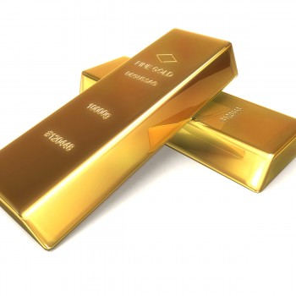
What's the most expensive thing you've ever bought?
The most expensive thing i’ve bought...

Slide 7
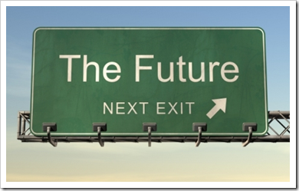
Can you talk about three things you want to do in the next twelve months?
In the future i want to ...

Slide 8
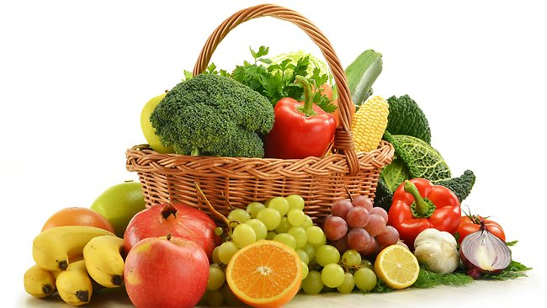
What are the most common fruits and vegetables in your country?
The most common...
What’s your favourite?
My favourite ...

