Slide 2
What do you find the most difficult about using the telephone?
What type of phone call do you find the most difficult to handle?
What type of phone calls do you make? (business, personal, employment)
What things make it difficult for you to understand during a telephone conversation?
Do you feel comfortable asking for clarification on the telephone?
Do you feel comfortable asking someone to repeat information?
Do you feel comfortable asking someone to slow down when they are speaking too quickly?
Do you feel comfortable asking someone to spell their name or address?

Slide 3
Telephone Etiquette

Slide 4
Telephone etiquette doesn't mean being stiff and overly formal on the phone, and it isn't just for talking to your grandmother or impressing a potential client. Using basic courtesy and good manners when talking and texting helps set a positive tone for a conversation and can help you avoid confusing, frustrating or even embarrassing situations.

Slide 5
Taking Calls
DO greet the caller pleasantly and identify yourself when you answer the phone. In a business setting, say "Good morning" or "Good afternoon," then name your company or department and say who's speaking. On a personal phone, say "Hello" and give your name. DON'T answer in a brisk or hurried tone or with "Yes" or "Yeah." People don't want to feel like their call is unwelcome.

Slide 6
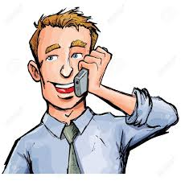
Making Calls
DO identify yourself clearly and politely ask for the person you're trying to reach or briefly state your reason for calling. Take a few moments before you place the call to determine what you're going to say. Being clear and concise up front will save time and reduce confusion. DON'T demand to talk to someone or launch into a request or complaint without first saying hello and identifying yourself. The recipient of your call will be much happier to help you if you make a good first impression.

Slide 7
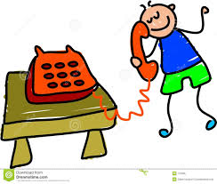
Using Your Voice
DO speak in a friendly, pleasant voice with moderate volume. Smiling while you're talking, regardless of whether anyone is looking at you, will improve your tone of voice. DON'T use an inappropriate volume. A voice that's too loud can sound aggressive, while an overly quiet voice can be very difficult to understand. If you have difficulty controlling the volume of your voice, try moving the receiver a little distance away from your ear and listen to yourself talk for a few moments. Adjust your volume as needed.

Slide 8
Watch Your Language
DO use polite, professional language, speaking to your conversation partner the way you would hope to be spoken to. If you're on a professional call, keep your conversation partner informed of what's going on at your end. DON'T use abrupt phrases or issue orders to your conversation partner, such as "Hang on" or "Who's calling?" If you're on a professional or business call, avoid using slang.

Slide 9
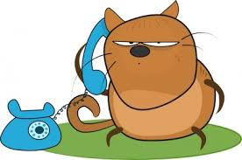
Call Interrupted
DO apologize if you're interrupted during a call and ask your conversation partner's permission before placing him on hold. Check back in on him regularly while he's on hold. DON'T talk in a distracting environment, try to multitask while you talk or carry on in-person conversations while you're on the phone.

Slide 10
Time to Say Goodbye
DO wind down the conversation courteously by using closing and past tense phrases, such as "Thanks for calling" and "I'm glad we were able to talk today." End the call by clearly saying goodbye. DON'T stop the conversation abruptly or impatiently. Avoid ambiguous or slang closing phrases like "OK, see ya" or "Toodles" that might make your partner uncertain about whether the call is ending.

Slide 11
Taking Messages
DO sound friendly and accommodating, letting the caller know you're writing her message down and will pass it on to the person she's trying to reach as soon as possible. If you need more information from the caller, ask for it politely and not in a prying way. DON'T be impatient or short with the caller. If she suspects her message won't be forwarded, she may be uneasy. Don't be nosey by asking for more information than you need or the caller wants to give.

Slide 12
Leaving Messages
DO speak clearly and slowly, leaving your name and complete number both at the beginning and the end of the message and briefly stating what you're calling about. DON'T ramble on or go into too much detail in a message, and don't assume that the caller remembers your last name or can get your number from the phone's display.

Slide 13
Using Cellphones
DO speak in a soft voice in public places and be mindful of your language and subject matter. If you think you might disrupt those around you, move to a different location or don't take the call. DON'T answer your phone or let it ring in a theater, library or meeting or at a table in a restaurant. Never talk on the phone or text while you're driving.

Slide 14
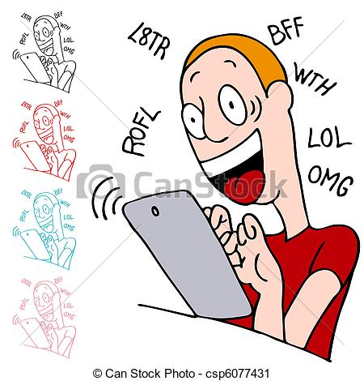
Texting Tips
DO identify yourself in text messages and be clear and concise. Be mindful of whether your recipient has a texting plan (so you can avoid sending too many messages) and whether he is familiar with common text speak. DON'T text anywhere where a phone call would not be appropriate, and don't text while you're having a conversation or should have your attention elsewhere. Avoid sending serious or sad news by text message.

Slide 15
Scenarios

Slide 16
A: Hello.
B: Hello, I'd like to speak with Mr. Smith, please.
A: He's not here right now. Can I take a message?
B: Sure. Can you tell him to call John Roberts?
A: Ok, I'll give him the message.
B: Thanks. Bye!
A: Goodbye.

Slide 17
A: Hello.
B: Hello, is this Mrs. Jones?
A: No, I think you have a wrong number.
B: This isn't 687-5791?
A: No, this is 686-5791.
B: Oh, I'm sorry.
A: It's ok.

Slide 18
A: Sears, how may I help you?
B: Hello, I'm looking for some information on bedroom furniture.
A: Please hold. I'll transfer you to the Furniture Department.
B: Thank you.

Slide 19
A: Hello.
B: Hello. Can I talk to Jim, please?
A: Sorry, he's busy right now.
B: Ok, I'll call back later.
A: Ok, bye.

Slide 20
A: Hello.
B: Hello, may I speak to Mrs. White?
A: Who's calling, please?
B: This is her sister, Janet.
A: Ok, I'll find her... Actually, she's not here.
B: I'll call back later then. Thank you. Goodbye.
A: Goodbye.

Slide 21
Part 1 Respond to the call

Slide 22
You 've reached ............ company/department.
___________?

Slide 23
How can I help you?
___________?

Slide 24
Can I speak to Mr/Mrs.....?
___________?

Slide 25
Could I speak to ...., please?
___________?

Slide 26
Who shall I say is calling?
___________?

Slide 27
Who's calling, please?
___________?

Slide 28
Who's speaking?
___________?

Slide 29
It's Mr/Mrs... here.
___________?

Slide 30
It's Mr/Mrs... speaking.
___________?

Slide 31
Mr/Mrs... speaking.
___________?

Slide 32
Please hold and I'll put you through.
___________?

Slide 33
Just a second. I'll see if s/he is in.
___________?

Slide 34
Hang on for a moment.
___________?

Slide 35
______________?
Who's calling?

Slide 36
Part 2

Slide 37
______________?
Can I take a message?

Slide 38
______________?
Do you want to leave a message?

Slide 39
______________?
Do you want to leave a message?

Slide 40
______________?
Please hold. One moment please.

Slide 41
______________?
I'd like to speak to...

Slide 42
______________?
Can you tell him/her to call me?

Slide 43
______________?
I'll call him/her back.

Slide 44
______________?
I'll leave my name and number.

Slide 45
______________?
Can I talk to Sophie?

Slide 46
______________?
Is John there?

Slide 47
______________?
I'll leave a message.

Slide 48
______________?
You have a wrong number.

Slide 49
______________?
Is this the Windsor Hotel?

Slide 50
______________?
Is this Mr. Miller?

Slide 51
______________?
You can reach me on my cell phone.

