Slide 1
Kurdistan Regional Government-Iraq
Ministry of Higher Education & Scientific Research
Salahaddin University
College of Education
Department of Mathematics
Advanced Programming
loop
Lecture : Rebaz Yaseen Taha
rebaz.taha@su.edu.krd
2022 -2023

Slide 2
Loops
Loops cause a section of your program to be repeated a certain number of times
Repeats until the condition remains true
Terminates when the condition becomes false

Slide 3
Loops in C++
for loop
while loop
do loop

Slide 4
Loops
Counter-controlled Loops
Depends on the value of a variable known as counter variable. The value of the variable is incremented or decremented in each iteration.
Example: for loop
Sentinel-Controlled Loops / Conditional loop
A loop that terminates when something happens inside the loop body indicating that loop should be exited. Also known as conditional loops
Example: while and do loops

Slide 5
(1) for loop
#include <iostream>
using namespace std;
int main()
{
int j;
for (j=0; j<10; j++)
cout << j * j <<endl;
return 0;
}

Slide 6
(1) for loop - Syntax
for (int j=0; j<10; j++)
cout << j * j <<endl;
Initialization
expression
Test Condition
Increment expression
cout << j*2 <<endl;
cout << j*j*j <<endl;

Slide 7
(for loop) -- Class Exercise-1
- Get a number form user and calculate its factorial

Slide 8
(for loop) -- Class Exercise-2
- Write a program that ask the user to enter a number. The program should print the Cube of all integers starting from 1 to the Number.
E.g.,
Enter a Number: 4
1 1
2 6
3 27
4 64

Slide 9
(for loop) -- Class Exercise-3
- Write a program that asks the user to enter two numbers: speed1, and speed2 representing speeds in KPH (Kilo meters per Hour). Then the program should convert and show table of speeds in MPH (Miles per Hour) for all the speed values between speed1 and speed2.
MPH = KPH * 0.6214
speed1 and speed2 variables should be multiple of 10. Each table entry (in KPH) should be updated by 5 in each iteration.

Slide 10
for loop – Multiple Expressions
for (int j=0, k=9; j<10; j++,k--)
cout << j * j <<endl;
cout<< k*k <<endl;
Multiple Initialization
expressions
Multiple Increment/Dec
expressions
Only one
Test Condition

Slide 11
(1) for loop - Variable Visibility
void main()
{
int j;
for(j=0; j<10; j++) {
int k=0;
k = j*j;
cout<<“\nValue of k: “<<k;
}
// k = 23; Cannot do this!
}

Slide 12
(1) for loop – optional expressions
int j=0;
for(; j<10; j++)
cout<<“\nHello world“;
int j=0;
for(; j<10;)
{
cout<<“\nHello world“;
j++;
}
for(; ;)
cout<<“\nHello world“;
Infinite loop
(it never terminates)

Slide 13
(1) for loop - Variable Visibility
void main()
{
for(int j=0; j<5; j++)
cout<<“\nValue of j: “<<j;
cout<<“\nValue of j: “<<j; // ERROR
}
Loop body

Slide 14
while loop
for loop does something a fixed number of times.
If you don’t know how many times you want to do something before you start the loop?
In this case a different kind of loop may be used: the while loop

Slide 15
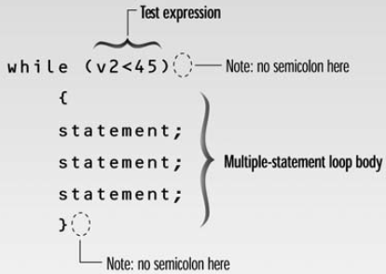
while loop - syntax
Loop body contain
single statement
Loop body contain
Multiple statement

Slide 16
Interesting, right?
This is just a sneak preview of the full presentation. We hope you like it! To see the rest of it, just click here to view it in full on PowerShow.com. Then, if you’d like, you can also log in to PowerShow.com to download the entire presentation for free.

