Slide 1
Advanced Research Methodology for Master Students
Dr. Rebwar Nasir Dara
Salahaddin University
College of Science
rebwar.dara@su.edu.krd

Slide 2
Introduction to Research Methodology Lecture 1

Slide 3
Course Objectives
To give the students:
A comprehensive understanding on all aspects of research.
A guide on how to conduct research in a systematic way.
A guide to solve and analyse data and results.
A guide on writing techniques and presentation skill.

Slide 4
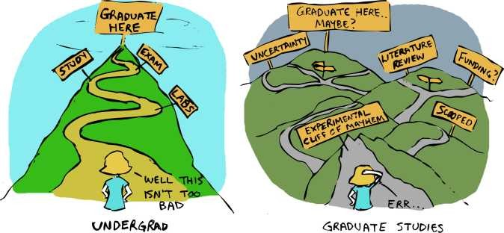

Slide 5
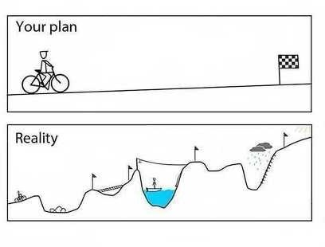

Slide 6
Masters (Course work)
Masters (Mixed-mode) Masters (Research) Mphil
PhD (Research)

Slide 7
Text books
by ARNOLD LUWANG USHAM

Slide 8
What is Research?

Slide 9
What is Research (Cont.)?
Research is an organized, systematic, database, critical, scientific inquiry or investigation into a specific problem, undertaken with the objective of finding answers or solution to it.

Slide 11
Two Important Characteristics

Slide 13
Two Important Characteristics (Cont.)

Slide 14
Two Important Characteristics (Cont.)

Slide 15
The aims of research

Slide 16
Factors to consider
The impact of your personal feelings and beliefs.
Access to data
Time and other resources
Validity and reliability of the data
Ethical issues

