Slide 1
Salahaddin University Collage of Education Biology Department
Impact of air pollution on environmental health and safety
Prepared by:
Asma Hewa Raza
Supervised by:
Mr. Rebwar Khdir Shekha

Slide 2
Air Quality
Air is essential for all life. All depends on its existence; without it nothing breathes or lives. Air is a homogeneous mixture of gases and suspended particles that exist in various compositions and sizes, this chemical composition is in a state of continuous change according to place and time as a result to many chemical reactions and physical transformations that affect air quality.

Slide 3
Air Pollution
Air pollution is the presence of substances in the atmosphere that are harmful to the health of humans and other living beings, or cause damage to the climate or to materials. There are different types of air pollutants, such as gases (such as ammonia, carbon monoxide, sulfur dioxide, nitrous oxides, methane and chlorofluorocarbons), particulates (both organic and inorganic), and biological molecules. Although a number of physical activities (volcanoes, fire ,etc.) may release different pollutants in the environment anthropogenic activities are the major cause of environmental air pollution.

Slide 4
Sources of air pollution
Air pollution can result from both human and natural actions:
1- Natural sources 2- Artificial sources
Natural sources
fire forest
Dust storms
volcanic eruption
pollen grain
Methane, emitted by the digestion of food by animals.

Slide 5
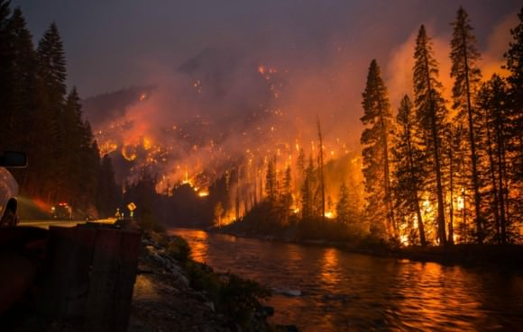
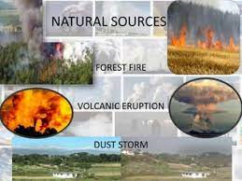
Sources of air pollution
.

Slide 6
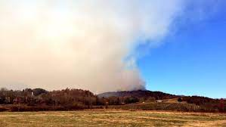
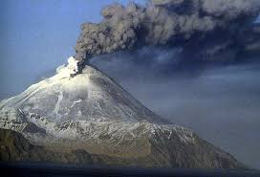
Sources of air pollution
.

Slide 7
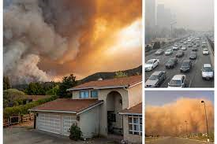
Sources of air pollution
.

Slide 8
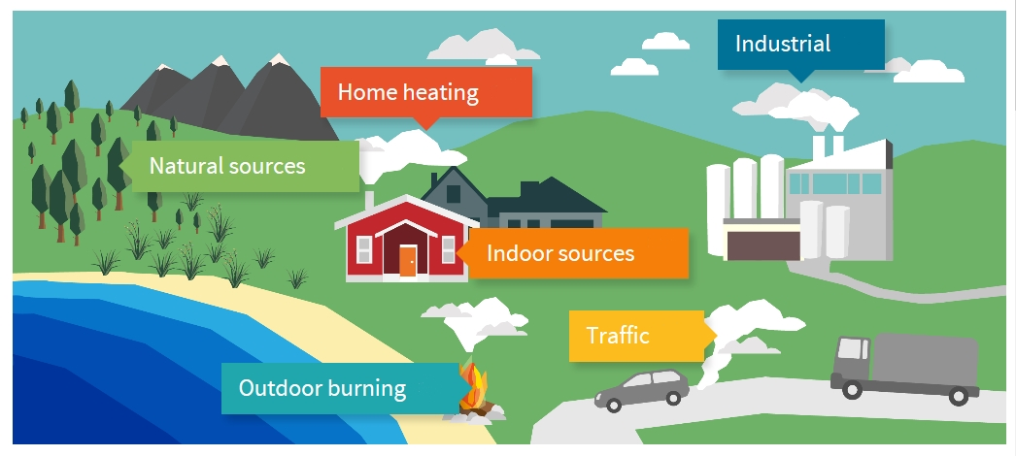
Sources of air pollution
.

Slide 9
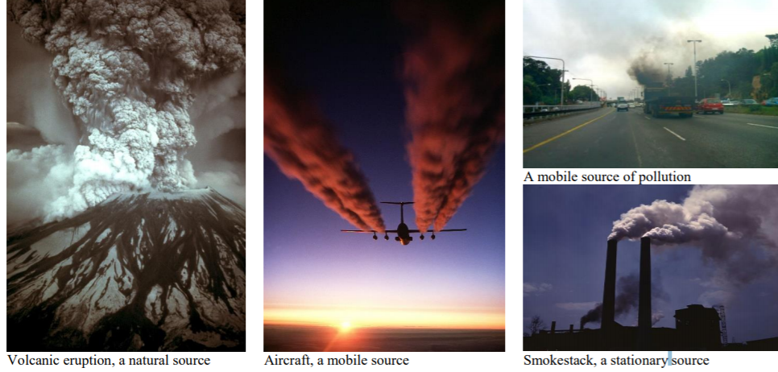
Sources of air pollution
.

Slide 10
Sources of air pollution
Artificial sources
Stationary sources (factories).
Mobile sources example: motor vehicles
Burn practices in agriculture and forest management
Fumes from paint, hair spray, varnish, aerosol sprays and other solvents.
Fertilized farmland.

Slide 11
Types of pollutants
Primary sources
They are pollutants which are directly emitted in to atmosphere from different polluted sources such as cars, volcano and industrial plant.
Secondary sources
They are pollutants which are formed by chemical reaction of two or more primary pollutants. Photochemical is responsible to formation of secondary pollutants (PAN, Ozone in troposphere).

Slide 12
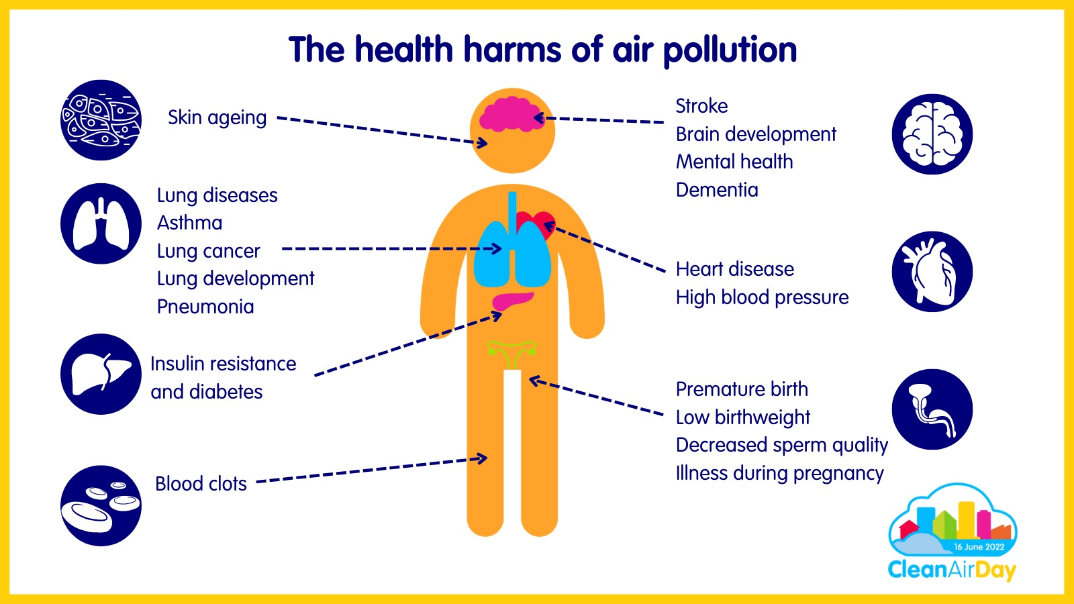
Effects of Air Pollution

Slide 13
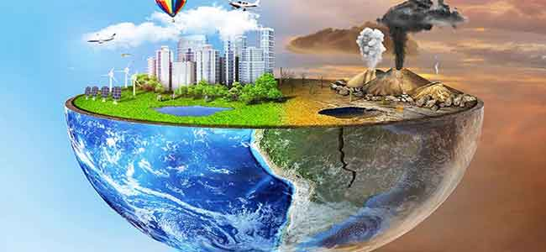
Effects of Air Pollution

Slide 14
Treatment of air pollution
Device
Rules
Plants

Slide 15
Air Quality Index
Air Quality Index (AQI) is a valuable tool to indicate the levels of daily air pollutants from a public health point of view. It is an alert to the public in terms of health impact. AQI values var­ies from “0” to “500” and its value is proportional to the concentrations of the pollutants in the air. Thus, greater AQI indicates more serious health complications. A daily air quality index (AQI) has been suggested by En­vironmental Protection Agency and the procedure was later updated and defined in terms of main air pollutants: Carbon monox­ide (CO), Nitrogen dioxide (NO2), Ozone (O3), particulate matter (PM) and Sulfur dioxide (SO2).

Slide 16
Air Quality Index

Slide 17
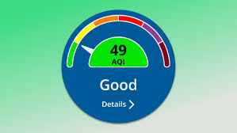
Air Quality Index

Slide 18
Air Quality Index

Slide 19
Conclusion
Air pollution is a mixture of solid particles and gases in the air. Car emissions, chemicals from factories, dust, pollen and mold spores may be suspended as particles. Ozone, a gas, is a major part of air pollution in cities. When ozone forms air pollution, it's also called smog. Some air pollutants are poisonous. Inhaling them can increase the chance you'll have health problems. People with heart or lung disease, older adults and children are at greater risk from air pollution. Air pollution can be prevented only if individuals and businesses stop using toxic substances that cause air pollution in the first place. This would require the cessation of all fossil fuel-burning processes, from industrial manufacturing to home use of air conditioners. This is an unlikely scenario at this time. However, we have to make rules which set stringent regulations on industrial and power supply manufacturing and handling. The regulations are to be designed to further reduce harmful emissions into the Earth's atmosphere.

Slide 20
Conclusion
AQI) is a valuable tool to indicate the levels of daily air pollutants from a public health point of view, it depending on color for determine level of pollutants risk. Air pollution is a mixture of solid particles and gases in the air. Car emissions, chemicals from factories, dust, pollen and mold spores may be suspended as particles. Ozone, a gas, is a major part of air pollution in cities. When ozone forms air pollution, it's also called smog. Some air pollutants are poisonous. Inhaling them can increase the chance you'll have health problems. People with heart or lung disease, older adults and children are at greater risk from air pollution. Air pollution can be prevented only if individuals and businesses stop using toxic substances that cause air pollution in the first place. This would require the cessation of all fossil fuel-burning processes, from industrial manufacturing to home use of air conditioners. This is an unlikely scenario at this time. However, we have to make rules which set stringent regulations on industrial and power supply manufacturing and handling. The regulations are to be designed to further reduce harmful emissions into the Earth's atmosphere. AQI) is a valuable tool to indicate the levels of daily air pollutants from a public health point of view, it depending on color for determine level of pollutants risk.

Slide 21
thanks

