Slide 1
Practical Pollution
Alkalinity
Lab .2

Slide 2
Alkalinity is a measure of the capacity of water or any solution to neutralize or “buffer” acids. This measure of acid-neutralizing capacity is important how “buffered” the water is against sudden changes in pH.

Slide 3
Alkalinity should not be confused with pH. pH is a measure of the hydrogen ion (H⁺) concentration, and the pH scale shows the intensity of the acidic or basic character of a solution at a given temperature. The reason alkalinity is sometime confused with pH is because the term alkaline is used to describe pH conditions greater than 7 (basic).
The most important compounds in water that determine alkalinity include the carbonate (CO₃²⁻), bicarbonate (HCO₃⁻) ions and OH. The ability to resist changes in pH by neutralizing acids or bases is called buffering.

Slide 4
Alkalinity is important to aquatic organisms because it protects them against rapid changes in pH. Alkalinity is especially important in areas where acid rain is a problem.

Slide 5
Sources
One source of alkalinity is calcium carbonate (CaCO₃), which is dissolved in water flowing through geology that has limestone and/or marble. Limestone is a sedimentary rock formed by the compaction of fossilized coral, shells and bones. Limestone is composed of the minerals calcium carbonate (CaCO₃) and/or dolomite (CaMg(CO₃)₂), along with small amounts of other minerals. Limestone is converted to marble from the heat and pressure of metamorphic events.

Slide 6
OH⁻ | Hydroxide ion
HCO₃⁻ | Bicarbonate ion
CO₃²⁻ | Carbonate ion

Slide 7
In addition to rocks and soils, the alkalinity of water can be influenced by: salts, plant activity, and wastewater

Slide 8
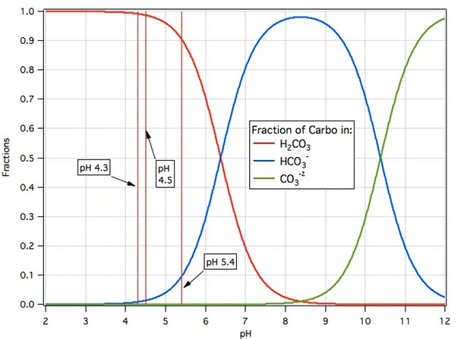

Slide 9
Types of Alkalinity:
1- Phenolphthalein Alkalinity
Phenolphthalein indicator
2- Total Alkalinity
Methyl Orange indicator

