Slide 1
Practical Pollution
Acidity of Water
Lab .3

Slide 2
Water acidity is ability of water to neutralize a strong base to designated pH. Acidity is produced by substances that yield hydrogen ions on hydrolysis or a substance is considered acid if it will neutralize hydroxyl ions or mineral acids, weak acids such as carbonic and acetic and hydrolyzing salts such as iron or aluminum sulfate may contribute to the measured acidity. The determination of acidity by using titration at the end point pH of the indicator.

Slide 3
In natural water, domestic sewage& industrial waste acidity is usually due to carbon dioxide, mineral acids& hydrolyzed salts ( iron or aluminum sulfate). Carbon dioxide is a natural component of all natural water, it form carbonic acid, in the presence of water.
CO₂ + H₂O <===> H₂CO₃

Slide 4
The main source of carbon dioxide in the water:
-Atmosphere.
-Biological oxidation of organic matter particularly in polluted water (respiration).

Slide 5
Water has two types of acidity:-
1- Carbon dioxide acidity: It is type of measured acidity in water by titration to a pH of about greater than 4.5.
2- Mineral acidity: It is type of measured acidity in water by titration to a pH of about less than 4.5, the methyl orange end point (known as methyl orange acidity).

Slide 6
Depending on the indicator, types of acidity are:-
Methyl orange acidity: Is a type of acidity, the industrial waste that has pH below 4, containing mineral or Methyl orange acidity, they are neutralized at time the pH has been raised to 4.5. Methyl orange is normally used as indicator.
Phenolphthalein acidity: all the natural water have pH value located between 4.5-8.3 contain carbonic acid or Phenolphthalein acidity, most carbon dioxide neutralized at the time the pH has been raised to 8.3, Phenolphthalein indicator can be used in this range.

Slide 7
The three sources of most of the [H+] that participate in such reactions are:
1) Hydrolysis, as in [H2O] = [H+] + [OH-].
2) Disassociation of acidic solutes H2CO3 = [H+] + [HCO3-].
3) Oxidation reactions such as [H2S] + 4[H20] = [S04-2] + 10[H+] + 8 electrons.

Slide 8
With lower pH levels are more likely to leach heavy metals from the environment. As a result, water — ends up with a higher concentration of heavy metals. Exposure to heavy metals can be dangerous, potentially leading to heavy metal poisoning and toxicity. Accumulation of heavy metals such as lead, mercury in the tissue of fish and plant (these metals available for plant by acid rain, enter water body through leaching process from the soil) which eat by human and animal through food chain, these metals are toxic elements and killing them..

Slide 9
pH of 4.5 or less have been shown to increase the risk of tooth decay, regularly drinking acidic water may slowly erode your tooth, causing cavities, exposure to certain heavy metals, including lead, cadmium, arsenic, and chromium, has been linked to negative side effects for bone health.
Due to its high acidity, water with a low pH can start to dissolve metal pipes over time, causing leaks and further increasing the presence of heavy metals in your drinking supply.

Slide 10
Most aquatic plant grow best in water with pH 7 to 9. When the pH is decrease, the aquatic plant life decline, reduce food for some water birds. At the pH 5.5, bacteria that decompose leaf litter and other debris begin to die. Aluminum leach from the soil by acidic water enter the lake in great quantities, fish population located under more stress. Young fish do not survive. Under acidic or metallic condition, fish female will not spawn and fish egg will not hatch. If pH is less than 5, the animal lives in harsh environment and create many problems such as diseases, below pH 5, adult fish die. For instance, a reduction of about 1.5 pH units can cause a thousand-fold increases in the acute toxicity of a metal-cyanide complex.

Slide 11
Also, the availability of many nutrient substances varies with the acidity. With higher pH values, for instance, iron tends to become unavailable to some plants.
In general, moderate acidity in irrigation water is beneficial to alkali soils for it helps to neutralize carbonates and prevents the precipitation of calcium. In fresh waters, the pH values and acidities of natural streams vary widely depending upon the soil and vegetation of the watershed.

Slide 12
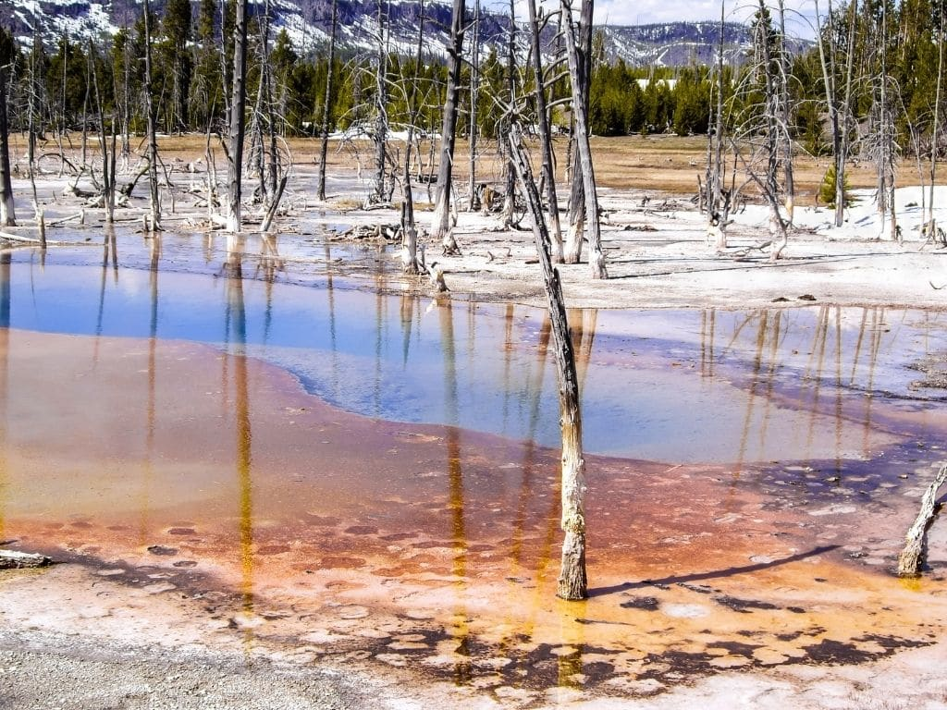

Slide 13
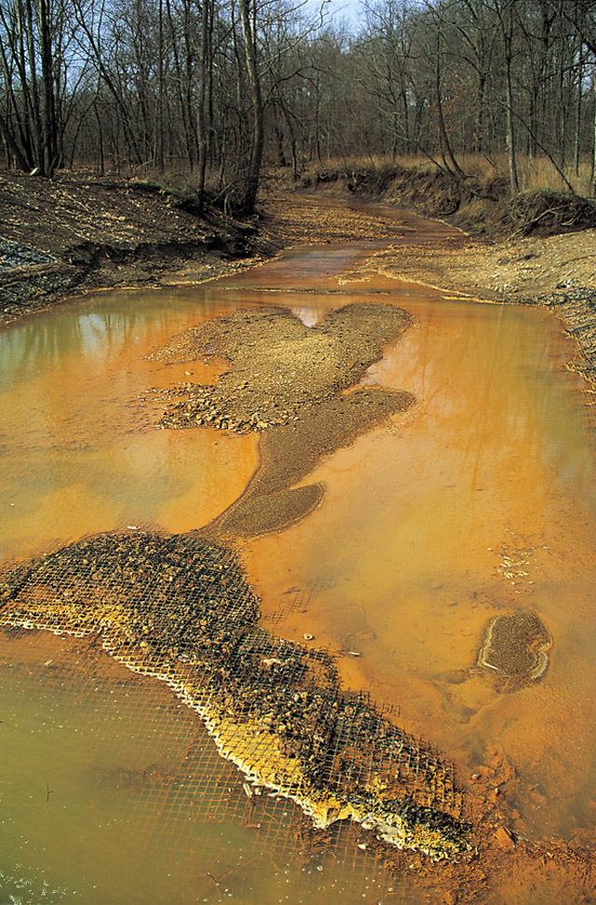

Slide 14
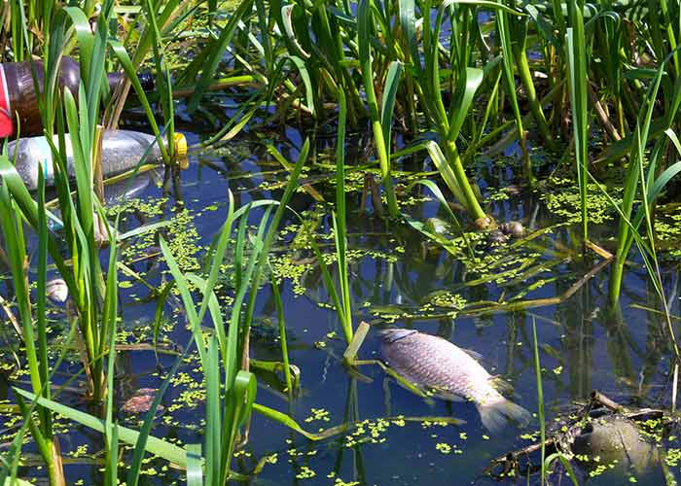

Slide 15
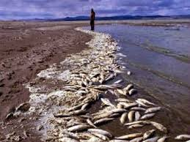

Slide 16
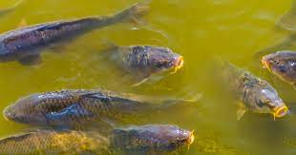

Slide 17
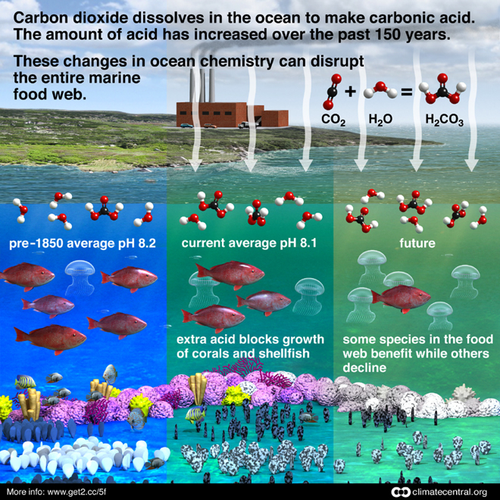

Slide 18
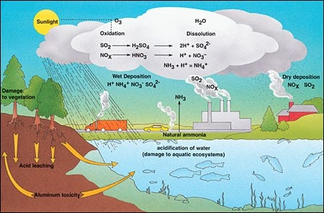

Slide 19
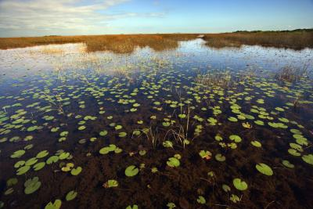

Slide 20
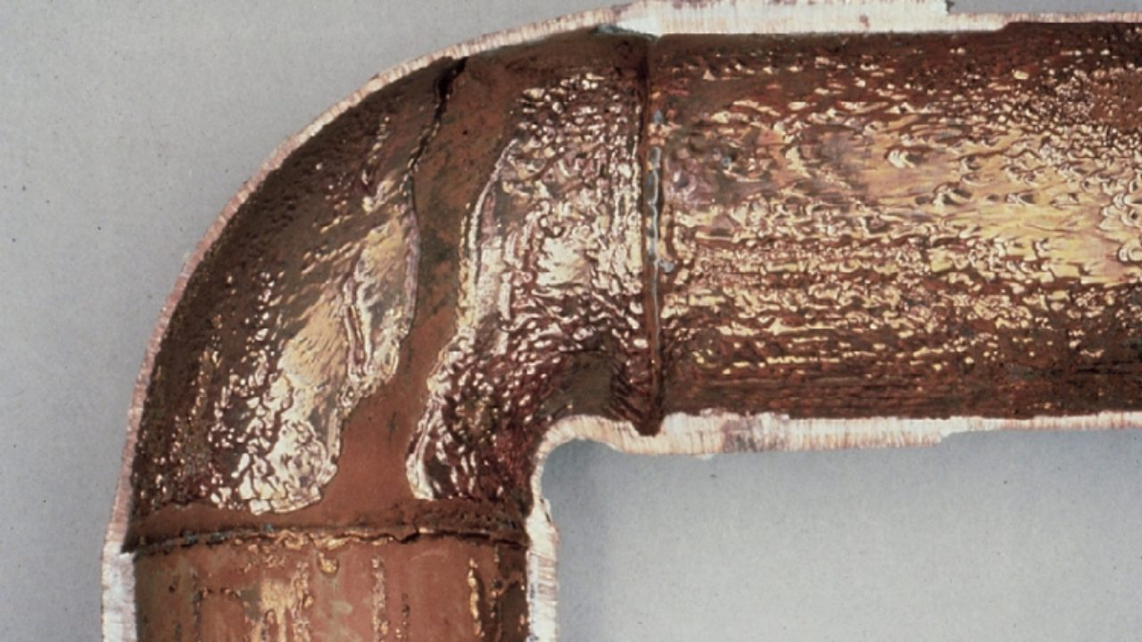

Slide 21
