Slide 1
Practical ecology
Nitrate
Lab .9

Slide 2
Nitrogen is one of the most abundant elements in nature. About 78 percent of the air we breathe is nitrogen. Nitrate is naturally occurring ions that is a part of the nitrogen cycle. It is found in the cells of all living things and is a major component of proteins. Inorganic nitrogen may exist in the Free State as a gas N₂, or as1 nitrate NO₃⁻, nitrite NO₂⁻, or ammonia NH₃⁺. Organic nitrogen is found in proteins and is continually recycled by plants and animals. Nitrate is the most highly oxidized form of nitrogen compounds, is commonly present in surface and ground water because it is the end product of the aerobic decomposition of organic nitrogenous matter.

Slide 3
The source of nitrate are chemical fertilizers from cultivated land and drainage from livestock feedlots, domestic and some industrial water. The determination of nitrate helps the assessment of character and degree of oxidation in surface water. Nitrate is found in many natural water at concentration of between (1-10mgl⁻¹).

Slide 4
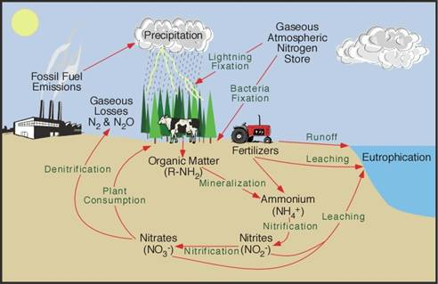

Slide 5
Major uses and application
Nitrate is used mainly in inorganic fertilizers. It is also used as an oxidizing agent and in the production of explosives, and purified potassium nitrate is used for glass making. It is a part of cells of all living things and is a major component of proteins.

Slide 6
Principle:
Use this technique only for screening samples that have low organic matter contents, uncontaminated natural waters and potable water supplies. Measurement of UV absorption at 220 nm enables rapid determination of . Because dissolved organic matter also may absorb at 220 nm and does not absorb at 275 nm, a second measurement made at 275 nm may be used to correct the value.

Slide 7
Consequently, this method is not recommended if a significant correction for organic matter absorbance is required, although it may be useful in monitoring levels within a water body with a constant type of organic matter. Correction factors for organic matter absorbance can be established by the method of additions in combination with analysis of the original content by another method. Sample filtration is intended to remove possible interference from suspended particles. Acidification with 1 N HCl is designed to prevent interference from hydroxide or carbonate concentrations up to 1000 mg CaCO₃/L.

