Slide 1
Practical Ecology
Meteorology , Meteorological Instruments
Lab. 2

Slide 2
Meteorology is one of the oldest observational sciences in human history and perhaps the most relevant to a broad segment of society. Some of our first observational meteorologists and weather forecasters were shepherds, farmers and sailors whose livelihoods and safety depended upon understanding and predicting the weather.

Slide 3
Meteorologyisthe science that deals with the phenomena of the atmosphere, especially weather and weather conditions.
Meteorological station is a specific place, either on land or sea, with instruments and equipment for measuring atmospheric conditions to provide information for weather forecasts and to study the weather and climate.

Slide 4
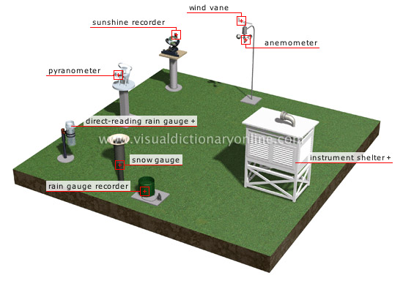

Slide 5
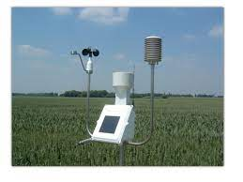

Slide 6
Weather forecasting is the application of science and technology to predict the state of the atmosphere for a given location.
Weather is current state of the atmosphere and is measurable in terms of temperature, atmospheric pressure, humidity, wind speed and direction, cloudiness and precipitation.
Climate is the state of the atmosphere over long time periods, such as over years, decades, centuries or greater.

Slide 7
Meteorological Parameters
Temperature: the heat energy which affected by solar energy of the sun, measured by thermometer in degree centigrade (ºC) or Fahrenheit (ºF) or Kelvin.
Air temperature: the degree of hotness or coldness of the air. Temperature is measured with a Thermometer or Thermograph.
Atmospheric pressure: is a measure of the force exerted by the mass of atmosphere on the surface at given location. The average pressure of the atmosphere at mean sea level is about 1 kg per square cm, Atmospheric pressure is measured with a barometer.

Slide 8
Humidity is a general term that refers to the water vapor content of the air. Absolute humidity is the actual amount of water vapor per volume of air.
Relative humidity is the percentage of water vapor in the atmosphere compared with the maximum amount of water vapor that the atmosphere could contain at that temperature. Humidity is measured with a psychrometer.

Slide 9
Wind, the movement of air from one place to another, it has two character Wind speed is measured with a 4-cup anemometer and wind direction is measured with a weather vane. The amount of cloud cover is estimated either visually or photographically. The amount of precipitation is measured with a rain gauge.

