Slide 1
Practical ecology
Soil
Lab .5

Slide 2
Pedology is a branch of soil science focusing on the formation, morphology, and classification of soils as bodies within the natural landscape.
Soil is outer portion of earth’s crust that is a natural body consisting of layer constituent of variable thickness which differs from the parent materials in there morphological, physical, chemical and mineralogical characteristic. It is the material that plants grow in and which provides the mechanical support, water and nutri­ent reservoir necessary for plant growth.

Slide 3
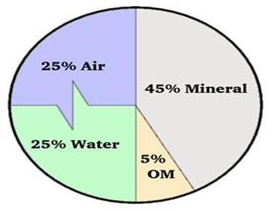
Soil component:
Soil is comprised of minerals, soil organic matter, water, and air. The composition and proportion of these components greatly influence soil physical properties, including texture, structure, and porosity, the fraction of pore space in a soil. these properties affect air and water movement in the soil, and thus the soil’s ability to function.

Slide 4
Soil forming factors:
(Parent materials, climate, time, organisms…)
Soil Physical Properties
Soil horizon (profile):
are layers parallel to the soil surface whose physical, chemical and biological characteristics differ from the layers above and beneath.
O horizon: The "O" stands for organic. It is a surface layer, dominated by the presence of large amounts of organic material in varying stages of decomposition system.

Slide 5
A horizon: this layer has a layer of dark decomposed organic materials, which is called "humus".
E horizon: is a subsurface horizon that has been heavily leached. Leaching is the process in which soluble nutrients are lost from the soil due to precipitation or irrigation. The horizon is typically light in color.
B horizon: is a subsurface horizon that has accumulated from the layer above. It is a site of deposition of certain minerals that have leached from the layer above.

Slide 6
C horizon: is composed of weathered parental material, Plant roots do not penetrate into this layer.
R horizon: the final layer of a typical soil profile this layer consisted of unweathered rock. (Bedrock) layer that is beneath all the other layers.

Slide 7
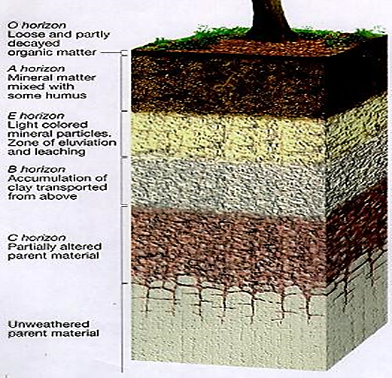

Slide 8
Soil forming factors:
1-Parent materials: Every soil “inherits” traits from the parent material from which it formed. For example, soils that form from limestone are rich in calcium and soils that form from materials at the bottom of lakes are high in clay.

Slide 9
2- Climate: Temperature and moisture influence the speed of chemical reactions, which in turn help control how fast rocks weather and dead organisms decompose. Soils develop faster in warm, moist climates and slowest in cold or arid ones.
3- Time: All of these factors work together over time. Older soils differ from younger soils because they have had longer to develop.

Slide 10
4-Organisms: Plants root, animals burrow, and bacteria eat – these and other organisms speed up the breakdown of large soil particles into smaller ones. For instance, roots produce carbon dioxide that mixes with water and forms an acid that wears away rock.

Slide 11
Soil Moisture
Water contained in soil is called soil moisture. The water is held within the soil pores. Soil water is the major component of the soil in relation to plant growth. If the moisture content of a soil is optimum for plant growth, plants can readily absorb soil water.

Slide 12
Forms of soil water:
Water percent in the soil can exist in three Forms:
1. Capillary water: Is held in the small pore or capillaries in continuous water film.
2. Hygroscopic water: Is the water that adsorbed on soil particle surface by surface tension or force.
3. Gravitational water: Is water that occupies aeration pore space but will drain down to lower depth under gravity force.

Slide 13
Water holding capacity (W.H.C.):
Is the maximum amount of water that soil retains it or (the ability of soil micro pore to hold water for the plant use).

Slide 14
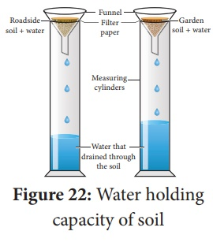

Slide 15
W.H.C. = Volume of retained water / weight of soil
Volume of retained water = volume of water used - volume of water in cylinder

