Slide 1
Practical Ecology
Measurement of soil texture
Lab .6

Slide 2
Soil texture is the proportion of the three sizes of soil particles which include sand, silt and clay. The texture of a soil is important properties because it determines soil characteristics that affect plant growth. A few of these characteristics are water-holding capacity and permeability. It affects the amount of water and nutrients that a soil can hold and supply to plants. Soil physical properties such as structure and movement of air and water through the soil are affected by texture. Texture is a relatively permanent physical property under natural conditions.

Slide 3
Soil textures determined in laboratory analyses where the amount of sand, silt, and clay are known quantitatively. The soil textural class is determined using the textural triangle. In the field, the soil's texture may be determined by the feeling method.

Slide 4
There are 12 different soil textural classes. The percentage units (0-100%) of sand, silt, and clay are listed along the sides of the triangle. Also notice that the relative proportion of sand, silt, and clay always adds up to 100%. These 3 separates are the only particles used to determine soil texture. Soil texture refers only to the mineral fraction of the soil. Organic matter is not considered when determining texture or textural class. A precise analysis of soil texture requires that organic matter be removed.

Slide 5
The ranges of diameters of the three separates are: sand (2.0- 0.05 mm), silt (0.05-.002 mm), and clay (<0.002 mm).

Slide 6
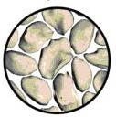
Sand: Is the largest of the mineral particles, particles creating large pore space that improving aeration. water flow quickly through large pore space. Sandy soil lacks the ability to hold nutrient and are generally well drained, also are not fertile.

Slide 7
Silt: Is medium size soil particles. It has good water –holding ability and fertility character.
Clay: Is the smallest size soil particles. It has ability to hold both nutrient and water that can be use by plants. It create very small pore space resulting I poor aeration and poor water drainage.

Slide 9

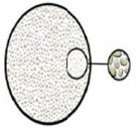
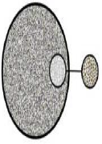
Sand Silt clay

Slide 10
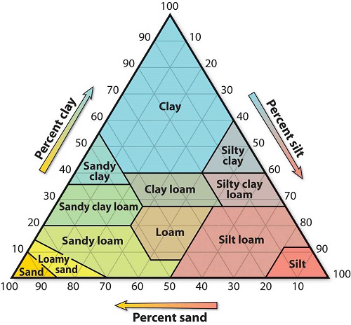

Slide 11
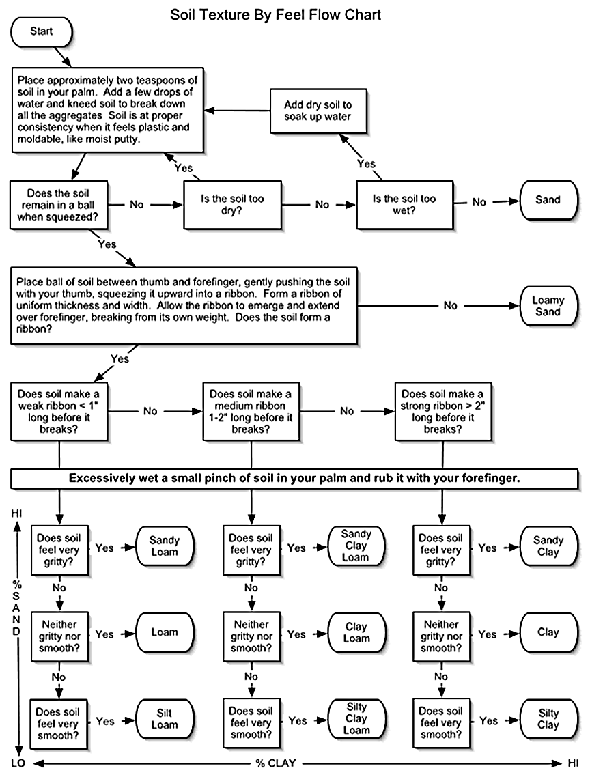

Slide 12
