Slide 1
Practical Ecology
Soil Organic Matter
Lab .7

Slide 2
Soil organic matter is any material produced originally by living organisms (plant or animal) that is returned to the soil and goes through the decomposition process; it is an important parameter in assessing the quality of a soil. Organic matter influences many of the physical, chemical and biological properties of soils. Some of the properties affected by organic matter include soil structure, soil compressibility or compaction. In addition, it also affects the water holding capacity, nutrient contributions, biological activity, and water and air infiltration rates.

Slide 3
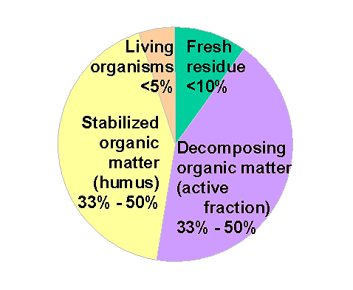
Soil organic matter =all living organisms (microorganisms, earthworms, etc), fresh residues (old plant roots, crop residues, recently added manures), well-decomposed residues OM and stable OM (humus).

Slide 4
The decomposition of OM is largely biological process that occurs naturally, the speed of this process is determine by three major factors:
1-soil organisms. 2-physical environment.
3-quqlity and quantity of OM.

Slide 5
Benefits of Soil Organic Matter:
1-Physical benefits
Enhance aggregate stability, improving water infiltration, soil aeration and reduce runoff, improve W.H.C.

Slide 6
2- Chemical Benefits
Increase ability to hold and supply over time essential nutrients such as calcium , magnesium and potassium. Improve the ability of soil to resist pH change.
3-Biological Benefits
Provide food for living organisms, Enhance pore space through action of soil organisms. This helps to increase infiltration and reduce runoff. Increase microbial biodiversity.

Slide 7
Factors effects on SOM are:
1. climate such as Moisture, temperature and aeration.
2. Proper fertilization.
3. Crop rotations.
4. Tillage practices (ploughing).
5. Vegetation burning and Returning crop residues to the soil.
6. Land use and management practices, leaching by water and humus stabilization.

