Slide 1
Practical ecology
Soil pH
Lab .9

Slide 2
Soil pH is an important measurement parameter to assess potential availability of beneficial nutrients and toxic elements to plants. pH is a measure of the acidity of the water or soil based on its hydrogen ion concentration and is mathematically defined as the negative logarithm of the hydrogen ion concentration, or pH = -log[H+], where the brackets around the H⁺ symbolize "concentration".

Slide 3
The pH of a material ranges on a logarithmic scale from 1-14, where pH 1-6 are more acidic, pH 7 is neutral, and pH 8-14 are more basic. Lower pH corresponds with higher [H⁺], while higher pH is associated with lower [H⁺].

Slide 4
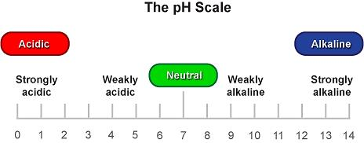

Slide 5
Soil pH is effecting by both acid and base forming cations (positively charge ions) in the soil. Common acid-forming cations are hydrogen (H+), aluminum (Al+3) and iron (Fe +2 or Fe+3). Where as common base-forming cations include Calcium (Ca+2), Magnesium (Mg+2), Potassium (K+) and Sodium (Na+).

Slide 6
Soil tend to become acidic as a results of :1-rainwater leaching away basic ions (calcium, Magnesium, Potassium and Sodium). 2- Carbone dioxide from decomposing organic matter and root respiration dissolved in soil water to form a weak organic acid. 3- formation of strong organic and inorganic acid such as nitric and sulfuric acid from decaying organic matter and oxidation of ammonium and sulfur fertilizers.

Slide 7
Soil pH Determination:
A meter or probe and litmus paper can be used to measure the pH of a sample, the method of meter or probe is more accurate, but expensive. The pH meters are calibrated using special solutions, or buffers with a known pH value ( pH 4, 7 and 9). Using litmus or pH paper is the simpler and less expensive way of measuring pH. This method employs special strips of paper that change color based on the pH of a sample solution.

Slide 8
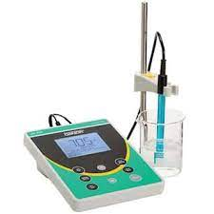

Slide 9
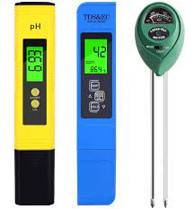

Slide 10
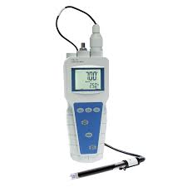

Slide 11
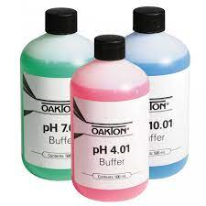
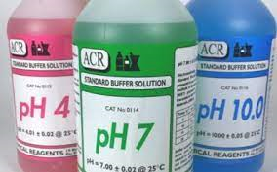

Slide 12
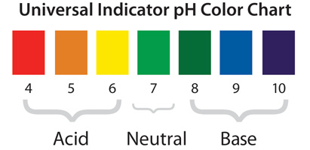

Slide 13
