Slide 1
Toxic metal detection in samples by digestion method
Lab 8

Slide 2
Toxic metal detection in samples by digestion method
Heavy metals are among the major contaminants of food and may pose serious threats to our environment and our body. Mostly, these are non-biodegradable and get transferred into human body via food chain. Trace heavy metals may act as nutrient or toxic agents for human health. Some of the trace metals like copper, selenium, cobalt, iron and zinc have important role in human body, while others are toxic like lead and cadmium.

Slide 3
Toxic metal detection in samples by digestion method
Lead (Pb) is among the well-known toxic metals. Cattle and Poultry may accumulate lead from environment, lead contaminated soils and contaminated water, using metal-based fertilizers, pesticides, transportation and harvesting processes may introduce lead in the soil, which is ultimately transferred into the plants grown onto it. Other sources of lead pollution include discharge of industrial wastewater, dust, gasoline using vehicle’s emissions and demolition of buildings with lead-based paints. From the contaminated cattle and poultry feed ingredients, lead is transferred into the human body via food chain.
Lead may cause renal failure, brain and liver damage, impairments to gastrointestinal tract (GIT), poor development of the grey matter of brain in children resulting in poor intelligence quotient (IQ). Maximum tolerance level (MTL) for Pb in poultry feed is 10 mg/kg.

Slide 4
Methods of digestion 1. Dry ashing mineralization:
Take 2 g of sample were taken in porcelain crucible, placed in muffle furnace at 500 °C for 5 h. The carbon free ash contents were solubilized in 5 ml conc. HCl. This solution was diluted up to 30 ml with distilled water.

Slide 5
2. Wet Acid Digestion on Hot Plate
0.5 g of sample was treated with the 10 mL HNO3 and 10ml H2SO4 in narrow opening flasks. Flasks containing mixtures were placed on hot plate at 100 °C and atmospheric pressure.

Slide 6
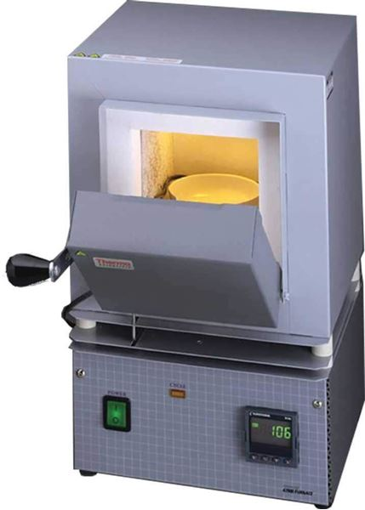
Determination of toxic metals in samples
Required materials and instruments
1. 125 ml beaker
2. Thin filter paper
3. kjeldahl flask
4. Hot plate
5. Thin filter paper
6. H2SO4 concentrate
7. HNO3 concentrate
8. Distilled water.
9. Muffle Furnace
10. Atomic absorption spectrophotometer
Muffle Furnace

Slide 7
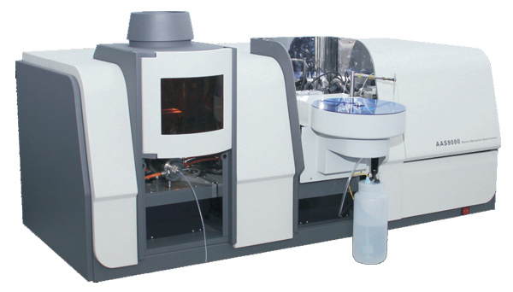
Procedure:
1.Put 0.5 gm of dry sample
2.Add (10) ml of HNO3 and 10ml of H2SO4 to
the sample.
3.Put the digestive tube (kjeldahl flask) on the hot plate until change the color.
4.Complete the digested samples with 100 ml distilled water.
5.Making filtration of digested samples.
6.After filtration and digested process the concentration of heavy metals are determined by atomic absorption spectrophotometer equipped with hallow –cathod lamp (electrode discharge source lamp) for heavy metal analysis.
Atomic absorption spectrophotometer

