Slide 1
Toxicity of hydrocarbons on microorganisms
Lab 2

Slide 2
Toxicity of hydrocarbons on microorganisms
Several classes of organic compounds are toxic for living organisms as they accumulate in and disrupt cell membranes.
Hydrocarbon compounds are compounds composed entirely of carbon and hydrogen. Hydrocarbon compounds are: Aromatic hydrocarbons, alkanes, alkenes, cycloalkanes, alkynes, and combinations of these compounds comprise different types of hydrocarbons. Complex mixtures of hydrocarbons occur naturally in crude oil and gasoline.

Slide 3
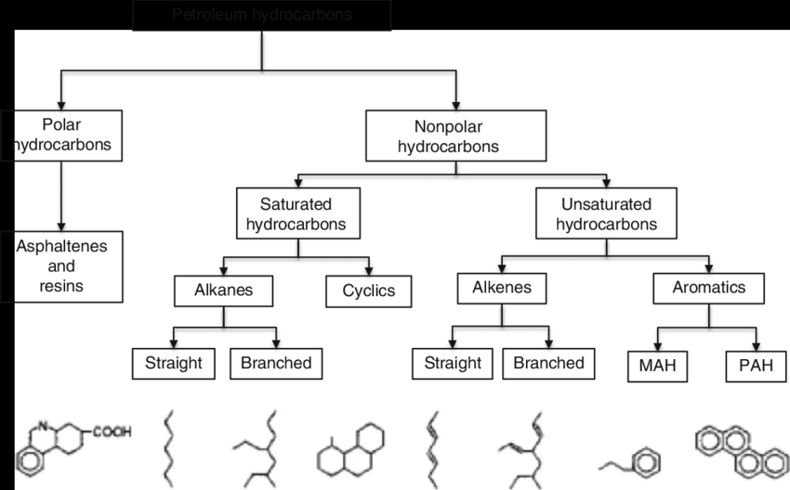
Classification of hydrocarbon

Slide 4
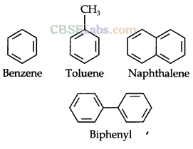
•Alkanes Alkanes are the simplest organic compounds made of
carbon and hydrogen only.
•Alkenes Alkenes are hydrocarbons that contain a carbon-carbon double bond (C=C) in their molecule.
• Alkynes
Alkynes are characterised by the presence of a triple bond in the molecule.
Aromatic Hydrocarbon:
Benzene and its derivatives are called aromatic compounds.
Alicyclic Compounds:
consist only of carbon atoms are called
alicyclic or carboeyclic compounds.
• Heterocyclic Compounds: Cyclic compounds in which the ring atoms are of carbon
and some other element (For example, N, S, or O) are called heterocyclic compounds.

Slide 5
Toxicity of hydrocarbons
Hydrocarbons are found alone or incombination with others. Lighter fluid, paint thinners, &removers, some furniture polishes, cleaning agents, solvents, accounting for almost 5% of all poisoning .The overall mortality rate may approach 0.5%. Modes of toxicity vary with age. Most cases involve accidental imbibing by young children. Abuse by inhalation in male adolescents & young adults. The most common substances reported in toxic ingestions are gasoline, kerosene, mineral seal oil preparations, &lighter fluid. Most victims develop pulmonary symptoms due to aspiration pneumonitis.
The major reason is due to their preferential partitioning into membranes causing an increase in the fluidity of the membrane that leads to its non-specific permeabilization.

Slide 6
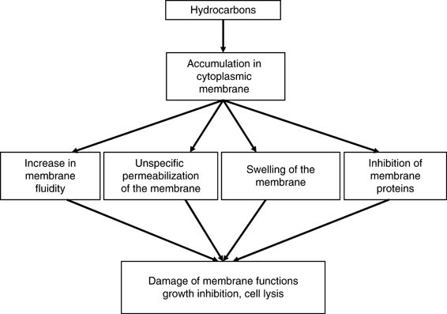

Slide 7
Factors affecting Toxicity of hydrocarbon compounds
1- abiotic condition
Temperature
pH
radiation
2- Biotic conditions
Type of microorganisms
Hydrophobicity
Extracellular enzyme
3- polymer properties
Molecular weight
Size and shape
Functional groups

