Slide 1
Maceration and Squashing Method
Lab 4

Slide 2
Cell division
The genetic information of plants, animals and other eukaryotic organisms resides in several or many chromosomes. For example, each human cell possesses 46 chromosomes, while each cell of an onion possesses 8 chromosomes. All cells must replicate their DNA when dividing, during DNA replication, the two strands of the DNA double helix separate, and for each original strand a new complementary strand is produced, yielding two identical DNA molecules.

Slide 3
Cell division
Mitosis is a process where a single cell divides into two identical daughter cells (cell division). Or we can define cell division as a process by which a parent cell divides into two daughter cells. Cell division is a small part of the cell cycle.
Cell cycle is mainly classified into two segments: M-phase and Interphase. Interphase is the longer period of cell division. During this phase the cell prepares for its next stage. Interphase is mainly divided into three phases: G1 phase, S phase and G2 phase. G1 and G2 are the two gap phases during which the cell grows, producing proteins and preparing the cells. S phase is the period of replication. These phases also have certain checkpoints and the whole cell cycle is strictly regulated.

Slide 4
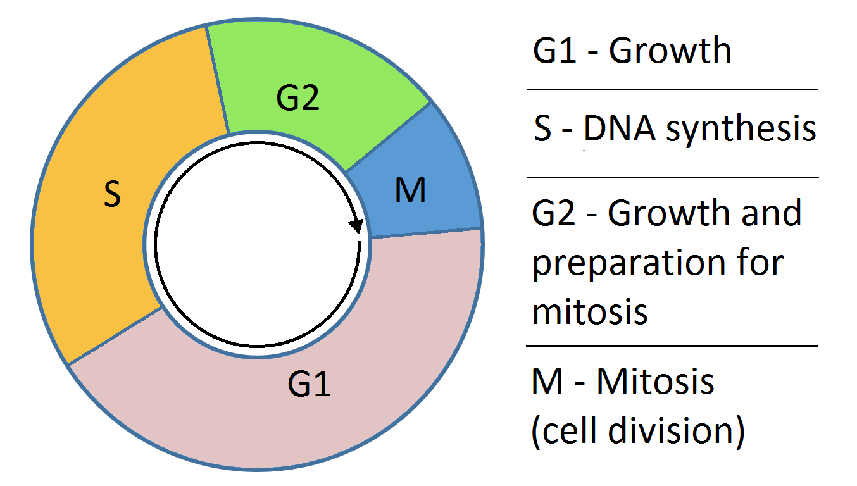
Cell division
During the process of mitosis, the chromosomes pass through several stages known as prophase, metaphase, anaphase and telophase. The actual division of the cytoplasm is called cytokinesis occur after karyokinesis (nuclear division of a cell during mitosis). Another type of cell division is present in reproductive cells of eukaryotes and is known as meiosis.

Slide 5
In plants, the roots continue to grow as they search for water and nutrients. These regions of growth are good for studying the cell cycle because at any given time, you can find cells that are undergoing division.
Prophase Metaphase Anaphase Telophase

Slide 6
Why use onion roots for viewing mitosis?
The roots are easy to grow in large numbers.
Onions have larger chromosomes than most plants.
The cells at the tip of the roots are actively dividing, and thus many cells will be in stages of mitosis.

Slide 7
Regions of Onion Root Tips
There are three cellular regions near the tip of an onion root:
The root cap: - contains cells that cover and protect the underlying growth region as the root pushed through the soil.
The region of cell division (or meristem): - cells are actively dividing but not increasing significantly in size.
Cell elongation regions: - cells are
increasing in size, but not dividing.

Slide 8
Procedure
Materials (Onion roots, blade or scissor, benzene burner, aceto-carmine or aceto-orcein stain, %10 HCl, watch glass or petridish, slide and cover slide)
Cut fresh onion roots and keep them in water.
Take some roots in a watch glass or petridish.
Add 10 % HCl in a test tube and gently warm by using benzene burner
Pour warm HCl in a watch glass that contain root tips wait for 10 min, then wash root with water 3-4 times.
Take roots on slide (only milky white portion of tip).
Put a drop of stain and wait until milky white tip turns red.
Place a cover slide, with the wooden end of a dissecting probe or pencil, apply pressure to the cover slide to squash them and spread the tissue on the slide.
Observe under microscope; use the 40X power objective to observe mitotic stages in individual cells.

