Slide 1
Acetaminophen Poisoning
Lab 7

Slide 2
Acetaminophen Poisoning
Acetaminophen or N-acetyl-p-aminophenol (paracetamol), also called Tylenol, mapap and panadol is analgesic, antipyretic and have weak anti-inflammatory effect. Exerts its effects through the inhibition of cyclo-oxygenase (COX).
COX catalyses the formation of prostaglandins (PGs) and other mediators that are important in the processing and signaling of pain and control of the thermoregulatory center of the brain.
Oral acetaminophen has excellent bioavailability. Peak plasma concentration occur within 30 to 60 minutes. The half-life in plasma is about 2 hours after therapeutic doses.

Slide 3
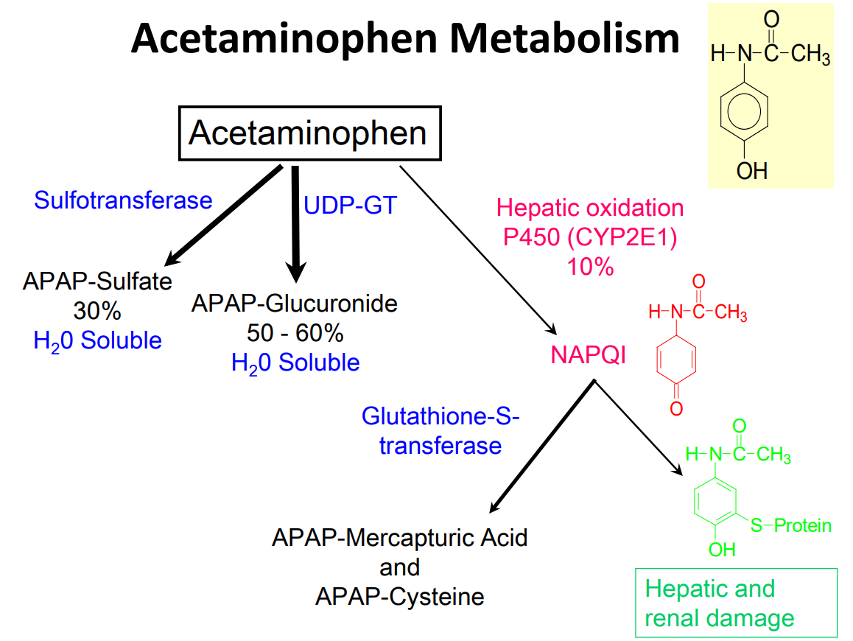

Slide 4
Therapeutic dose is 10-15 mg/kg.
Toxic dose: More than 7.5 gm (around 15 tablets) – minimal toxicity, severe liver toxicity if > 15gms (30 tablets). In adults toxic dose is 150mg/kg. In children under 12 years toxic dose is 200mg/kg. In the presence of chronic liver disease or malnutrition, even 2g can be a toxic dose.

Slide 5
Mechanism of Toxicity
When the dose of paracetamol is high. The glucuronide and sulfate conjugation pathways become saturated, and increasing amounts undergo CYP-mediated hydroxylation to form N-acetyl-para- benzoquinoneimine (NAPQI). Eliminated rapidly by conjugation with glutathione (GSH) and then further metabolized to a mercapturic acid and excreted into the urine. in acetaminophen overdose, hepatocellular levels of GSH become depleted.
The highly reactive NAPQI metabolite binds covalently to cell macromolecules, leading to dysfunction of enzymatic systems and structural and metabolic disarray. Depletion of intracellular GSH renders the hepatocytes highly susceptible to oxidative stress and apoptosis. Binding covalently to cellular proteins, causes cell death

Slide 6
Conditions of CYP induction (e.g. heavy alcohol consumption, those on anticonvulsant drugs). Condition of GSH depletion (e.g. fasting or malnutrition). With pre-existing liver disease. Those suffering from anorexia nervosa and other eating disorders & HIV infection

Slide 7
Stages of acute acetaminophen toxicity

Slide 8
Treatment
1) Activated charcoal may be used in patients presenting within 1 hour.
2) Antidotes for paracetamol poisoning a. N-acetylcysteine (NAC) b. Methioinine Act by replenishing hepatic glutathione and N-acetyl cysteine may also repair oxidation damage caused by NAPQI.

Slide 9
Procedure
1. Mix 1 mL of specimen (victim or control urine, water blank) and 1 mL of concentrated hydrochloric acid. Heat at 100C for 10 min.
2. Cool and add 100 µL of the above solution to 10 mL of o-cresol reagent and then 2 mL of ammonium hydroxide, 4 mol/L.
– Urine - use HCl .
-Plasma can be enzymatically converted. Addition of copper sulfate improves color.
Result: Acetaminophen is hydrolyzed to p-aminophenol, which reacts with o-cresol and ammonium hydroxide to form an indophenol blue chromogen.

