Slide 1
Microscope
2nd Lab
Practical Human biology
Renas Najat Saleem
M.Sc. degree in Hematology
2nd class-Medical Physics Science college

Slide 2
Microscope
Micro= small thing Scope= to be seen
*Microscope:- Is a coordinated system of lens arranged to produce an enlarged focusable image slide.
*Types of microscope:-
1. Dissecting microscope
2. Compound (light) microscope
3. Electron microscope

Slide 3
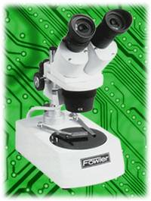
Dissecting Microscope

Slide 4
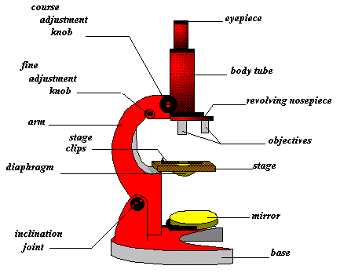
Microscope

Slide 5
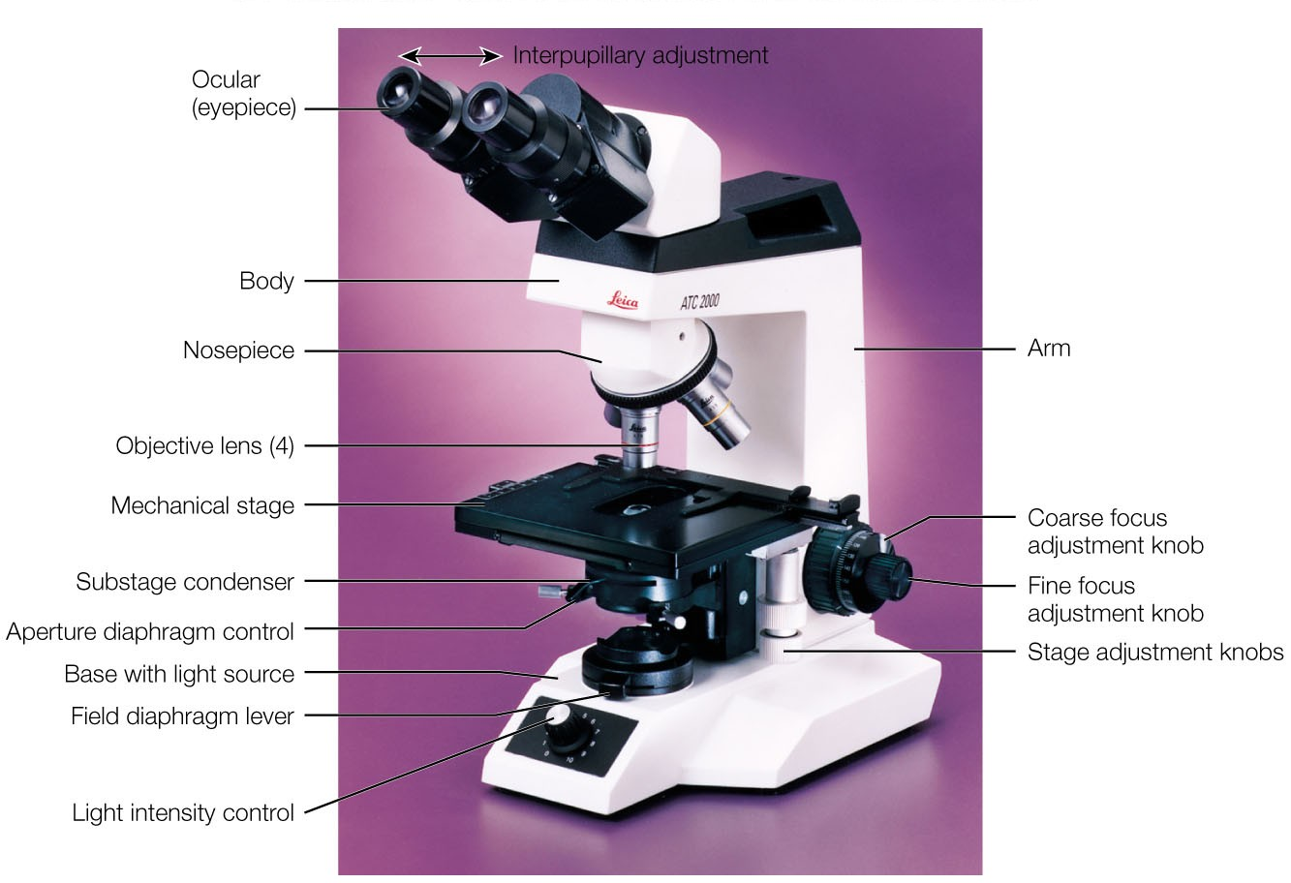
Light Microscope

Slide 6
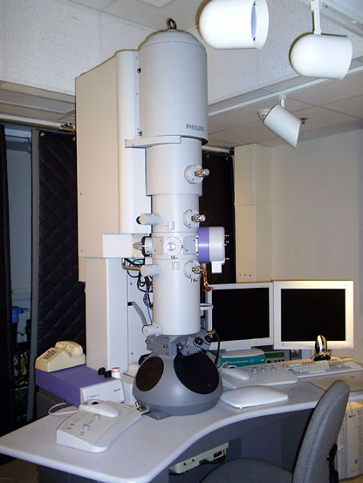
Microscope

Slide 7
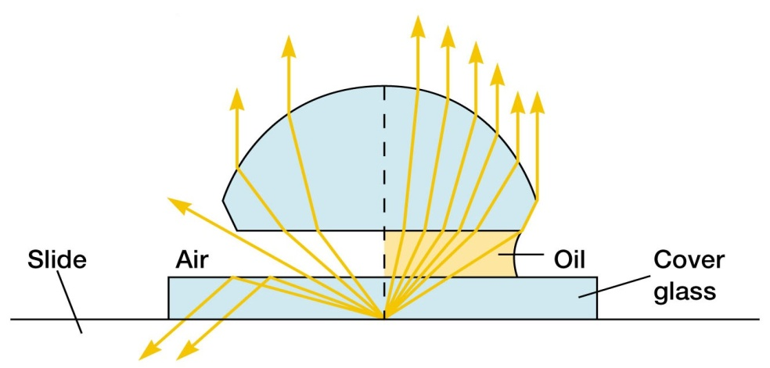

Slide 8
