Slide 1
University of Salahaddin
College of Science
3rd Lab
Diversity of the Cells
Practical human bio. 2nd class-medical physics
M. Renas N. Sleem

Slide 2
ORGANIZATION OF LIVING ORGANISM:
1. Atoms, molecules 2. Cells 3. Tissues
4. Organs 5. Systems 6. Organism
THE CELLS:
The cell can be defined as the Smallest and basic unit of life….

Slide 3
Basic components of cells:
  1. Barrier between cell and environment:
  cell membrane
  2. Machinery for existence:
  within the cytoplasm
  3. Machinery for reproducing:
  genetic material i.e. DNA

Slide 4
History of cell
In 1665 an English Scientist Robert Hooke
Made an improved microscope, and
First used the word (cell) to refer the basic units of life.
In 1820 Robert Brown found the Nucleus in the cell

Slide 5
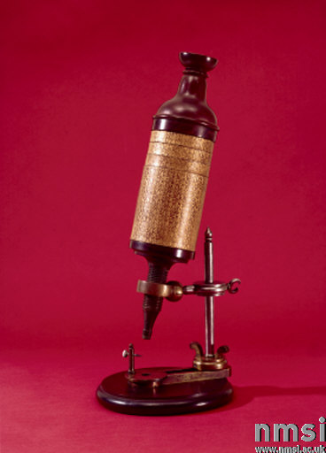
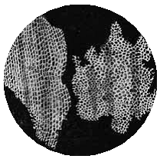
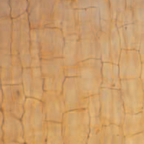
(a) (b) (c)
Robert Hooke used an early microscope (a) to see cells in thin slices of cork. His drawings of what he saw (b) indicate that he had clearly observed the remains of cork cells (300 X) (c).

Slide 6
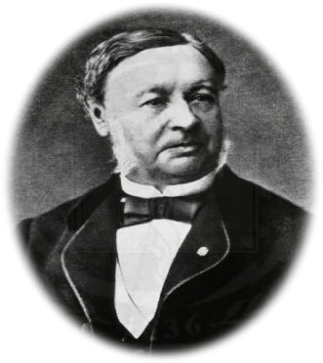
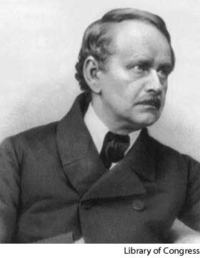
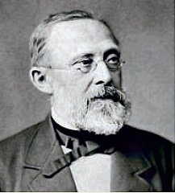
In 1838 two German biologists (Schwann and Schleiden) published what is called the (cell theory), this theory states that the
(cell is the basic units of the life and that all living organism are composed of one or more cells).
Virchow said all cells divide and come from the old cells.

Slide 7
Biologists recognize two organization plans for cells:
Prokaryotic cells (are lack nuclear envelope and membranous cytoplasmic organelles like Bacteria and blue green algae).
Eukaryotic cells (have nuclear envelope and membranous cytoplasmic organelles, like Protozoa, Fungi, Plants and Animals).

Slide 8
1- Plasma membrane: is a lipid bilayer separating the inside of cell from outside.
2- Cytoplasm: 80%water, 15%protiens, 5%lipids, sugar, and salts.
Organelles in cytoplasm:
➢RER:-Protein synthesis.
SER:- Synthesis and storage of lipid, Detoxification.
Ribosome:- Protein synthesis.
➢Golgi apparatus:- Synthesis of complex sugar, storage of proteins and moving it toward parts of cell which need proteins.
➢Mitochondria:- Center of energy (provide the cell with energy).
➢Lysosome: Contain hydrolytic enzymes for hydrolysis of particles.

Slide 9
Animal Cell

Slide 10
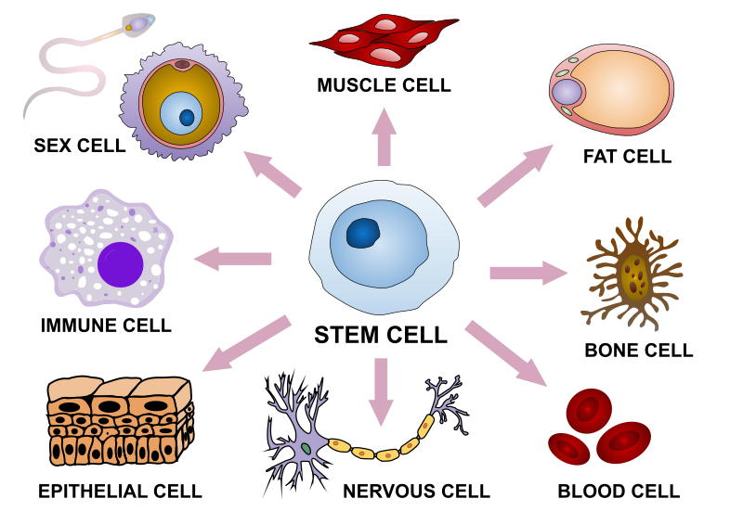
Human cells
There are about 200 different cell types which perform different functions.
They have also different shapes and sizes. They are located in different parts.
Notes:
The smallest cell in the human body is the sperm cell.These cells are small in volume. Head of the sperm cell measures about 4 micrometres in length, just a little bit smaller than a red blood cell (RBCs).
The largest cell in the human body is Egg cells (ovum). They are 20 times larger than the sperm cells and measure about 0.1 millimetres in diameter.

Slide 11


