Slide 1
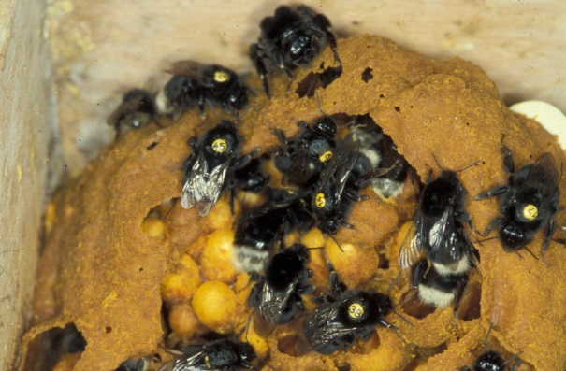
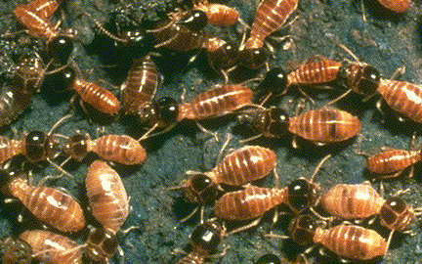
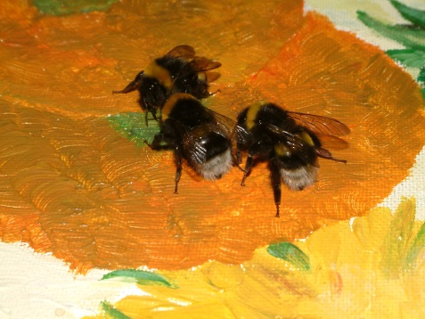
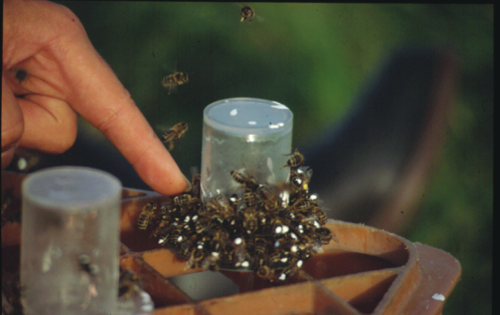
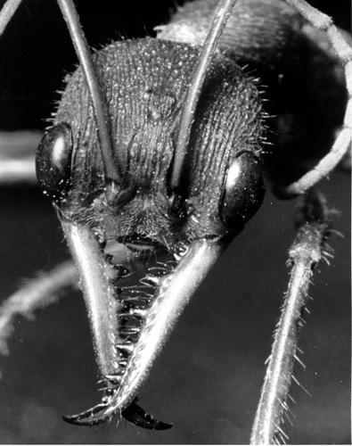
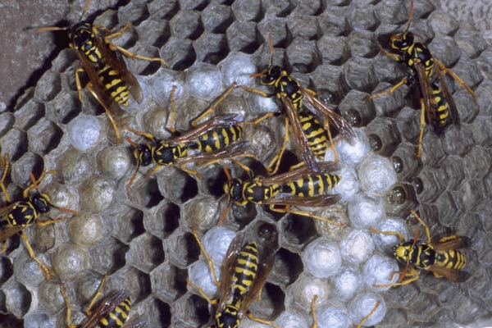
The social structure of insect societies

Slide 2
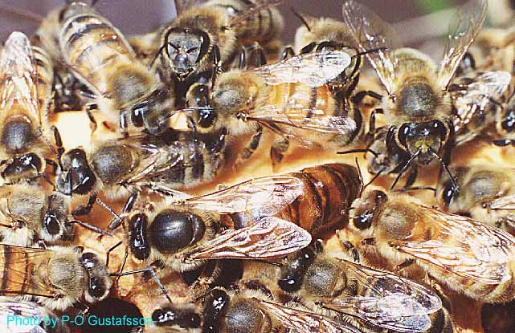
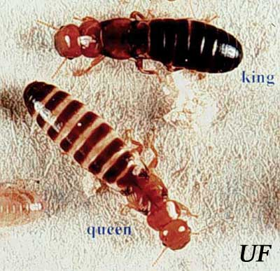
The social insects have royalty!
Social Hymenoptera (ants, wasps, bees) have a queen
Social Isoptera (termites) have a king & queen
The queens (and kings) are typically long lived (15 years in termites, 4 years in honeybees)
Their sole task is often reproduction (while other individuals are often sterile and don’t reproduce)
Western drywood termite, Incisitermes minor
Honeybee
Apis mellifera
queen

Slide 3
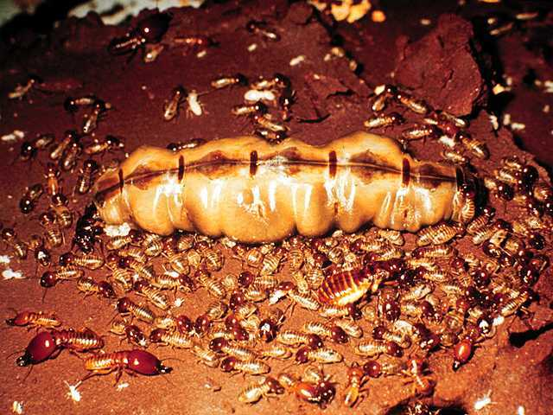
Queen, king, soldiers and workers in termites

Slide 4
Queens are not genetically different from workers!
The question of whether a female individual turns out as a queen or worker is dependent on the food that she receives as a larva.
In honeybees, larvae turn to queens when food nectar contains more than 35% hexose, and workers when there is less than 10% hexose
Workers feed “queens to be” with a mandibular gland secretion called “royal jelly” which ensures that bee queens live for 2-4 years (rather than 7-8 weeks as in workers)
In addition, the queen is much larger, has bigger ovaries, and spermatheca
Can lay 1500 eggs / day!

Slide 5
Characteristics of insect societies
They live in groups of closely related individuals
Individuals are usually faithful to their “family”
Often live in a confined locality (“nest, hive”)
In eusocial insects
Overlapping generations: parents live with offspring
Members collaborate in raising the offspring
Sterility of a large number of individuals of the colony (e.g. “workers”, “soldiers”): reproductive division of labour

Slide 6
Evolution of eusociality in different taxa
Insect order | common names | frequency of evolution of eusociality
Hymenoptera | Ants, wasps, bees, sawflies | 11
Isoptera | Termites | 1
Homoptera | Gall-forming aphids | 1
Coleoptera | Bark-nesting weavils | 1
Thysanoptera | Gall-forming thrips | 1
Non-insects | Snapping shrimps and naked mole rats | 2
Total |  | 17

Slide 7
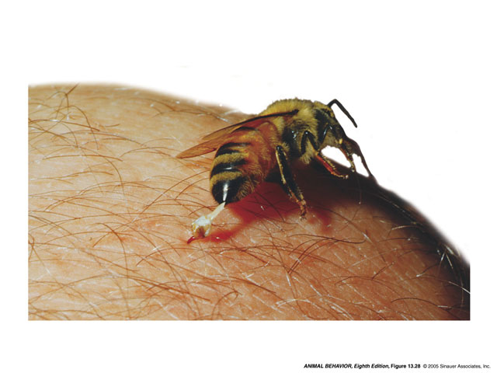
Altruistic suicide?
In many social insects, workers not only forego reproduction, but also their own life, “for the good of the colony”

Slide 8
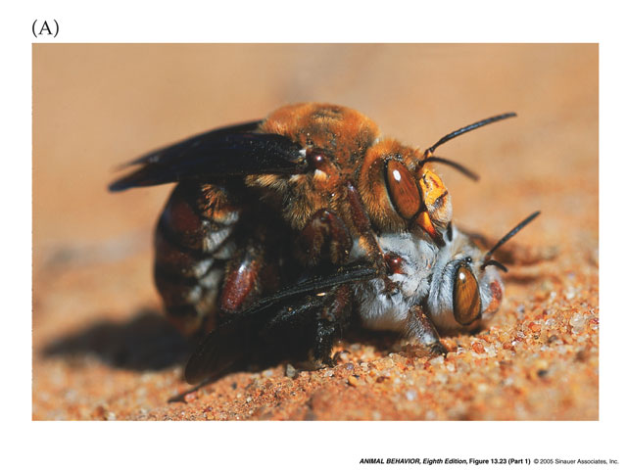
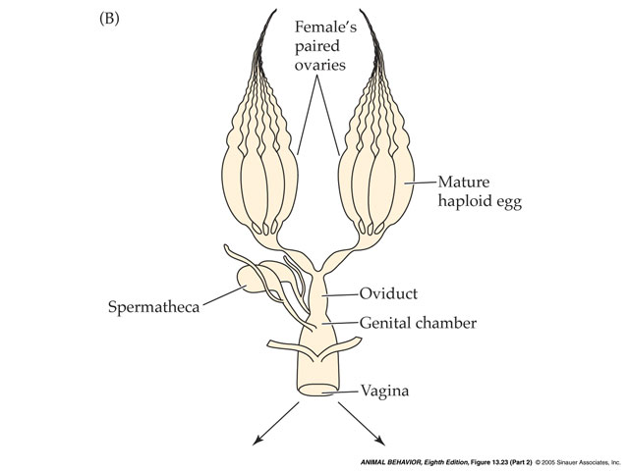
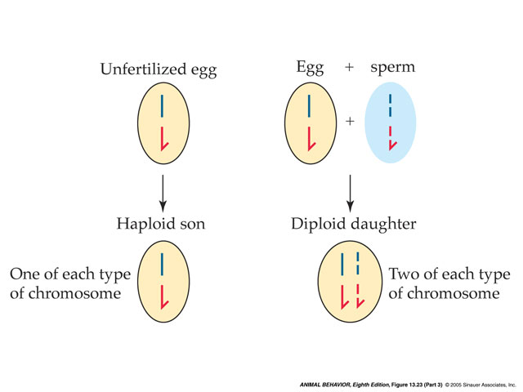
Haplodiploid sex determination in all Hymenoptera
Haploid male bee copulates with diploid female -> haploid sperm is stored in female bee’s spermatheca
When female “wants” to produce son, she lays an unfertilised (haploid) egg -> male offspring
To produce female offspring, mother needs to add sperm to egg as it passes down oviduct
Only 2 chromosomes shown here

Slide 9
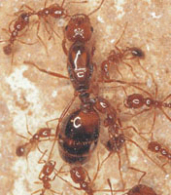
Fire ant: efficient use of sperm by the queen
Like in honeybees, the queen of fire ants can also actively determine the sex of her offspring
On average, only 3 sperm are used to produce one fertilised egg (female offspring)

Slide 10
Thus haplo-diploidy implies that
it might be more beneficial for a worker to help raise more sisters (workers and new queens) than to reproduce on her own
this is because the average relationship between sisters is higher (0.75) than between workers and their (possible) offspring (0.5)
this might explain why the haplodiploid Hymenoptera have evolved eusocial systems more than any other insect order

Slide 11
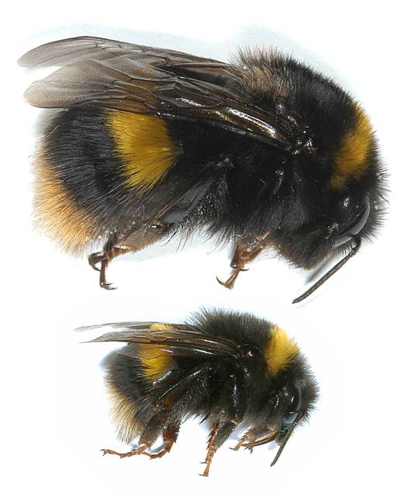
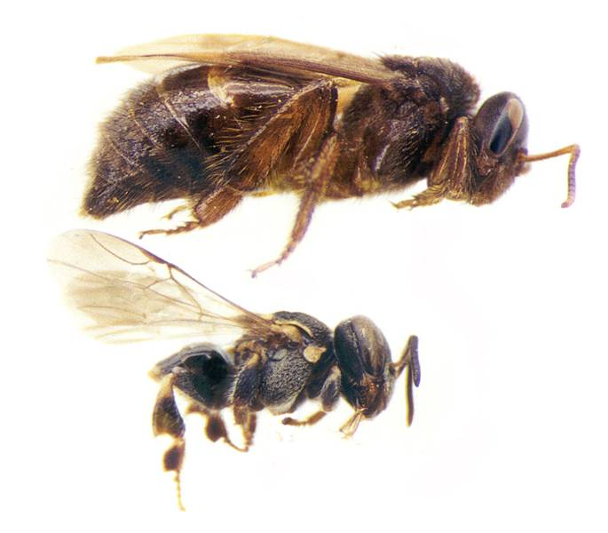
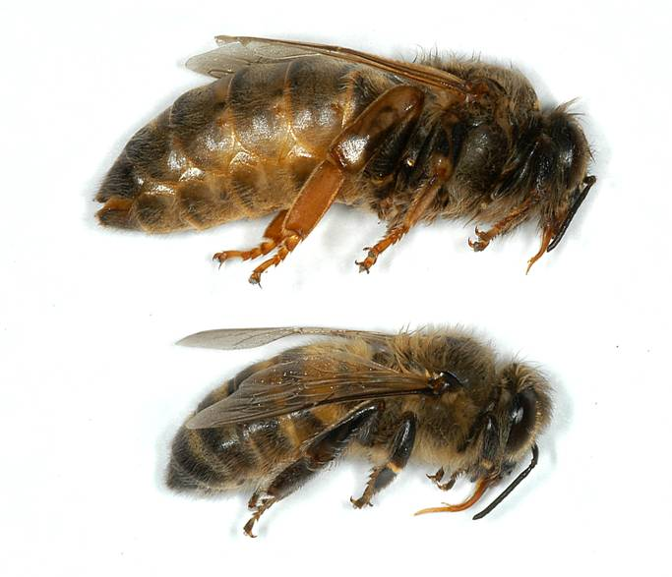
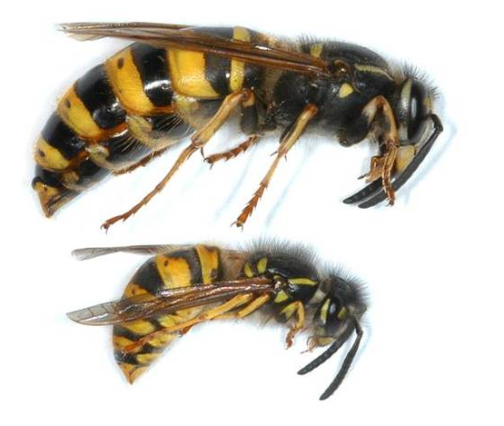
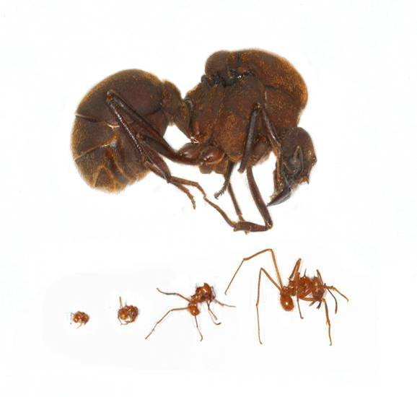
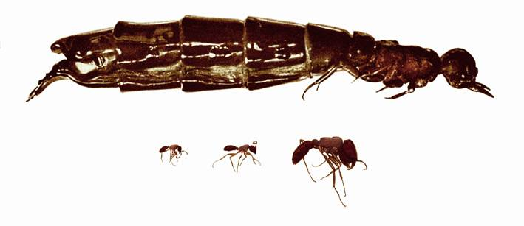
Queen/worker dimorphism allows coercion (Tom Wenseleers)
Bombus terrestris
Apis mellifera
Nannotrigona melanocera
Vespula vulgaris
Atta cephalotes
Dorylus wilverthi

Slide 12
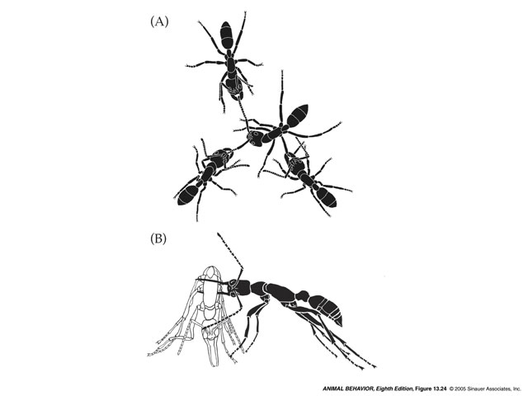
Worker policing (F. Ratnieks)
In cases where queens mate with multiple fathers, workers often patrol the colony to ensure that other workers don’t lay eggs
They eat other worker’s eggs and attack or immobilise reproductively active females
In two ant species, individuals about to reproduce are detected by nestmates and immobilised. In A the queen has smeared the culprit with a chemical, and workers physically prevent it from doing anything at all. In B the “black” worker hold the “white worker” captive for days, then turns it over to another worker for imprisonment

Slide 13
Life cycle of a bumblebee colony
new queens mate in summer
all other individuals of colony (old queen, workers, males) die before autumn
new queen overwinters and founds new nest in spring
early in colony development: sterile workers produced
later in colony development: new queens and males produced
when colony becomes large and queen old, queen “loses control”: workers start “rebellion”: attacking queen, and laying their own eggs
old queen dies, workers take over reproduction (but produce only (haploid) males)

