Slide 1
Sulfur compounds in water LAB -5-
Ministry of Higher Education and Scientific Research
Salahaddin University-Erbil
College of Science
Biology Department
By:
Ms.c. Rezan Sabah Ahmed
Email: rezan.s.ahmed@su.edu.krd

Slide 2
Sulfate (SO₄˭):
Is the most abundant ion (form) of sulfur (S) on the earth’s crust and its concentration may range from few milligrams to several thousand milligrams per liter. It is derived from most sedimentary rocks in many natural waters, but it discharged to water through industrial wastes or through atmospheric deposition.

Slide 3
Application:
Sulfates and sulfuric acid products are used in the production of fertilizers, chemicals, dyes, glass, paper, soaps, textiles, fungicides, insecticides, astringents and emetics. They are also used in the mining, wood pulp, metal and plating industries, in sewage treatment and in leather processing.

Slide 4
Environmental fate:
Sulfates are discharged into water from mines and smelters and from kraft pulp and paper mills, textile mills and tanneries. Sodium, potassium and magnesium sulfates are all highly soluble in water, whereas calcium and barium sulfates and many heavy metal sulfates are less soluble. Atmospheric sulfur dioxide, formed by the combustion of fossil fuels and in metallurgical roasting processes, may contribute to the sulfate content of surface waters. Sulfur trioxide, produced by the photolytic or catalytic oxidation of sulfur dioxide, combines with water vapour to form dilute sulfuric acid, which falls as “acid rain”

Slide 5
Effects of SO₄˭ in water:-
1. Cause hardness when it founds in the form of CaSO₄ or MgSO₄
2. Cause salinity when its concentration more than 200 ppm (mg.L⁻¹).
3. Cause laxative effect at concentration greater than 250 mg.L⁻¹
4. It is important parameter for determination of water quality for irrigation and building purposes
5. About 80% of SO₄˭ compounds may be reduced by anaerobic bacteria at pH=7, liberating H₂S gas which cause undesirable odor in the water body as well as corrosion of pipelines or sewer systems.

Slide 6
Concentration of sulfate in water
Sulfate concentration in seawater is about 2,700 milligrams per liter (mg/L). It ranges from 3 to 30 mg/L in most freshwater supplies, although much higher concentrations ($ 1000 mg/L) are found in some geographic locations.
The permissible limit for sulfate in drinking water is 250mg/L.

Slide 7
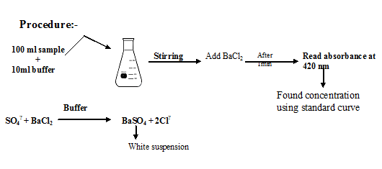
Procedure:-

Slide 8
